Slide 1

Achan
Atonement

Slide 2
Defeat at AI
Now Joshua sent men from Jericho to Ai, which is beside Beth Aven, on the east side of Bethel, and spoke to them, saying, "Go up and spy out the country." So the men went up and spied out Ai. And they returned to Joshua and said to him, "Do not let all the people go up, but let about two or three thousand men go up and attack Ai. Do not weary all the people there, for the people of Ai are few." So about three thousand men went up there from the people, but they fled before the men of Ai. And the men of Ai struck down about thirty-six men, for they chased them from before the gate as far as Shebarim, and struck them down on the descent; therefore the hearts of the people melted and became like water. Then Joshua tore his clothes, and fell to the earth on his face before the ark of the LORD until evening, he and the elders of Israel; and they put dust on their heads. Joshua 7:2-6

Slide 3
Israel’s Self Confidence
The great victory that God had gained for them had made the Israelites self-confident. Because He had promised them the land of Canaan they felt secure, and failed to realize that divine help alone could give them success. Even Joshua laid his plans for the conquest of Ai without seeking counsel from God. The Israelites had begun to exalt their own strength and to look with contempt upon their foes. An easy victory was expected, and three thousand men were thought sufficient to take the place. { PP 493.4}

Slide 4
Joshua’s Lament
Joshua 7:7 And Joshua said, Alas, O Lord GOD, wherefore hast thou at all brought this people over Jordan, to deliver us into the hand of the Amorites, to destroy us? would to God we had been content, and dwelt on the other side Jordan! - (Struggling faith about the promise of the land)
SDA Bible Commentary: Would to God. This expression indicates a profound feeling of despair and utter inability to understand the situation. Joshua’s prayer (almost) takes on the spirit of murmuring and complaining, so characteristic of the children of Israel on numerous occasions. But even the best of men at times give way to discouragement and fear.

Slide 5
Sound Familiar?
Exo 16:3 And the children of Israel said unto them, Would to God we had died by the hand of the LORD in the land of Egypt, when we sat by the flesh pots, and when we did eat bread to the full; for ye have brought us forth into this wilderness, to kill this whole assembly with hunger.
Num 14:2 And all the children of Israel murmured against Moses and against Aaron: and the whole congregation said unto them, Would God that we had died in the land of Egypt! or would God we had died in this wilderness!
And he said unto him, I am the LORD that brought thee out of Ur of the Chaldees, to give thee this land to inherit it. And he said, Lord GOD, whereby shall I know that I shall inherit it? Genesis 15:7-8

Slide 6
Lack of Faith requires sacrifice.
Then He said to him, "I am the LORD, who brought you out of Ur of the Chaldeans, to give you this land to inherit it. And he said, "Lord GOD, how shall I know that I will inherit it?" Genesis 15:7-8
And he said unto him, Take me an heifer of three years old, and a she goat of three years old, and a ram of three years old, and a turtledove, and a young pigeon. And he took unto him all these, and divided them in the midst, and laid each piece one against another: but the birds divided he not. Genesis 15:9-10

Slide 7
What Caused this?
But the children of Israel committed a trespass in the accursed thing: for Achan, the son of Carmi, the son of Zabdi, the son of Zerah, of the tribe of Judah, took of the accursed thing: and the anger of the LORD (withdrawal of protection) was kindled against the children of Israel. Joshua 7:1
The great victory that God had gained for them had made the Israelites self-confident. Because He had promised them the land of Canaan they felt secure, and failed to realize that divine help alone could give them success. Even Joshua laid his plans for the conquest of Ai without seeking counsel from God.
{PP 493.4}

Slide 8
All Israel guilty of Sin
Joshua 7:11 Israel hath sinned, and they have also transgressed my covenant which I commanded them: for they have even taken of the accursed thing, and have also stolen, and dissembled also, and they have put it even among their own stuff.
Of the millions of Israel there was but one man who, in that solemn hour of triumph and of judgment, had dared to transgress the command of God. PP 496.1

Slide 9
The Breach Principle
Achan’s sin brought disaster upon the whole nation. For one man’s sin the displeasure of God will rest upon His church till the transgression is searched out and put away. The influence most to be feared by the church is not that of open opposers, infidels, and blasphemers, but of inconsistent professors of Christ. These are the ones that keep back the blessing of the God of Israel and bring weakness upon His people. { PP 497.2}
When the church is in difficulty, when coldness and spiritual declension exist, giving occasion for the enemies of God to triumph, then, instead of folding their hands and lamenting their unhappy state, let its members inquire if there is not an Achan in the camp. With humiliation and searching of heart, let each seek to discover the hidden sins that shut out God’s presence. { PP 497.3}

Slide 10
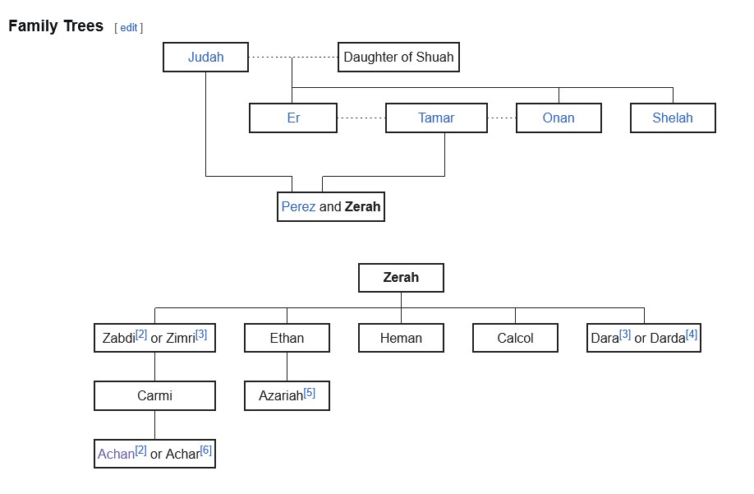
Achan’s Family Line

Slide 11
Iniquity Visited after the fourth generation
Achan was the Great great great grand son of Judah and Tamar. He was a descendent of the twin that put out his arm when he was born, then pulled it back in and came out second. He had come from a line born out of adultery and prostitution and incest between Judah and Tamar. Five generations after the sin of Judah and Tamar the seed bore fruit. The fourth generation had completed and seed manifested.
Gen 38:24 And it came to pass about three months after, that it was told Judah, saying, Tamar thy daughter in law hath played the harlot; and also, behold, she is with child by whoredom. And Judah said, Bring her forth, and let her be burnt. [H8313]
Lev 20:14 And if a man take a wife and her mother, it is wickedness: they shall be burnt [H8313] with fire, both he and they; that there be no wickedness among you.

Slide 12
Accursed Thing and or Man?
Joshua 7:11 Israel hath sinned, and they have also transgressed my covenant which I commanded them: for they have even taken of the accursed thing, and have also stolen, and dissembled also, and they have put it even among their own stuff.
Joshua 7:12 Therefore the children of Israel could not stand before their enemies, but turned their backs before their enemies, because they were accursed: neither will I be with you any more, except ye destroy the accursed from among you.
Joshua 7:12 (YLT) and the sons of Israel have not been able to stand before their enemies; the neck they turn before their enemies, for they have become a devoted (accursed) thing; I add not to be with you--if ye destroy not the devoted thing out of your midst.
Joshua 7:13 Up, sanctify the people, and say, Sanctify yourselves against to morrow: for thus saith the LORD God of Israel, There is an accursed thing in the midst of thee, O Israel: thou canst not stand before thine enemies, until ye take away the accursed thing from among you.

Slide 13
Connection from thing to Man
Deuteronomy 7:26 Neither shalt thou bring an abomination into thine house, lest thou be a cursed thing like it: but thou shalt utterly detest it, and thou shalt utterly abhor it; for it is a cursed thing.
2 Peter 3:9 The Lord is not slack concerning his promise, as some men count slackness; but is longsuffering to us-ward, not willing that any should perish, but that all should come to repentance.
Ezekiel 18:31 Cast away from you all your transgressions, whereby ye have transgressed; and make you a new heart and a new spirit: for why will ye die, O house of Israel?

Slide 14
The Judgments of God
I was shown that the judgments of God would not come directly out from the Lord upon them, but in this way: They place themselves beyond His protection. He warns, corrects, reproves, and points out the only path of safety; then if those who have been the objects of His special care will follow their own course independent of the Spirit of God, after repeated warnings, if they choose their own way, then He does not commission His angels to prevent Satan’s decided attacks upon them. 14MR 3
A possible scenario
God speaks of removing and burning the accursed object.
Israel wants atonement through punishment so include the man with the thing.
Israel’s stumbling faith requires punishment of sacrifice.
God reveals to Israel what they think to do to the offender
Joshua 7:15 and it hath been, he who is captured [Niphil “was captured”] with the devoted thing is burnt [Niphal] with fire, he and all that he hath, because he hath transgressed the covenant of Jehovah, and because he hath done folly in Israel.’ – Command or Prediction

Slide 15
Casting Lots
Joshua 7:14 In the morning therefore ye shall be brought according to your tribes: and it shall be, that the tribe which the LORD taketh shall come according to the families thereof; and the family which the LORD shall take shall come by households; and the household which the LORD shall take shall come man by man.
The lot was to be employed for the detection of the guilty. PP 494.3
Jonah 1:7 And they [Pagans] said every one to his fellow, Come, and let us cast lots, that we may know for whose cause this evil is upon us. So they cast lots, and the lot fell upon Jonah.
Jonah 1:11-12 Then said they unto him, What shall we do unto thee, that the sea may be calm unto us? for the sea wrought, and was tempestuous. And he said unto them, Take me up, and cast me forth into the sea; [sacrifice to the god of the sea] so shall the sea be calm unto you: for I know that for my sake this great tempest is upon you.

Slide 16
How is Hail caused?
The Lift (Updraft): Strong winds known as updrafts blow upward from the ground into the storm. These winds carry liquid raindrops high into the atmosphere where the temperature is well below freezing.
Freezing: As the raindrops reach these freezing heights, they turn into small ice pellets called "hail embryos."
Growth (Accretion): The ice pellet doesn't fall immediately. The updraft keeps it suspended. As it moves through the cloud, it collides with supercooled water droplets (water that is colder than 0∘C but still liquid). These droplets freeze instantly onto the ice pellet, adding a new layer of ice.
The "Juggling" Effect: Depending on the strength of the wind, the hailstone may rise and fall multiple times within the cloud, adding a new layer of ice with every "lap." If you cut a hailstone in half, you can often see rings like those in a tree trunk, representing these different cycles.
The Fall: Eventually, the hailstone becomes too heavy for the updraft to support, or the updraft weakens. Gravity takes over, and the ice falls to the ground.

Slide 17
Burnt With Fire
Jos 7:15 And it shall be, that he that is taken with the accursed thing shall be burnt [H8313] with fire, he and all that he hath: because he hath transgressed the covenant of the LORD, and because he hath wrought folly in Israel.
This was the law in regard to spoils taken
Deut 13:15, 16 Thou shalt surely smite the inhabitants of that city with the edge of the sword, destroying it utterly, and all that is therein, and the cattle thereof, with the edge of the sword. And thou shalt gather all the spoil of it into the midst of the street thereof, and shalt burn with fire the city, and all the spoil thereof every whit, for the LORD thy God: and it shall be an heap for ever; it shall not be built again.
There are 6 references in the Torah speaking of “burnt with fire” 4 of them relate to the offering of the sacrifices in the temple service. The other two are 1) Lev 20:14 which relates to incest, a man taking a wife and mother. 2) Lev 21:9 the daughter of a priest playing the whore. – Judah said that Tamar was to be burnt with fire. Achan does not meet these qualifications – but the objects do.

Slide 18
Achan Son of Joshua
Joshua 7:19 And Joshua said unto Achan, My son, give, I pray thee, glory to the LORD God of Israel, and make confession unto him; and tell me now what thou hast done; hide it not from me.
Another story of people taking spoils of war. Then God doesn’t answer Saul.
1 Samuel 14:43-44 Then Saul said to Jonathan, Tell me what thou hast done. And Jonathan told him, and said, I did but taste a little honey with the end of the rod that was in mine hand, and, lo, I must die. And Saul answered, God do so and more also: for thou shalt surely die, Jonathan.
A confession without any hope of forgiveness. A confession only for the purpose of condemnation and death. Does this represent the character of God? John 5:22; 8:15

Slide 19
The sacrifice – Innocent and Guilty
Joshua offered up his “son” Achan as a sacrifice to atone for the breach made in Israel and the disaster at Ai. But the sacrifice required not only the death of the immediate guilty but also the innocent.
Joshua 7:24-25 And Joshua, and all Israel with him, took Achan the son of Zerah, and the silver, and the garment, and the wedge of gold, and his sons, and his daughters, and his oxen, and his asses, and his sheep, and his tent, and all that he had: and they brought them unto the valley of Achor. And Joshua said, Why hast thou troubled us? the LORD shall trouble thee this day. And all Israel stoned him with stones, and burned them with fire, after they had stoned them with stones.

Slide 20
Atonement Chp 11 – Man’s Atonement
As we discovered in chapter four, the desire to kill is a manifestation of the human enmity against the Son of God and the woman who led Adam to eat the fruit. The desire to slay the guilty is an expression of satanic retaliation. The desire to slay the innocent is a revelation of Satan’s desire, from the beginning, to slay the Son of God. These two principles, slaying the guilty and the innocent play out in the stories of the Bible and are manifestations of the original seed of Genesis 3:12 – “the woman whom you gave to me.” At-One-Ment Page 62

Slide 21
Were Achan’s family also guilty?
Nothing is mentioned of his family's confession. They appear silently going to their deaths. Were the children minors or adults? We don’t know. Should the sons and daughters of Achan be killed for their father’s sin?
Deu 24:16 The fathers shall not be put to death for the children, neither shall the children be put to death for the fathers: every man shall be put to death for his own sin.
Even if we conclude them guilty of their father’s sin, was there no place for repentance? Was there no appeal to them to confess and forsake this sin? Was the gift of salvation not to be offered them? – (In human terms no, because 36 men had been killed and Israel were humiliated)
And what of all the animals. We can’t conclude that they had any knowledge of Achan’s sin or part in it in any way. They were completely innocent and this certainly brings in the atonement principle. The death of the guilty and the death of the innocent.
A symbol of Christ’s death is raised in the death of these animals and possibly the children

Slide 22
Things to Ponder
When they were all having their skulls cracked by the stones, did not Christ feel all of it? Is this not the Cross that Christ suffers.
Israel needed forgiveness for their overconfidence leading to the death of 36 men. They needed to know God was with them and forgave the whole nation. Achan and his family became the means of atonement for the nation. There could be no forgiveness only condemnation and death, just like Christ on the Cross.
Achan brought this on himself. His actions caused his own destruction and he is responsible for his own demise. But it is a hard case to say his children required the same treatment especially when the Torah forbids it.
Once again, the principle of every sin must be punished required sacrifice and offering. God didn’t want it but Israel needed it to be restored to favour with God in their own minds. This was the price of Atonement. Christ suffered the cross in the loss of those who died in order to give hope and confidence back to Israel.

