Slide 1
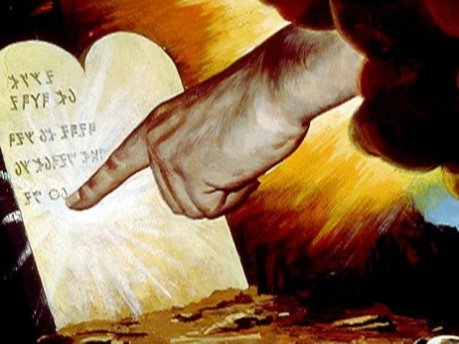
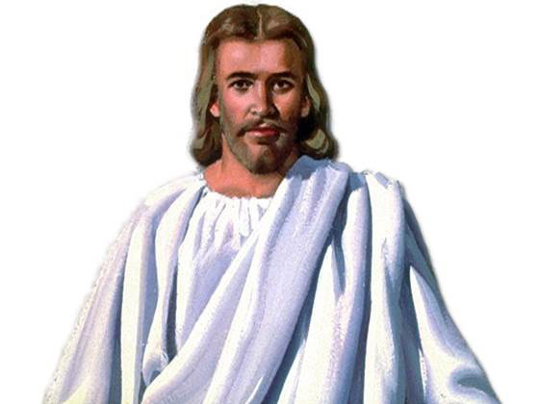
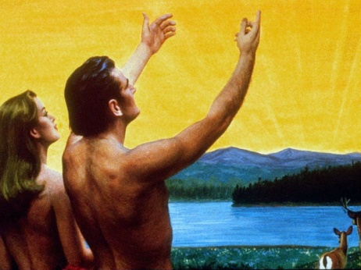
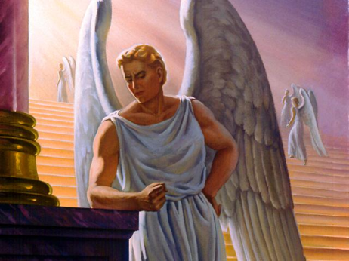
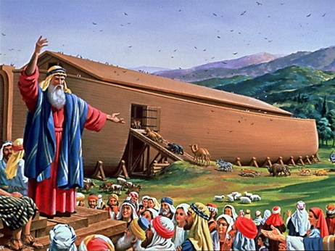
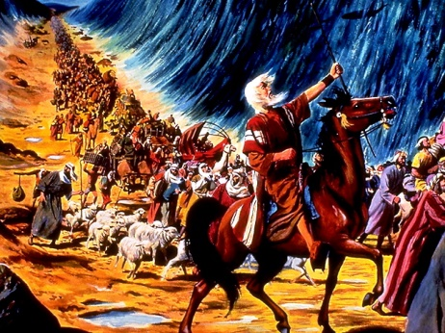
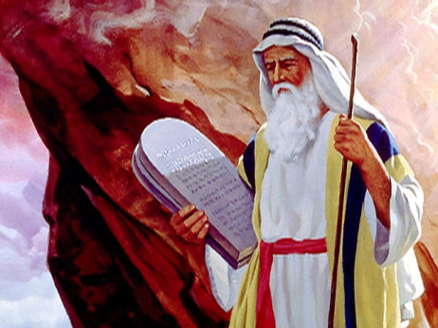
Jesus Believed All of the Old Testament
But he said to him, ‘If they do not hear Moses and the prophets, neither will they be persuaded though one rise from the dead’. Luke 16:31
Then He said to them, “These are the words which I spoke to you while I was still with you, that all things must be fulfilled which were written in the Law of Moses and the Prophets and the Psalms concerning Me.” And He opened their understanding, that they might comprehend the Scriptures. Luke 24:44,45.
Jesus Believed In...
Ten Commandments Matt 5:17,18; Luke 10:26-28
Creation Mark 10:6
Marriage Mark 10:6-9
Angels Matt 13:39; 18:10; 22:30
Satan Luke 10:18; 11:18; Matt 4:10
The Flood Matt 24:38,39
Destruction of Sodom Matt 10:15; 11:23,24; Luke 17:29
The Exodus Story Luke 20:37; John 3:14; John 7:22
Jonah & The Fish Matt 12:39,40
Old Testament Characters Jesus Mentions By Name...
Abel Matt 23:35
Noah Matt 24:38,39
Abraham, Isaac & Jacob Matt 22:32
Moses Mark 7:10; 12:26; John 3:14
David Matt 12:3; 22:43,45; Mark 2:25
Solomon Matt 6:29; 12:42
Elijah Matt 11:14; Luke 4:26
Elisha Luke 4:27
Isaiah Matt 13:13; 15:7
Jonah Matt 12:39,40; 16:14; Luke 11:30
Daniel Matt 24:15
© Adrian Ebens 1998
7

