Slide 1
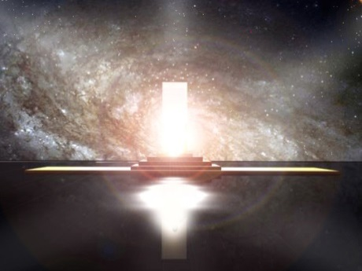
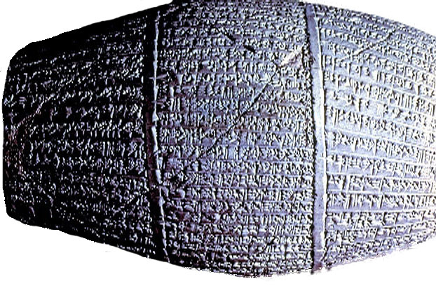
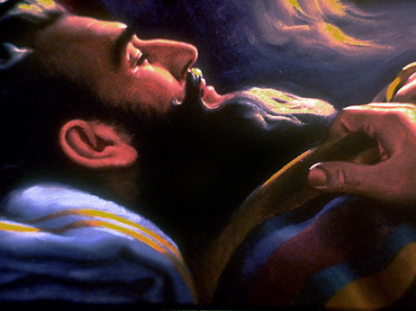
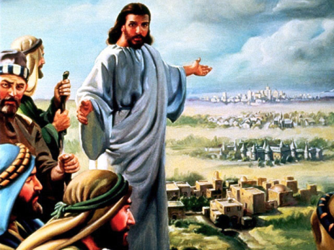
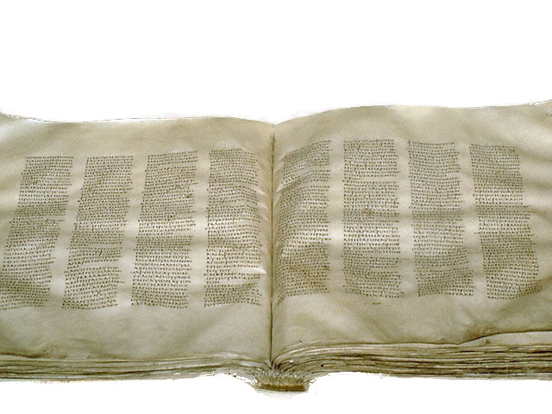
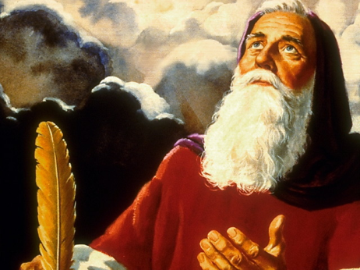
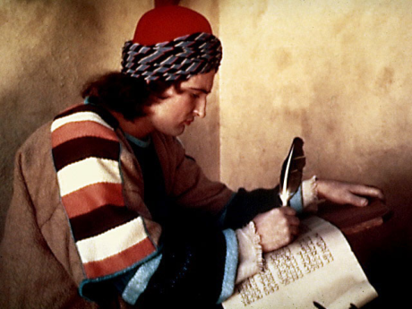
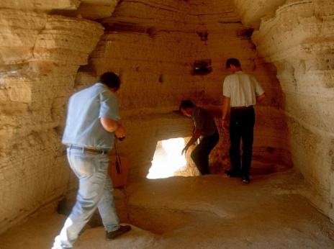
The Word of God
1. Inspired By God – 2 Tim 3:16
2. God spoke to Prophets by:
a) Dreams and Visions – Num 12:6; 2 Cor 12:1-4; Dan 7:1; Rev 1:10 b) Audible Voice – Num 12:7; 1 Sam 3:8 c) Personal Experience – 2 Pet 1:16; 1 John 1:1-2
d) Angels – Dan 9:24-27; Luke 1:19
God Spoke to Prophets in dreams
3. Given to holy men [Prophets] as moved by Holy Spirit. 2 Peter 1:21 eg – 2 Sam 23:2; Eze 2:2; 11:5; Micah 3:8
4. Written down by Prophets - Ex 34:27; Isa 8:1; Jer 30:2; 36:28; Eze 43:11; Hab 2:2; Luke 1:3; Rev 1:11,19
Prophets wrote down what they saw and heard
5. Scribes faithfully reproduced the Scriptures down through time through an exacting process
6. Preserved by God through History - Ps 12:6,7; Prov 30:5; Matt 24:35
Qumran Caves where Dead Sea Scrolls Found
© Adrian Ebens 2002
9

