Slide 1
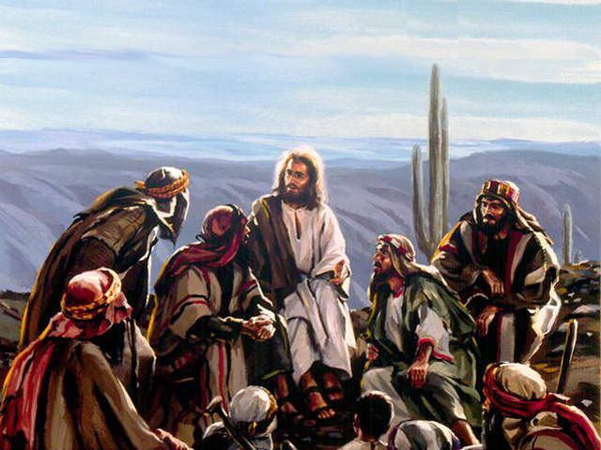
Signs of Christ’s Second Coming
Matt 24:7
15
Matt 24:6,7
James 5:1-4
Matt 24:5
Matt 24:37-40

