Slide 1

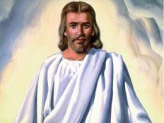
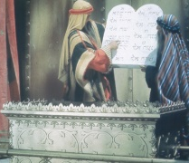
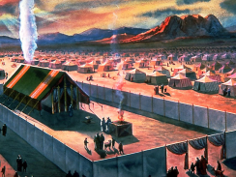
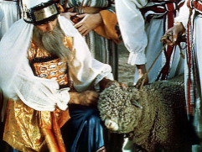
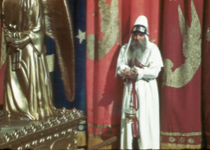
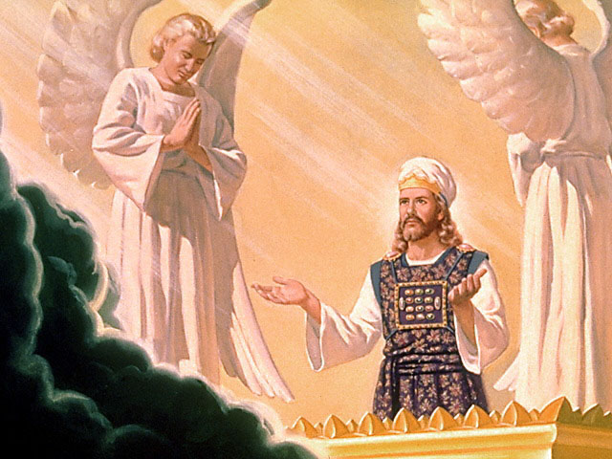
The Divine Pattern of the Priesthood
LAW
SANCTUARY
LAMB
PRIEST
The priesthood of Christ commenced as soon as man had sinned. He was made a priest after the order of Melchizedek. Ms43b-1891 (July 4, 1891)
Invisible Source:
Lamb Slain. Rev 13:8
Invisible Cross Isa 63:9
Heavenly Reality – Ministry of Jesus after the order of Melchizedec Heb 8:1,2
Heaven
Visible Cross : Lamb Manifested.
Rom 16:25; John 1:29
Mt Sinai
Grace & Mercy
Grace & Mercy
Faith in Promises
Faith in Promises
57
Earth
Visible Channel: The Royal priesthood,
The church of God. 1 Pet 2:9, Heb 12:23
Visible Channel: Earthly – Symbolic Ministry. Heb 8:4,5
Plan of Salvation
as Revealed in Scripture. 2 Tim 3:16
LAW
SANCTUARY
LAMB
PRIEST
1. Sacrifices Cease Daniel 9:27
2. Priesthood Changed. Heb 7:12
3. Circumcision Spiritual. Rom 2:29
As soon as Adam sinned, the Son of God presented Himself as surety for the human race, with just as much power to avert the doom pronounced upon the guilty as when He died upon the cross of Calvary. FLB 75.

