Slide 1
Divine Pattern of life

Slide 2
Divine Pattern = Key to Everything
But to us there is but one God, the Father, of whom are all things, and we in him; and one Lord Jesus Christ, by whom are all things, and we by him. 1 Corinthians 8:6

Slide 3
Divine Pattern = Key to Everything
Being | Pattern | Definition (From Strong’s Concordance)
Father | ἐκ Of Whom | ek, ex - A primary preposition denoting origin, source (the point whence motion or action proceeds)
Jesus Christ | dia By Whom | dia dee-ah' - A primary preposition denoting the channel of an act; through.

Slide 4
Divine Pattern Elements
Passage |  | Origin (Father) - ἐκ → | Channel (Son) - dia
He [Christ] is the image of the invisible God, the firstborn over all creation. Colossians 1:15 | 1 | Invisible | Visible
[Christ] who being the brightness of His [Father’s] glory and the express image of His person… has by inheritance obtained a more excellent name… Hebrews 1:3, 4 Therefore God exalted him to the highest place and gave him the name that is above every name…to the glory of God the Father. Philippians 2:9-11 | 2 | Glory | Brightness (Magnifier)
The Son can do nothing by himself; he can do only what he sees his Father doing, John 5:19. But I want you to realize that… the head of Christ is God. 1 Corinthians 11:3 | 3 | Headship | Submission

Slide 5
Divine Pattern Elements
Passage |  | Origin (Father) - ἐκ → | Channel (Son) - dia
But to which of the angels has He ever said: “Sit at My right hand, Till I make Your enemies Your footstool”? Hebrews 1:13 Whoever dwells in the shelter of the Most High will rest in the shadow of the Almighty. Psalms 91:1 | 4 | Protector | Protected
And a voice from heaven said, "This is my Son, whom I love; with him I am well pleased." Matthew 3:17 Jesus answered, "It is written: 'Man shall not live on bread alone, but on every word that comes from the mouth of God.'" Matthew 4:4 | 5 | Blessing Giver/ Provider | Blessing Receiver

Slide 6
Made in Their Image
Then God said, “Let Us make man in Our image, according to Our likeness;”… So God created man in His own image; in the image of God He created him; male and female He created them. Genesis 1:26, 27

Slide 7
Who Made Us?
And to make all see what is the fellowship of the mystery, which from the beginning of the ages has been hidden in God who created all things through Jesus Christ; Ephesians 3:9
And now God says to his Son, “Let us make man in our image.” 1SP 24,25

Slide 8
Who Made Us?
And to make all see what is the fellowship of the mystery, which from the beginning of the ages has been hidden in God who created all things through Jesus Christ; Ephesians 3:9
And now God says to his Son, “Let us make man in our image.” 1SP 24,25

Slide 9
Divine Pattern Elements
Passage |  | Origin (Adam) - ἐκ → | Channel (Eve) - dia
For a man indeed ought not to cover his head, since he is the image and glory of God; but woman is the glory of man. 1Cor 11:7 | 2 | Glory | Brightness (Magnifier)
But I want you to know that the head of every man is Christ, the head of woman is man, and the head of Christ is God. 1Cor 11:3 | 3 | Headship | Submission

Slide 10
Man and Woman as Image of God
Passage |  | Origin (Adam) - ἐκ → | Channel (Eve) - dia
Husbands, likewise, dwell with them with understanding, giving honor to the wife, as to the weaker vessel, and as being heirs together of the grace of life, that your prayers may not be hindered. 1Pet 3:7 | 4 | Protector | Protected
Husbands, love your wives, just as Christ also loved the church and gave Himself for her, Eph 5:25 | 5 | Blessing Giver/ Provider | Blessing Receiver

Slide 11
All the Treasures of Wisdom and Knowledge
…that their hearts may be encouraged, being knit together in love, and attaining to all riches of the full assurance of understanding, to the knowledge of the mystery of God, both of the Father and of Christ, in whom are hidden all the treasures of wisdom and knowledge. Col 2:2-3
He who does not love does not know God, for God is love. 1John 4:8
Love is about relationships

Slide 12
All the Treasures of Wisdom and Knowledge
Source – ἐκ → | Channel – dia
Husband | Wife | the head of the woman is man. 1 Cor 11:3
Parent | Child | honor your father and mother. Matt 19:19
Christ | Church | For the husband is head of the wife, as also Christ is head of the church; Eph 5:23
Elder | Flock | Shepherd the flock of God which is among you, serving as overseers. 1 Pet 5:2
Governor | Citizens | Let every soul be subject to the governing authorities. For there is no authority except from God, and the authorities that exist are appointed by God. Romans 13:1
Reason | Emotion | Test all things; hold fast what is good. 1 Thess 5:21
Faith | Works | …faith which works by love. Gal 5:6
Christ | Bible | And beginning at Moses and all the Prophets, He expounded to them in all the Scriptures the things concerning Himself. Luke 24:27 You search the Scriptures, for in them you think you have eternal life; and these are they which testify of Me. John 5:39
Old Testament | New Testament | Think not that I came to destroy the law or the prophets: I came not to destroy, but to fulfill. Matt 5:17

Slide 13
Divine Pattern of Scripture
Origin (Old Testament) - ἐκ → | Channel (New Testament) - dia
Glory | Brightness (Magnifier) | Heb 1:3
Headship | Submission | 1 Cor 11:3
The Source | The Way to | John 14:6

Slide 14
Counterfeit System
"How you are fallen from heaven, O Lucifer, son of the morning! How you are cut down to the ground, You who weakened the nations! For you have said in your heart: 'I will ascend into heaven, I will exalt my throne above the stars of God; I will also sit on the mount of the congregation On the farthest sides of the north; I will ascend above the heights of the clouds, I will be like the Most High.' Isa 14:12-14
ἐκ and ἐκ (source) and (source)

Slide 15
Counterfeit System
"How you are fallen from heaven, O Lucifer, son of the morning! How you are cut down to the ground, You who weakened the nations! For you have said in your heart: 'I will ascend into heaven, I will exalt my throne above the stars of God; I will also sit on the mount of the congregation On the farthest sides of the north; I will ascend above the heights of the clouds, I will be like the Most High.' Isa 14:12-14
ἐκ→ and ἐκ→ (source) and (source)

Slide 16
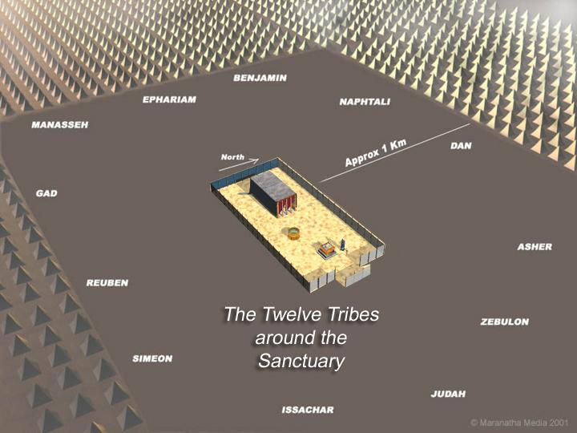
Your Way is in the Sanctuary

Slide 17
Your Way is in the Sanctuary

Slide 18
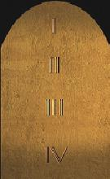
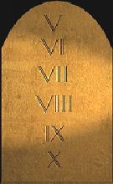
Your Way is in the Sanctuary
10 Commandments
Book of the Law
Channel
Source

Slide 19
Tablets and Book
10 Commandments
Tablets
Source
"Do not think that I came to destroy the Law [Torah] or the Prophets. I did not come to destroy but to fulfill. For assuredly, I say to you, till heaven and earth pass away, one jot or one tittle will by no means pass from the law till all is fulfilled. (Mat 5:17-18)
Book of the Law
Channel
Jesus said unto him, Thou shalt love the Lord thy God with all thy heart, and with all thy soul, and with all thy mind. This is the first and great commandment. And the second is like unto it, Thou shalt love thy neighbour as thyself. On these two commandments hang all the law and the prophets.(Mat 22:37-40)

Slide 20
Tablets and Book
10 Commandments
Tablets
But He did not stop with giving them the precepts of the Decalogue. The people had shown themselves so easily led astray that He would leave no door of temptation unguarded. Moses was commanded to write, as God should bid him, judgments and laws giving minute instruction as to what was required. These directions relating to the duty of the people to God, to one another, and to the stranger were only the principles of the Ten Commandments amplified and given in a specific manner, that none need err. They were designed to guard the sacredness of the ten precepts engraved on the tables of stone. {PP 364.1}
Source
Book of the Law
Channel

Slide 21
Law of Moses is Law of Christ
Moses of himself framed no law. Christ, the angel whom God had appointed to go before his chosen people, gave to Moses statutes and requirements necessary to a living religion and to govern the people of God. Christians commit a terrible mistake in calling this law severe and arbitrary, and then contrasting it with the gospel and mission of Christ in his ministry on earth, as though he were in opposition to the just precepts which they call the law of Moses. {RH, May 6, 1875 par. 12}
10 Commandments
Tablets
Source
Book of the Law
Channel
The instructions given to Moses for ancient Israel, with their sharp, rigid outlines, are to be studied and obeyed by the people of God today (Letter 259, 1903).

Slide 22
Law of Moses is Law of Christ
10 Commandments
Tablets
Source
As Christ is the way to the Father so the Law of Moses is the way to the 10 Commandments
Book of the Law
Channel

Slide 23
Christian Oppositional System
Source
Source
10 Commandments
Tablets
Book of the Law
John 1:17 For the law was given by Moses, but grace and truth came by Jesus Christ.

Slide 24
Christian Oppositional System
Source
10 Commandments
Tablets
Source
10 Commandments
Tablets
Channel
Book of the Law
Channel
Book of the Law
John 1:17 Because the law was given by Moses, grace and truth came by Jesus Christ.

Slide 25
Your Way is in the Sanctuary
To him that overcometh will I grant to sit with me in my throne, even as I also overcame, and am set down with my Father in his throne. Rev 3:21
10 Commandments
Book of the Law
Channel
Source

Slide 26
Divine Pattern of Sabbath
Origin (Sabbath) - ἐκ → | Channel (Feasts) - dia
Glory | Brightness (Magnifier) | Heb 1:3
Headship | Submission | 1 Cor 11:3
The Source | The Way to | John 14:6

