Slide 1
Faith of Abraham

Slide 2
The Command of God
Now it came to pass after these things that God tested Abraham, and said to him, "Abraham!" And he said, "Here I am." Then He said, "Take now your son, your only son Isaac, whom you love, and go to the land of Moriah, and offer him there as a burnt offering on one of the mountains of which I shall tell you." (Gen 22:1-2)

Slide 3
Reflection
Just as Abraham's faith is tested by God in the Book of Genesis, so the reader's own faith is tested by personal reflection on the biblical story. – Soren Kierkegaard

Slide 4
Katie Luther’s Reaction
Martin Luther once read the account of Abraham offering Isaac on the altar of sacrifice. His wife, Katie, with all the compassion of a mother said, "I do not believe it. God would not have treated his son like that!" "But, Katie," Luther replied, "He did."

Slide 5
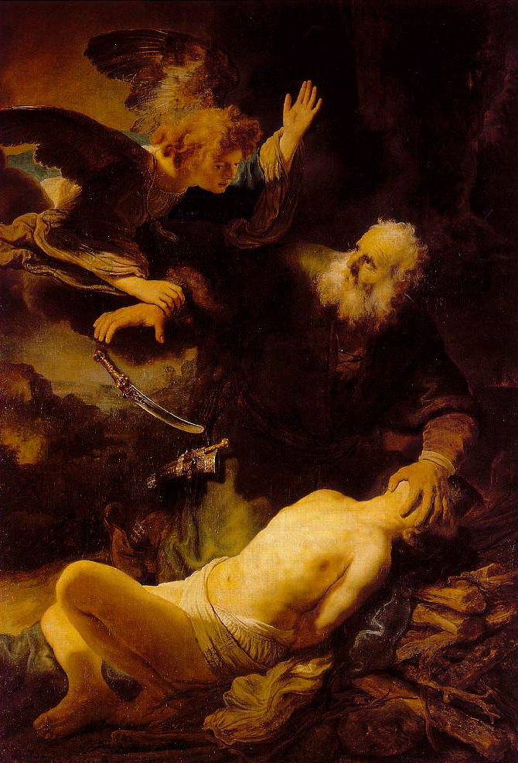
Rembrandt's depiction

Slide 6
Abraham’s response
So Abraham rose early in the morning and saddled his donkey, and took two of his young men with him, and Isaac his son; and he split the wood for the burnt offering, and arose and went to the place of which God had told him. Then on the third day Abraham lifted his eyes and saw the place afar off. And Abraham said to his young men, "Stay here with the donkey; the lad and I will go yonder and worship, and we will come back to you." (Gen 22:3-5)

Slide 7
Abraham’s prayer
The command was expressed in words that must have wrung with anguish that father's heart: "Take now thy son, thine only son Isaac, whom thou lovest, . . . and offer him there for a burnt offering." Isaac was the light of his home, the solace of his old age, above all else the inheritor of the promised blessing. The loss of such a son by accident or disease would have been heart rending to the fond father; it would have bowed down his whitened head with grief; but he was commanded to shed the blood of that son with his own hand. It seemed to him a fearful impossibility. {PP 148.2}

Slide 8
Abraham’s Wrestle
Satan was at hand to suggest that he must be deceived, for the divine law commands, "Thou shalt not kill," and God would not require what He had once forbidden. Going outside his tent, Abraham looked up to the calm brightness of the unclouded heavens, and recalled the promise made nearly fifty years before, that his seed should be innumerable as the stars. If this promise was to be fulfilled through Isaac, how could he be put to death? Abraham was tempted to believe that he might be under a delusion. In his doubt and anguish he bowed upon the earth, and prayed, as he had never prayed before, for some confirmation of the command if he must perform this terrible duty. He remembered the angels sent to reveal to him God's purpose to destroy Sodom, and who bore to him the promise of this same son Isaac, and he went to the place where he had several times met the heavenly messengers, hoping to meet them again, and receive some further direction; but none came to his relief. {PP 148.3}

Slide 9
Abraham’s Wrestle
Darkness seemed to shut him in; but the command of God was sounding in his ears, "Take now thy son, thine only son Isaac, whom thou lovest." That command must be obeyed, and he dared not delay. Day was approaching, and he must be on his journey. {PP 148.3}
Returning to his tent, he went to the place where Isaac lay sleeping the deep, untroubled sleep of youth and innocence. For a moment the father looked upon the dear face of his son, then turned tremblingly away. He went to the side of Sarah, who was also sleeping. Should he awaken her, that she might once more embrace her child? Should he tell her of God's requirement? He longed to unburden his heart to her, and share with her this terrible responsibility; but he was restrained by the fear that she might hinder him. Isaac was her joy and pride; her life was bound up in him, and the mother's love might refuse the sacrifice. {PP 148.4}

Slide 10
Abraham’s response
So Abraham rose early in the morning and saddled his donkey, and took two of his young men with him, and Isaac his son; and he split the wood for the burnt offering, and arose and went to the place of which God had told him. Then on the third day Abraham lifted his eyes and saw the place afar off. And Abraham said to his young men, "Stay here with the donkey; the lad and I will go yonder and worship, and we will come back to you." (Gen 22:3-5)

Slide 11
To the Summit
So Abraham took the wood of the burnt offering and laid it on Isaac his son; and he took the fire in his hand, and a knife, and the two of them went together. But Isaac spoke to Abraham his father and said, "My father!" And he said, "Here I am, my son." Then he said, "Look, the fire and the wood, but where is the lamb for a burnt offering?" And Abraham said, "My son, God will provide for Himself the lamb for a burnt offering." So the two of them went together. (Gen 22:6-8)

Slide 12
Supreme Faith
Then they came to the place of which God had told him. And Abraham built an altar there and placed the wood in order; and he bound Isaac his son and laid him on the altar, upon the wood. And Abraham stretched out his hand and took the knife to slay his son. But the Angel of the LORD called to him from heaven and said, "Abraham, Abraham!" So he said, "Here I am." And He said, "Do not lay your hand on the lad, or do anything to him; for now I know that you fear God, since you have not withheld your son, your only son, from Me." (Gen 22:9-12)

Slide 13
Why Sacrifice?
Job 31:33 If I have covered my transgressions as Adam, By hiding my iniquity in my bosom,
Hos 6:7 And they, as Adam, transgressed a covenant, There they dealt treacherously against me. (YLT)
Rom 8:7 Because the carnal mind is enmity against God: for it is not subject to the law of God, neither indeed can be.

Slide 14
Why Sacrifice?
Abel also brought of the firstborn of his flock and of their fat. And the LORD respected Abel and his offering, but He did not respect Cain and his offering. And Cain was very angry, and his countenance fell. (Gen 4:4-5)
Rom 8:7 Because the carnal mind is enmity against God: for it is not subject to the law of God, neither indeed can be.
Gen 4:8 Now Cain talked with Abel his brother; and it came to pass, when they were in the field, that Cain rose up against Abel his brother and killed him.

Slide 15
Why Sacrifice?
Psa 40:6 Sacrifice and offering You did not desire; My ears You have opened. Burnt offering and sin offering You did not require.
He says, "The foxes have holes, and the birds of the air have nests; but the Son of man hath not where to lay his head." {SW 84.3}
Four thousand years before a voice of strange and mysterious import was heard in heaven from the throne of God: "Sacrifice and offering thou didst not desire; mine ears hast thou opened: burnt offering and sin offering hast thou not required. Then said I, Lo, I come: in the volume of the book it is written of me, I delight to do thy will, O my God: yea, thy law is within my heart." {SW 85.1}

Slide 16
A.T. Jones
But without the divine nature, how can divine unity ever be found among men? As they are naturally, men have not the Spirit of unity, but the spirit of enmity. "The carnal mind is enmity against God." And being enmity against God, it results in putting men at enmity with one another. And so men always and everywhere have drawn lines, and built up walls, of separation among themselves, - RH January 17, 1899
Matt 25:40 And the King shall answer and say unto them, Verily I say unto you, Inasmuch as ye have done it unto one of the least of these my brethren, ye have done it unto me.

Slide 17
Purpose of Sacrifices
The introduction of the sacrificial system to the human race afforded us the opportunity to see the enmity that existed within us. It was a mirror to magnify the enmity within the Patriarchs to lead them to grace through faith.

Slide 18
Sacrifices Perverted
The sacrificial system, committed to Adam, was also perverted by his descendants. Superstition, idolatry, cruelty, and licentiousness corrupted the simple and significant service that God had appointed. Through long intercourse with idolaters the people of Israel had mingled many heathen customs with their worship; PP 364

Slide 19
Sacrifices Perverted
With what shall I come before the LORD, And bow myself before the High God? Shall I come before Him with burnt offerings, With calves a year old? Will the LORD be pleased with thousands of rams, Ten thousand rivers of oil? Shall I give my firstborn for my transgression, The fruit of my body for the sin of my soul? Micah 6:6-7

Slide 20
Had Abraham Demonstrated Enmity?
And when Abram heard that his brother was taken captive, he armed his trained servants, born in his own house, three hundred and eighteen, and pursued them unto Dan. And he divided himself against them, he and his servants, by night, and smote them, and pursued them unto Hobah, which is on the left hand of Damascus.(Gen 14:14-15)

Slide 21
Was Abraham familiar with child sacrifice?
"The Canaanite was then in the land." Abraham had reached the goal of his hopes to find a country occupied by an alien race and overspread with idolatry. In the groves were set up the altars of false gods, and human sacrifices were offered upon the neighboring heights. While he clung to the divine promise, it was not without distressful forebodings that he pitched his tent. PP 127.2

Slide 22
The Mirror
Then she came and worshiped Him, saying, "Lord, help me!" But He answered and said, "It is not good to take the children's bread and throw it to the little dogs." And she said, "Yes, Lord, yet even the little dogs eat the crumbs which fall from their masters' table." (Mat 15:25-27)

Slide 23
The Mirror
In this parable Christ was meeting the people on their own ground. The doctrine of a conscious state of existence between death and the resurrection was held by many of those who were listening to Christ's words. The Saviour knew of their ideas, and He framed His parable so as to inculcate important truths through these preconceived opinions. He held up before His hearers a mirror wherein they might see themselves in their true relation to God. COL 263

Slide 24
The Mirror
Christ Speaks
Woman misunderstands
Her Faith holds on through misunderstanding
Victory is won, new comprehension takes place

Slide 25
What did God say
Gen 22:2 And he said, Take now thy son, thine only son Isaac, whom thou lovest, and get thee into the land of Moriah; and offer him there for a burnt offering upon one of the mountains which I will tell thee of.

Slide 26
To Offer or to Ascend?
to bring up, cause to ascend or climb, cause to go up, to bring up, bring against, take away, to bring up, draw up, train, to cause to ascend, to rouse, stir up (mentally), to offer, bring up (of gifts), to exalt, to cause to ascend, offer - Hiphil form of H5927

Slide 27
To Offer or to Ascend?
to bring up, cause to ascend or climb, cause to go up, to bring up, bring against, take away, to bring up, draw up, train, to cause to ascend, to rouse, stir up (mentally), to offer, bring up (of gifts), to exalt, to cause to ascend, offer - Hiphil form of H5927
And He saith, `Take, I pray thee, thy son, thine only one, whom thou hast loved, even Isaac, and go for thyself unto the land of Moriah, and cause him to ascend there for a burnt-offering on one of the mountains of which I speak unto thee.' Genesis 22:2 (YLT)

Slide 28
Burnt offering or Go Up?
Feminine active participle of H5927; a step or (collectively stairs, as ascending); usually a holocaust (as going up in smoke): - ascent, burnt offering (sacrifice), go up to. See also H5766.
And there were seven steps to go up to it, and the arches thereof were before them: and it had palm trees, one on this side, and another on that side, upon the posts thereof. Ezekiel 40:26

Slide 29
How do you read?
"Take now your son, your only son Isaac, whom you love, and go to the land of Moriah, and offer him there as a burnt offering on one of the mountains of which I shall tell you." Genesis 22:2
Then He said, "Take now your son, your only son Isaac, whom you love, and go to the land of Moriah, and ascend there and go up on one of the mountains of which I shall tell you." Genesis 22:2

Slide 30
The Faith of Abraham
By faith Abraham, when he was tested, offered up Isaac, and he who had received the promises offered up his only begotten son, of whom it was said, "In Isaac your seed shall be called," concluding that God was able to raise him up, even from the dead, from which he also received him in a figurative sense. Hebrews 11:17-19
And not being weak in faith, he did not consider his own body, already dead (since he was about a hundred years old), and the deadness of Sarah's womb. He did not waver at the promise of God through unbelief, but was strengthened in faith, giving glory to God, and being fully convinced that what He had promised He was also able to perform. And therefore "It was accounted to him for righteousness." Romans 4:19-22

Slide 31
The Mirror
God Speaks
Abraham misunderstands
Abraham’s Faith holds on through misunderstanding
Victory is won, new comprehension takes place

