Slide 1
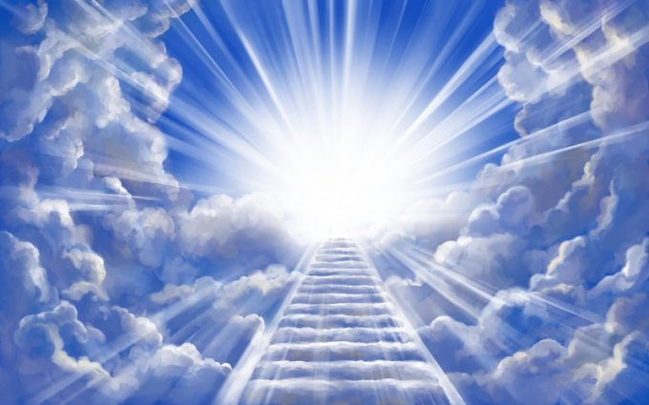
Jacob’s dream of a Ladder
Genesis 28:10-15
PP 177-183
1
Notes:
Abraham’s grandson. What a privilege to be born into a successful family who were, by the way, quite well off. Jacob was privileged to be a descendant of Abraham’s family tree. It was a goodly line tracing back to Shem the son of Noah. But more than just his blood line, it was Jacob’s privilege to be a representative of the only true God. What a privilege – true. But what a responsibility: to represent God in this world. As we look at Jacob’s life we will discover that being privileged doesn’t make life any easier. We still need to make choices, we will still face many temptations and we will still have many lessons to learn. But brothers and sisters, that is also part of the privilege of being a representative of God in this world. May we take courage from Jacob’s story - both the highs and the lows as we see the patience and wisdom of the living God work a miracle in the life of Jacob.

Slide 2
Jacob’s dream of a Ladder
Gen 28:12 And he dreamed, and behold a ladder set up on the earth, and the top of it reached to heaven: and behold the angels of God ascending and descending on it.
1

Slide 3
Ecc 3:3 A time to kill, and a time to heal; a time to break down, and a time to build up;
2

Slide 4
Deut 32:39 See now that I, even I, am he, and there is no god with me: I kill, and I make alive; I wound, and I heal: neither is there any that can deliver out of my hand.
3
Notes:
If we put our lives into God’s hands, nobody is going to take us from Him. Therefore we can be sure, we can be confident, that He who has begun the good work in us will perform it - that is - complete it until the day of Jesus Christ.

Slide 5
The story behind the dream
Birth Gen 25:19-26 > prediction Gen 25:23 >
birthright exchanged Gen 25:27-34 (A.P.E)>
blessing stolen Gen 27:1-29 >
departure Gen 28:1-5 >
dream Gen 28:10-15 > …
4
Notes:
Birth – Gen 25:19-26; promise – Gen 25:23; birthright exchanged Gen 25:27-34; blessing stolen (deception) Gen 27:1-29; sent away Gen 28:1-5
Jacob was even now beginning a journey that would involve deep pain and considerable conflict. Through these experiences he was to learn vital llessons about his own character which needed repair. The only way God could accomplish this goal, and save Jacob, was to bring him through many trials which would expose the flaws in his character, awaken the need for conversion, and lead to his repentance and salvation. This is the experience each one of us must pass through if we are to be saved.

Slide 6
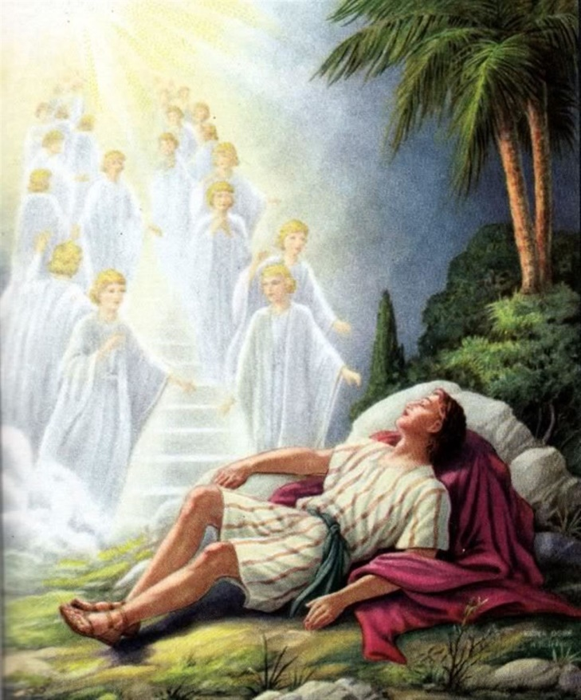
Genesis 28:10-15
Gen 28:13 And, behold, the LORD stood above it, and said, I am the LORD God of Abraham thy father, and the God of Isaac: the land whereon thou liest, to thee will I give it, and to thy seed;
Gen 28:12 And he dreamed, and behold a ladder set up on the earth, and the top of it reached to heaven: and behold the angels of God ascending and descending on it.
The Dream
5
Notes:
Da 142-143; PP 184.

Slide 7
Genesis 28:10-15
Gen 28:15 And, behold, I am with thee, and will keep thee in all places whither thou goest, and will bring thee again into this land; for I will not leave thee, until I have done that which I have spoken to thee of.
Gen 28:14 And thy seed shall be as the dust of the earth, and thou shalt spread abroad … : and in thee and in thy seed shall all the families of the earth be blessed.
The Dream
6
Notes:
V15 What doe stis tell us about God? He is faithful and keeps His promises …

Slide 8
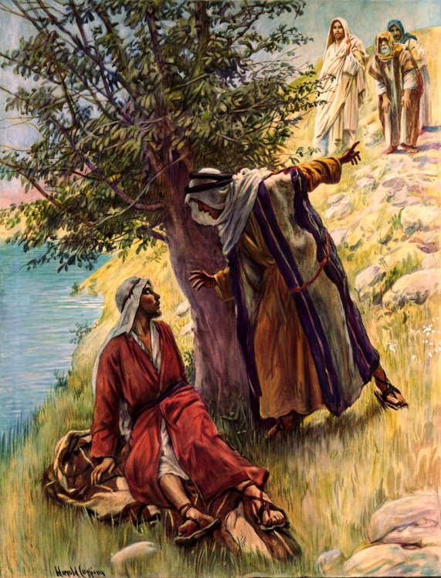
Philip said to Nathanael, “Come and see.” He did not ask him to accept another's testimony, but to behold Christ for himself. Now that Jesus has ascended to heaven, His disciples are His representatives among men, and one of the most effective ways of winning souls to Him is in exemplifying His character in our daily life. DA 142
6
Notes:
V15 What doe stis tell us about God? He is faithful and keeps His promises …

Slide 9
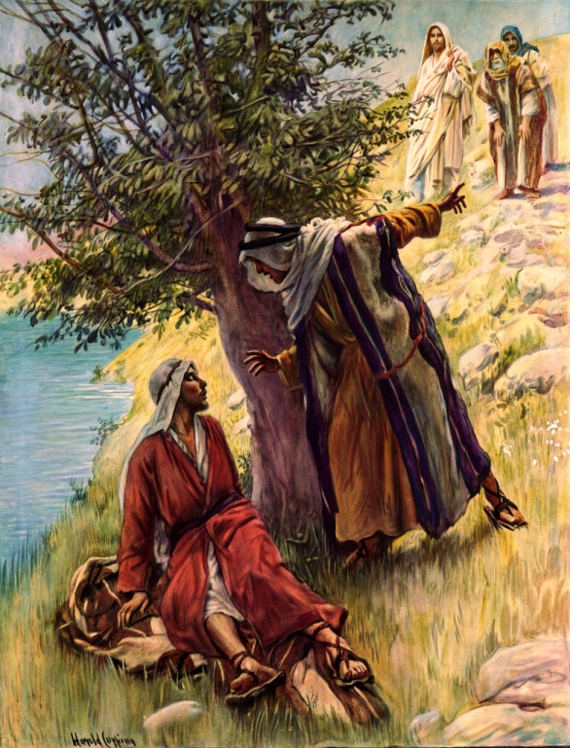
Our influence upon others depends not so much upon what we say as upon what we are. Men may combat and defy our logic, they may resist our appeals; but a life of disinterested love is an argument they cannot gainsay. A consistent life, characterized by the meekness of Christ, is a power in the world.
DA 142
6
Notes:
V15 What doe stis tell us about God? He is faithful and keeps His promises …

Slide 10
Genesis 28:10-15
“In the vision the plan of redemption was presented to Jacob, not fully, but in such parts as were essential to him at that time. The mystic ladder revealed to him in his dream was the same to which Christ referred in His conversation with Nathanael.
John 1:51
“Ye shall see heaven open, and the angels of God ascending and descending upon the Son of man.”.
The Dream
7
Notes:
This is two days after His baptism … speaking to Nathaniel. “Son of God … King of Israel.”

Slide 11
Genesis 28:10-15
“Said He, “Ye shall see heaven open, and the angels of God ascending and descending upon the Son of man.” Up to the time of man's rebellion against the government of God, there had been free communion between God and man.
John 1:51
“Ye shall see heaven open, and the angels of God ascending and descending upon the Son of man.”.
The Dream
8

Slide 12
Genesis 28:10-15
“But the sin of Adam and Eve separated earth from heaven, so that man could not have communion with his Maker. Yet the world was not left in solitary hopelessness. The ladder represents Jesus, the appointed medium of communication.
John 1:51
“Ye shall see heaven open, and the angels of God ascending and descending upon the Son of man.”.
The Dream
9

Slide 13
Genesis 28:10-15
“Had He not with His own merits bridged the gulf that sin had made, the ministering angels could have held no communion with fallen man. Christ connects man in his weakness and helplessness with the source of infinite power.” PP 184.2
John 1:51
“Ye shall see heaven open, and the angels of God ascending and descending upon the Son of man.”.
The Dream
10
Notes:
Who is the Source of infinite power? When did Christ bridge the gulf that sin had made between heaven and earth? Calvary or ere there was a sinner there was a Saviour. Rev 13:8

Slide 14
John 14:6 Jesus saith unto him, I am the way, the truth, and the life: no man cometh unto the Father, but by me.
11

Slide 15
John 10:9 I am the door: by me if any man enter in, he shall be saved, and shall go in and out, and find pasture.
12

Slide 16
John 10:1 Verily, verily, I say unto you, He that entereth not by the door into the sheepfold, but climbeth up some other way, the same is a thief and a robber.
2 But he that entereth in by the door is the shepherd of the sheep.
3 To him the porter openeth; and the sheep hear his voice: and he calleth his own sheep by name, and leadeth them out.
13
Notes:
How many ways are there to God? Why does Jesus use the terms thief and robber? 2 reasons: 1. They only have their own interests at heart. 2. When they steal something it goes to their own house and not to the Father’s house. Jesus one said, My house is a house of prayer for all people … Mt 21:13; He later said, “Your house is left unto desolate.” Mt 23:38. Who is the porter?

Slide 17
John 10:4 And when he putteth forth his own sheep, he goeth before them, and the sheep follow him: for they know his voice.
5 And a stranger will they not follow, but will flee from him: for they know not the voice of strangers.
6 This parable spake Jesus unto them: but they understood not what things they were which he spake unto them.
14
Notes:
Why does the porter put the sheep out? What else is significant about his verse? He goes before them and leads with His word.

Slide 18
John 10:7 Then said Jesus unto them again, Verily, verily, I say unto you, I am the door of the sheep.
Joh 10:8 All that ever came before me are thieves and robbers: but the sheep did not hear them.
Joh 10:9 I am the door: by me if any man enter in, he shall be saved, and shall go in and out, and find pasture.
15

Slide 19
John 10:10 The thief cometh not, but for to steal, and to kill, and to destroy: I am come that they might have life, and that they might have it more abundantly.
11 I am the good shepherd: the good shepherd giveth his life for the sheep.
16

Slide 20
Genesis 28:10-15
Gen 28:16 And Jacob awaked out of his sleep, and he said, Surely the LORD is in this place; and I knew it not.
Gen 28:17 And he was afraid, and said, How dreadful is this place! this is none other but the house of God, and this is the gate of heaven.
The Dream
17
Notes:
Yawray- dreadful or awesome in the sense of reverence.

Slide 21
Gen 28:18 And Jacob rose up early in the morning, and took the stone that he had put for his pillows, and set it up for a pillar, and poured oil upon the top of it.
Mat 21:44 And whosoever shall fall on this stone shall be broken: but on whomsoever it shall fall, it will grind him to powder.
18
Notes:
The pillow became the pillar? What is the result of being broken?
What is the significance of pouring oil on the stone? That was his Ebenezer.

Slide 22
Hosea 6:1 Come, and let us return unto the LORD: for he hath torn, and he will heal us; he hath smitten, and he will bind us up.
Hosea 6:2
After two days will he revive us: in the third day he will raise us up, and we shall live in his sight.
19

Slide 23
Ecc 3:3 A time to kill, and a time to heal; a time to break down, and a time to build up;
Gal 2:20 I am crucified with Christ: nevertheless I live; yet not I, but Christ liveth in me: and the life which I now live in the flesh I live by the faith of the Son of God, who loved me, and gave himself for me.
20
Notes:
What happens if we have a problem with our heart and don’t get it treated?
What happens if we have a bad heart spiritually and don’t get it treated? We will die without hope.

Slide 24
Deut 32:39 See now that I, even I, am he, and there is no god with me: I kill, and I make alive; I wound, and I heal: neither is there any that can deliver out of my hand.
Our Heavenly Father has a desire to kill the old man in our lives
so that He can raise up a new man in Christ.
This is the only killing God approves.
21
Notes:
If we put our lives into God’s hand, nobody is going to remove us from that place – in His hand. Therefore we can be sure, we can be confident, that He who has begun the good work in us will perform it - that is - complete it until the day of Jesus Christ.

Slide 25
Deut 32:39 See now that I, even I, am he, and there is no god with me: I kill, and I make alive; I wound, and I heal: neither is there any that can deliver out of my hand.
If we put our lives into God’s hand, nobody is going to remove us from that place – in His hand. Therefore we can be sure, we can be confident, that He who has begun the good work in us will perform it - that is - complete it until the day of Jesus Christ.
21
Notes:
If we put our lives into God’s hand, nobody is going to remove us from that place – in His hand. Therefore we can be sure, we can be confident, that He who has begun the good work in us will perform it - that is - complete it until the day of Jesus Christ.

Slide 26
Rev 3:19 As many as I love, I rebuke and chasten: be zealous therefore, and repent.
22

Slide 27
Jacob’s ladder is always there for you.
The Ladder/He/Christ is your assurance that:
God keeps His promises – 2Cor 1:20
Christ is always there for you – Mat 28:20
Angels are constantly there to support you – Heb 1:14
God will complete the good work He has begun in you -
Phil 1:6
23
Notes:
Jacob still had much to learn as he only now left the comfort of his family and home. This can be the theme for another time.

Slide 28
May God bless your journey
and inspire your choices as you face
the mirrors in your life
that will teach you who you are;
so you can turn to Him
who has healing in His wings.
Amen
end

Slide 30
Jacob’s dream of a Ladder
Part 2
1

Slide 31
Previous lesson
The Dream and
The story behind the dream
Birth > promise > birthright exchanged >
blessing stolen > departure > dream …
4
Notes:
Birth – Gen 25:19-26; promise – Gen 25:23; birthright exchanged Gen 25:27-34; blessing stolen (deception) Gen 27:1-29; sent away Gen 28:1-5
Jacob was even now beginning a journey that would involve deep pain and considerable conflict. Through these experiences he was to learn vital llessons about his own character which needed repair. The only way God could accomplish this goal, and save Jacob, was to bring him through many trials which would expose the flaws in his character, awaken the need for conversion, and lead to his repentance and salvation. This is the experience each one of us must pass through if we are to be saved.

Slide 32
Ecc 3:3 A time to kill, and a time to heal; a time to break down, and a time to build up;
Deut 32:39 See now that I, even I, am he, and there is no god with me: I kill, and I make alive; I wound, and I heal: neither is there any that can deliver out of my hand.
end

Slide 33
Hosea 6:1 Come, and let us return unto the LORD: for he hath torn, and he will heal us; he hath smitten, and he will bind us up.
Hosea 6:2 After two days will he revive us: in the third day he will raise us up, and we shall live in his sight.
end

Slide 34
How was God going to save Jacob, the usurper, after he had burned so many bridges behind himself?
We left our last lesson with Jacob running for his life.
What lessons did Jacob need to learn in order to come to the place of repentance, restoration and salvation.
end

Slide 35
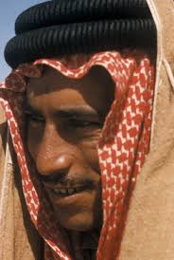
Jacob needed to see who he really was so he would humble himself and repent.
He required a mirror.
end

Slide 36
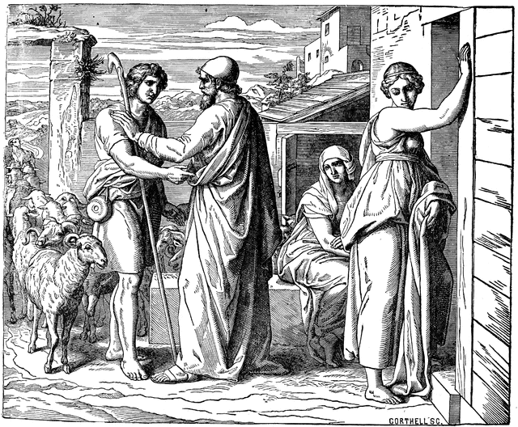
Gen 28:15 And, behold, I am with thee, and will keep thee in all places whither thou goest, and will bring thee again into this land; for I will not leave thee, until I have done that which I have spoken to thee of.
end

Slide 37
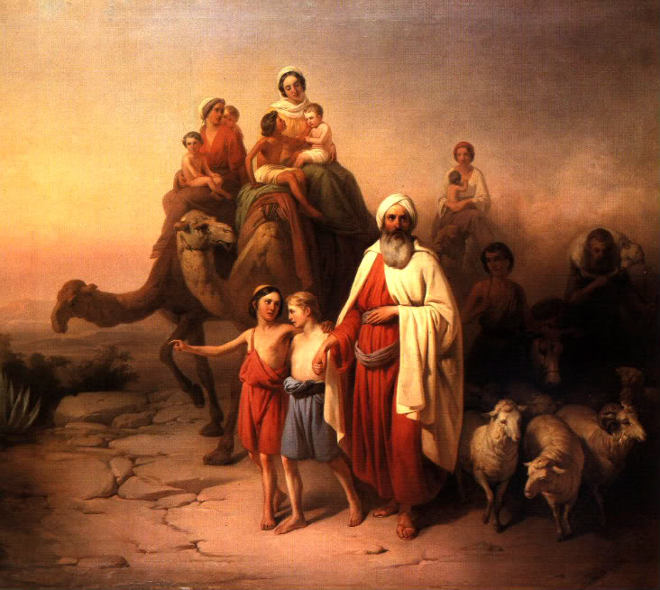
end

Slide 38
end

Slide 39
end

Slide 40
end

Slide 41
end

Slide 42
end

Slide 43
end

Slide 44
end

