Slide 1
Key to the Atonement

Slide 2
Commentary on the Atonement
The NT writers do not repeat a stereotyped story. Each writes from his own perspective. But each shows that it is the death of Christ and not any human achievement that brings salvation.
But none of them sets out a theory of atonement. There are many references to the effectiveness of Christ's atoning work, and we are not lacking in information about its many - sidedness. Thus Paul gives a good deal of emphasis to the atonement as a process of justification, and he uses such concepts as redemption, propitiation, and reconciliation. Sometimes we read of the cross as a victory or as an example. It is the sacrifice that makes a new covenant, or simply a sacrifice. There are many ways of viewing it. We are left in no doubt about its efficacy and its complexity. View the human spiritual problem as you will, and the cross meets the need. But the NT does not say how it does so. – Leon Morris

Slide 3
Commentary on the Atonement
Through the centuries there have been continuing efforts to work out how this was accomplished. Theories of the atonement are legion as men in different countries and in different ages have tried to bring together the varied strands of scriptural teaching and to work them into a theory that will help others to understand how God has worked to bring us salvation. – Leon Morris

Slide 4
Subjective View or Moral Influence
In all its variations this theory emphasizes the importance of the effect of Christ's cross on the sinner. The view is generally attributed to Abelard, who emphasized the love of God, and is sometimes called the moral influence theory, or exemplarism. When we look at the cross we see the greatness of the divine love. this delivers us from fear and kindles in us an answering love. We respond to love with love and no longer live in selfishness and sin.– Leon Morris

Slide 5
Victory or Ransom Theory
God offered his son as a ransom, a bargain the evil one eagerly accepted. When, however, Satan got Christ down into hell he found that he could not hold him. On the third day Christ rose triumphant and left Satan without either his original prisoners or the ransom he had accepted in their stead. - Leon Morris

Slide 6
Anslem’s satisfaction Theory
In the eleventh century Anselm, Archbishop of Canterbury, produced a little book called Cur Deus Homo? ("Why did God become Man?"). In it he subjected the patristic view of a ransom paid to Satan to severe criticism. He saw sin as dishonoring the majesty of God. Now a sovereign may well be ready in his private capacity to forgive an insult or an injury, but because he is a sovereign he cannot. The state has been dishonored in its head. Appropriate satisfaction must be offered. God is the sovereign Ruler of all, and it is not proper for God to remit any irregularity in his kingdom. Anselm argued that the insult sin has given to God is so great that only one who is God can provide satisfaction.- Leon Morris

Slide 7
Satan’s Satisfaction Theory
In the opening of the great controversy, Satan had declared that the law of God could not be obeyed, that justice was inconsistent with mercy, and that, should the law be broken, it would be impossible for the sinner to be pardoned. Every sin must meet its punishment, urged Satan; and if God should remit the punishment of sin, He would not be a God of truth and justice. DA 761.4
Appropriate satisfaction must be offered. God is the sovereign Ruler of all, and it is not proper for God to remit any irregularity in his kingdom. - Anslem

Slide 8
Penal Substitution
The Reformers agreed with Anselm that sin is a very serious matter, but they saw it as a breaking of God's law rather than as an insult to God's honor.
It seemed clear to them that the essence of Christ's saving work consisted in his taking the sinner's place. In our stead Christ endured the death that is the wages of sin. He bore the curse that we sinners should have borne (Gal. 3:13). The Reformers did not hesitate to speak of Christ as having borne our punishment or as having appeased the wrath of God in our place.

Slide 9
Governmental Theory
Hugo Grotius argued that Christ did not bear our punishment but suffered as a penal example whereby the law was honored while sinners were pardoned. His view is called "governmental" because Grotius envisions God as a ruler or a head of government who passed a law, in this instance, "The soul that sinneth, it shall die." Because God did not want sinners to die, he relaxed that rule and accepted the death of Christ instead. He could have simply forgiven mankind had he wanted to, but that would not have had any value for society. The death of Christ was a public example of the depth of sin and the lengths to which God would go to uphold the moral order of the universe. – Leon Morris

Slide 10
Key thought
In order to understand the atonement you must have an understanding of the character of God.
John 17:3 And this is life eternal, [at-one-ment] that they might know thee the only true God, and Jesus Christ, whom thou hast sent.

Slide 11
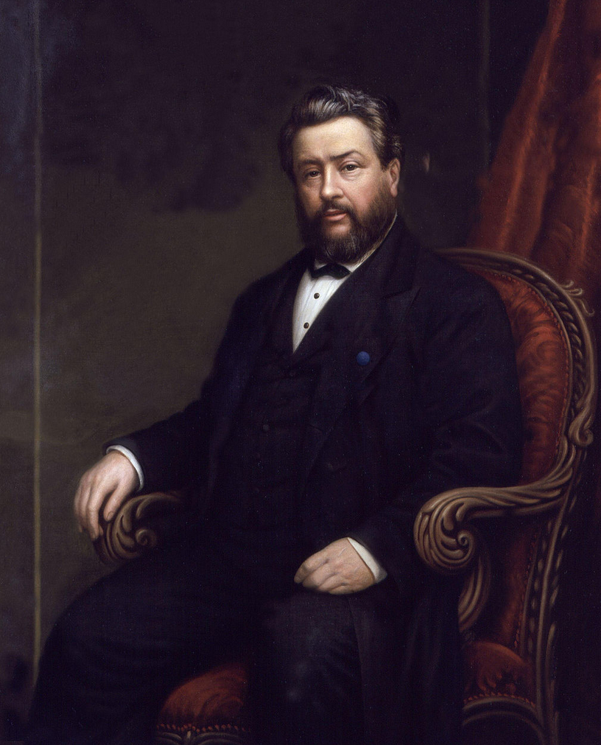
Charles Spurgeon
Charles Haddon Spurgeon (19 June 1834[1] – 31 January 1892) was an English Particular Baptist preacher. Spurgeon remains highly influential among Christians of various[which?] denominations, among whom he is known as the "Prince of Preachers". He was a strong figure in the Reformed Baptist tradition, defending the 1689 London Baptist Confession of Faith, and opposing the liberal and pragmatic theological tendencies in the Church of his day.

Slide 12
Spurgeon
One sin can ruin a soul for ever; it is not in the power of the human mind to grasp the infinity of evil that slumbereth in the bowels of one solitary sin. There is a very infinity of guilt couched in one transgression against the majesty of Heaven. If, then, you and I had sinned but once, nothing but an atonement infinite in value could ever have washed away the sin and made satisfaction for it. – Particular Redemption, Spurgeon.

Slide 13
Spurgeon
This, then, is the first measure of the atonement—the greatness of our guilt.
II. Now, secondly, we must measure the great redemption BY THE STERNNESS OF DIVINE JUSTICE. "God is love," always loving; but my next proposition does not at all interfere with this assertion. God is sternly just, inflexibly severe in His dealings with mankind. The God of the Bible is not the God of some men's imagination, Who thinks so little of sin that He passes it by without demanding any punishment for it.

Slide 14
Spurgeon
Learn ye, my friends, to look upon God as being as severe in His justice as if He were not loving, and yet as loving as if He were not severe. His love does not diminish His justice, nor does His justice, in the least degree, make warfare upon His love. The two things are sweetly linked together in the atonement of Christ. But, mark, we can never understand the fullness of the atonement till we have first grasped the Scriptural truth of God's immense justice.

Slide 15
Spurgeon
Learn ye, my friends, to look upon God as being as severe in His justice as if He were not loving, and yet as loving as if He were not severe. His love does not diminish His justice, nor does His justice, in the least degree, make warfare upon His love. The two things are sweetly linked together in the atonement of Christ. But, mark, we can never understand the fullness of the atonement till we have first grasped the Scriptural truth of God's immense justice.

Slide 16
Spurgeon
There was never an ill word spoken, nor an ill thought conceived, nor an evil deed done, for which God will not have punishment from some one or another. He will either have satisfaction from you, or else from Christ. If you have no atonement to bring through Christ, you must for ever lie paying the debt which you never can pay, in eternal misery; for as surely as God is God, He will sooner lose His Godhead than suffer one sin to go unpunished, or one particle of rebellion unrevenged. You may say that this character of God is cold, and stern, and severe. I cannot help what you say of it; it is nevertheless true. Such is the God of the Bible;

Slide 17
Normal Thinking
Option 1
Option 2
Light
Dark
Strong
Weak
High
Low
New Testament
Old Testament
Grace
Law
Faith
Works
Love
Justice

Slide 18
New Wine Skin
Glory
Brightness
Heb 1:3 who being the brightness of His glory and the express image of His person, and upholding all things by the word of His power, when He had by Himself purged our sins, sat down at the right hand of the Majesty on high,
Light
Brightness
Strong
Stronger
High
Higher
Old Testament
New Testament
Law
Grace
Faith
Works
Justice
Mercy

Slide 19
Divine Pattern
Glory
Brightness
1Co 8:6 yet for us there is one God, the Father, of whom [source] are all things, and we for Him; and one Lord Jesus Christ, through whom [Channel] are all things, and through whom we live.
Light
Brightness
Strong
Stronger
High
Higher
Old Testament
New Testament
Law
Grace
Faith
Works
Justice
Mercy

Slide 20
Divine Pattern = Key to Everything
Being | Pattern | Definition (From Strong’s Concordance)
Father | ἐκ Of Whom | ek, ex - A primary preposition denoting origin, source (the point whence motion or action proceeds)
Jesus Christ | dia By Whom | dia dee-ah' - A primary preposition denoting the channel of an act; through.

Slide 21
Counterfeit System
"How you are fallen from heaven, O Lucifer, son of the morning! How you are cut down to the ground, You who weakened the nations! For you have said in your heart: 'I will ascend into heaven, I will exalt my throne above the stars of God; I will also sit on the mount of the congregation On the farthest sides of the north; I will ascend above the heights of the clouds, I will be like the Most High.' Isa 14:12-14
ἐκ and ἐκ (source) and (source)

Slide 22
Counterfeit System
"How you are fallen from heaven, O Lucifer, son of the morning! How you are cut down to the ground, You who weakened the nations! For you have said in your heart: 'I will ascend into heaven, I will exalt my throne above the stars of God; I will also sit on the mount of the congregation On the farthest sides of the north; I will ascend above the heights of the clouds, I will be like the Most High.' Isa 14:12-14
ἐκ→ and ἐκ→ (source) and (source)

Slide 23
Oppositional System
Source
Source
Father
Son
I will ascend above the heights of the clouds, I will be like the Most High.' Isa 14:14
Old Testament
New Testament
Faith
Works
Law
Grace
Justice
Mercy/Love

Slide 24
Satan’s Counterfeit Justice
The condemning power of Satan would lead him to institute a theory of justice inconsistent with mercy. He claims to be officiating as the voice and power of God, claims that his decisions are justice, are pure and without fault. Thus he takes his position on the judgment seat and declares that his counsels are infallible. Here his merciless justice comes in, a counterfeit of justice, abhorrent [to abominate] to God. {Christ Triumphant 11.4}
In the opening of the great controversy, Satan had declared that the law of God could not be obeyed, that justice was inconsistent with mercy, and that, should the law be broken, it would be impossible for the sinner to be pardoned. Every sin must meet its punishment, urged Satan; and if God should remit the punishment of sin, He would not be a God of truth and justice. DA 761.4

Slide 25
The Two Systems
Source
Source
Co-Equal God
Justice
Love
Source
Channel
Father-Son
Justice
Love

Slide 26
The Seal of God – Father’s Name
Rev 14:1 Then I looked, and behold, a Lamb standing on Mount Zion, and with Him one hundred and forty-four thousand, having His Father's name [G3685 – Character] written on their foreheads.
I have come in My Father's name, and you do not receive Me; if another comes in his own name, him you will receive. John 5:43
Jesus answered them, "I told you, and you do not believe. The works that I do in My Father's name, they bear witness of Me. John 10:25
I have manifested Your name to the men whom You have given Me out of the world. They were Yours, You gave them to Me, and they have kept Your word. John 17:6

Slide 27
Christ’s Mission
John 17:4 I have glorified You on the earth. I have finished the work which You have given Me to do.

Slide 28
Christ’s Mission
In Christ God beheld the reflection of his own image. God was manifest in the flesh because of the entire identity of his character with Christ's character. That God should be thus manifest in the flesh was a wonder to the heavenly host, “even the mystery which hath been hid from ages and from generations.” {ST, April 15, 1897 par. 10}

Slide 29
Christ’s Mission
Satan had so misrepresented the character of God to the world, that man stood remote from God; but Christ came to display to the world the Father’s attributes, to represent the express image of his person. “As the Father gave me commandment, even so I do.” “This commandment have I received of my Father.” The object of Christ’s mission to the world was to reveal the Father. {ST, April 11, 1895 par. 2}
Christ never killed anyone. {CTr 248.4}

