Slide 1
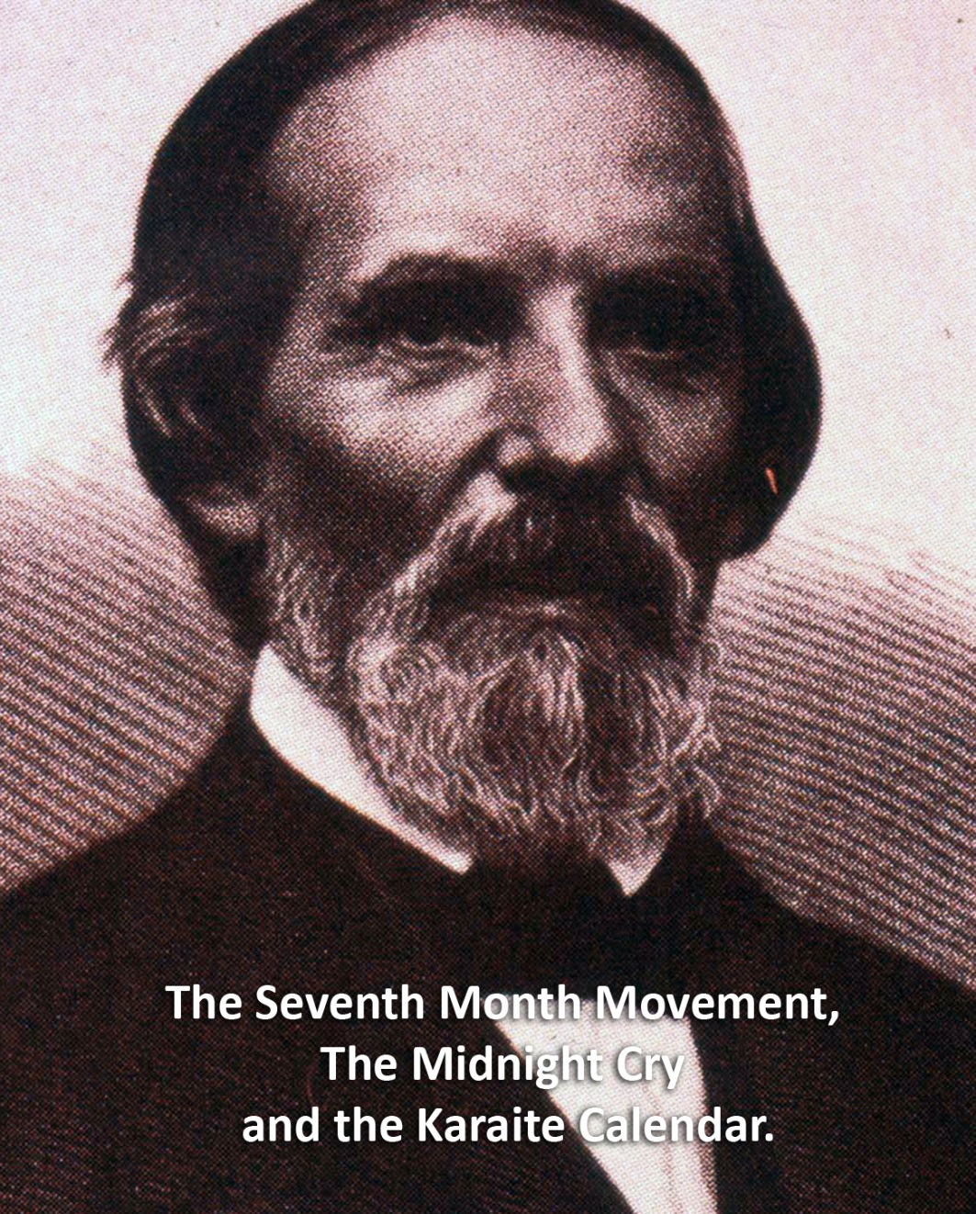
Midnight Cry Calendar

Slide 2
1. The Prophetic foundations of Adventism
The scripture which above all others had been both the foundation and the central pillar of the advent faith was the declaration: "Unto two thousand and three hundred days; then shall the sanctuary be cleansed." Daniel 8:14. GC 409

Slide 3
1. The Prophetic foundations of Adventism
The tenth day of the seventh month, the great Day of Atonement, the time of the cleansing of the sanctuary, which in the year 1844 fell upon the twenty-second of October, was regarded as the time of the Lord's coming. This was in harmony with the proofs already presented that the 2300 days would terminate in the autumn, and the conclusion seemed irresistible. GC 400

Slide 4
1. The Prophetic foundations of Adventism
"From the going forth of the commandment to restore and to build Jerusalem unto the Messiah the Prince shall be seven weeks, and threescore and two weeks"--namely, sixty-nine weeks, or 483 years. The decree of Artaxerxes went into effect in the autumn of 457 B.C. From this date, 483 years extend to the autumn of A.D. 27. (See Appendix.) At that time this prophecy was fulfilled. The word "Messiah" signifies "the Anointed One." In the autumn of A.D. 27 Christ was baptized by John and received the anointing of the Spirit. {GC 327.1}

Slide 5
1. The Prophetic foundations of Adventism
"In the midst of the week He shall cause the sacrifice and the oblation to cease." In A.D. 31, three and a half years after His baptism, our Lord was crucified. With the great sacrifice [328] offered upon Calvary, ended that system of offerings which for four thousand years had pointed forward to the Lamb of God. Type had met antitype, and all the sacrifices and oblations of the ceremonial system were there to cease. {GC 327.3} The seventy weeks, or 490 years, especially allotted to the Jews, ended, as we have seen, in A.D. 34. {GC 328.1}

Slide 6
2. How was the year AD 31 established for the crucifixion of Christ
If the Cariate Jews are correct, the true passover in A. D. 33, was held one moon, or 29 days later than Ferguson supposed, which would bring it that year, on Saturday. In the same table, Ferguson shows us that in A. D. 30, the Rabinical passover came on Thursday: if therefore we reckon from that time 29 days to the Caraite passover, it will bring us to Friday of the next moon. We therefore find that according to Ferguson if the Caraite Jews are correct, the crucifixion was in A. D.30, [Had not found the zero year at this point] in the middle of the week, this would leave 3 1-2 years from the 7th month of A. D. 26 and 3 1-2 years. Joshua Himes Signs of the Times, July 12, 1843

Slide 7
2. How was the year AD 31 established for the crucifixion of Christ
The question is often asked, When does the Jewish year terminate? The general impression has been, that it only extends to the 21st of March.--This opinion, however, is only in accordance with the present method of reckoning time, in use among the Jewish Rabbins: but in this they have, departed from the requirements of the Mosaic law. According to the 23rd of Levit. the year was to commence with the appearance of the New Moon nearest the barley harvest, which, in Judea, is one entire Moon later than the one at which the Rabbins commence their year. – JV Himes, ST, March 20, 1884

Slide 8
2. How was the year AD 31 established for the crucifixion of Christ
Originally, the Jewish year, as shown by Dr. Prideaux, was entirely inartificial, and continued thus so long as they remained in their own land, before their enemies began to reign over them. A few hundred years before Christ, they used an astronomical cycle of 84 years, with a certain number of intercalary years, containing thirteen moons each, instead of twelve, the usual number. This was found to be faulty, and Meto's cycle of 19 years, was substituted for it. To remedy its defects the Jewish calendar in its persent shape was struck out by Rabbi Samuel without its being perfected; it was improved upon by Rabbi Adda, and afterwards perfected by Rabbi Hillel, about A. D. 360. (See Prideaux Con. vol. I, pp. 49-54.) According to this calendar, the Jewish year ends with the first new moon after the vernal equinox, which this year is March 21st. But according to the Caraite Jews, the true year cannot commence till the appearance of the next new moon in April.

Slide 9
2. How was the year AD 31 established for the crucifixion of Christ
That the Caraite Jews are correct, is plain from the 23rd of Lev., which requires that the barley shall be ripe at the passover, on the 14th day of the first month, and which, at Jerusalem, is one whole moon later, than the Rabbins keep the passover, and who pay no attention to this requirement of God. Joshua Himes, Signs of the Times, March 20, 1844

Slide 10
2. How was the year AD 31 established for the crucifixion of Christ
The second correction was related to the correct year for the parousia. Miller's "Jewish year" from [equinox] March 21, 1843 to [equinox] March 21, 1844 was at first quite generally accepted among his followers. Gradually, however, as attention was called to different Jewish reckonings, the general trend of discussion favored the Karaite reckoning above the Rabbinical as being more biblical. Acceptance of the Karaite reckoning led them to the correction of the date for the Crucifixion, because Ferguson, heretofore the Millerite's chief authority on the Crucifixion date, had used the Rabbinical reckoning in determining it. Gerard Damsteegt, Foundations of the Seventh-day Adventist Message and Mission (1977) page 89.

Slide 11
3. The Midnight Cry
Of all the great religious movements since the days of the apostles, none have been more free from human imperfection and the wiles of Satan than was that of the autumn of 1844. Even now, after the lapse of nearly half a century, all who shared in that movement and who have stood firm upon the platform of truth, still feel the holy influence of that blessed work, and bear witness that it was of God. GC88 401.1

Slide 12
3. The Midnight Cry
In the parable of Matthew 25 the time of waiting and slumber is followed by the coming of the bridegroom. This was in accordance with the arguments just presented, both from prophecy and from the types. They carried strong conviction of their truthfulness; and the "midnight cry" was heralded by thousands of believers. Like a tidal wave the movement swept over the land. From city to city, from village to village, and into remote country places it went, until the waiting people of God were fully aroused. GC 399

Slide 13
3. The Midnight Cry - Loughborough
So the battle went on until July 1844, when the greatest campmeeting that was ever held by Adventists, assembled at the same Exeter, N.H. It was reported that there were three thousand in that encampment. It was held in the woods, in the open, no cloth pavilion for the camp services, but plenty of seats. On Sunday forenoon Elder Joseph Bates was preaching, when a man came riding at full speed into the camp, placed his horse where they kept their stock, then came into the audience, and seated himself by the family of Elder John Couch, and with open Bible, in a whisper, explained to them the cause of their disappointment, and the midnight cry that was now due.
Brother Bates was using as an illustration of their course in patient waiting, his experience on nearing home on a sea voyage, after a long absence. The power of God came upon Sister Couch, as she arose, and beckoned to Brother Bates. He said, "Sister, what is it?" She replied, "What you are saying is all very good, but here is a man who has light on the midnight cry." "Well," said Brother Bates, "then let him come up here on the platform, and give it to the people," and he sat down.

Slide 14
3. The Midnight Cry - Loughborough
The minister who thus walked into the stand was S. S. Snow, who in a few sentences gave them the path of his midnight cry message. Elder James White was in that audience; I was not there, but got my light on the subject from those who were there.
The Midnight Cry
Brother Snow thus questioned them; "Where are we in our Advent experience?“ Answer from the audience: "In the tarrying time.“ Question: "How long was the vision to tarry?" Answer: "Until midnight" Question: "What is a day in prophecy?" Answer: "A year." Question: "Then what would a night be?" Answer: "Six months." Question: "Then what would Midnight be?" Answer: "Three months.“ Question: "How long have we been in the tarrying time?" Answer: "Just three months."

Slide 15
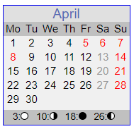
3. The Midnight Cry - Loughborough
March 21
1844
April 20
1844
July 21
1844
Oct 22
1844
March/April
1845
First
Disappoint-
ment
Tarrying Time
3 Months
Sunset
Midnight
Dawn
Sunset
Although the Karaite reckoning which indicated the end of the Jewish year at the new moon on April 17, 1844, was favored in the major Millerite periodicals, the majority of believers looked to March 21, 1844 as the time for Christ's return. Outside the Millerite movement March 21 was well known and there was "a very general expectation of an entire overthrow of the whole system of Adventism" on that date. - Seventh Month Movement, the Midnight Cry and the Karaite Calendar, 28

Slide 16
3. The Midnight Cry - Loughborough
He said, "Then it is just the midnight now, and I am here with the midnight cry." In a few sentences he explained that it was the fall of 457 that the decree went forth, and so they were short six months in their reckoning, showing them that the 2300 days would terminate Oct. 22, 1844, instead of the spring as they had previously supposed. Then, in a strong voice he said, "Behold the Bridegroom cometh on the tenth day of the seventh month, Oct. 22, 1844. Go ye out to meet Him."

Slide 17
3. The Midnight Cry - Loughborough
As he uttered those words the mighty power of God swept over that camp, prostrating many to the ground, suddenly turning that camp into a most powerful confessing and testimony meeting. That was only the beginning of the midnight cry message. Of that movement Brother Southard said, in the Midnight Cry, the paper of which he was the editor, "It swept over the land with the velocity of a tornado, and it reached hearts in different and distant places almost simultaneously, and in a manner which can be accounted for only on the supposition that God was in it." J.N. Loughborough, The Great Second Advent Movement, p 523

Slide 18
3. The Midnight Cry - Snow
The 6000 years
The 2520 year prophecy
The 2300 year prophecy
The Seventy Weeks of Daniel Nine – 457BC, 27AD, 34AD
The year of the crucifixion being AD 31
Friday is the day Christ died that year.
The Karaite Jewish Calendar being the correct calendar by which to determine the biblical festivals and thus determine the date Oct 22 1844 as the date for the day of atonement that year.
The giving of the law on Mt Sinai was a type of the outpouring of the Holy Spirit on the day of Pentecost.
The coming of Christ is connected to the Jubilee and then the anti type of the feast of tabernacles will occur with the marriage supper of the Lamb.
The period of the 1000 years after the coming of Christ is a Millennial Sabbath of Rest.

Slide 19
3. The Midnight Cry - Snow
The word Caraite signifies "one period in the law." These accuse the Rabbins of having departed from the law, and conformed to the customs of the heathen; and the charge is just, as they regulate their year by the vernal equinox, in imitation of the Romans; whereas the law says nothing of the vernal equinox; Samuel Snow, The True Midnight Cry August 22, 1844.
According to the Rabbinical reckoning, the Passover occurred on the day before the Sabbath in A.D. 33, and not for several years before and after. But according to the Caraite reckoning, the Passover occurred on that day in A. D. 31. Therefore that was the year of the crucifixion. The True Midnight Cry August 22, 1844

Slide 20
3. The Midnight Cry – GC88
It was the discovery of the correct time, in connection with other scripture testimony, that led to the movement known as the “midnight cry” of 1844. And to this day the computation of the prophetic periods placing the close of the 2300 days in the autumn of 1844, stands without impeachment. {GC88 682.1}

Slide 21
4. What Was Ellen White Shown about the Midnight Cry?
While I was praying at the family altar, the Holy Ghost fell upon me, and I seemed to be rising higher and higher, far above the dark world. I turned to look for the Advent people in the world, but could not find them, when a voice said to me, "Look again, and look a little higher." At this I raised my eyes, and saw a straight and narrow path, cast up high above the world. On this path the Advent people were traveling to the city, which was at the farther end of the path. They had a bright light set up behind them at the beginning of the path, which an angel told me was the midnight cry. This light shone all along the path and gave light for their feet so that they might not stumble. If they kept their eyes fixed on Jesus, who was just before them, leading them to the city, they were safe. EW 14.

Slide 22
5. The Midnight Cry – Light for our feet
The 6000 years
The 2520 year prophecy
The 2300 year prophecy
The Seventy Weeks of Daniel Nine – 457BC, 27AD, 34AD
The year of the crucifixion being AD 31
Friday is the day Christ died that year.
The Karaite Jewish Calendar being the correct calendar by which to determine the biblical festivals and thus determine the date Oct 22 1844 as the date for the day of atonement that year.
The giving of the law on Mt Sinai was a type of the outpouring of the Holy Spirit on the day of Pentecost.
The coming of Christ is connected to the Jubilee and then the anti type of the feast of tabernacles will occur with the marriage supper of the Lamb.
The period of the 1000 years after the coming of Christ is a Millennial Sabbath of Rest.

Slide 23
6. Behold the Bridegroom Cometh
Then, in a strong voice he said, "Behold the Bridegroom cometh on the tenth day of the seventh month, Oct. 22, 1844. Go ye out to meet Him."
As he uttered those words the mighty power of God swept over that camp, prostrating many to the ground, suddenly turning that camp into a most powerful confessing and testimony meeting. That was only the beginning of the midnight cry message. Of that movement Brother Southard said, in the Midnight Cry, the paper of which he was the editor, "It swept over the land with the velocity of a tornado, and it reached hearts in different and distant places almost simultaneously, and in a manner which can be accounted for only on the supposition that God was in it." J.N. Loughborough, The Great Second Advent Movement, p 523

Slide 24
6. Behold the Bridegroom Cometh - Channel
I saw that God had children who do not see and keep the Sabbath. They have not rejected the light upon it. And at the commencement of the time of trouble, we were filled with the Holy Ghost as we went forth and proclaimed the Sabbath more fully. This enraged the churches and nominal Adventists, as they could not refute the Sabbath truth. And at this time God's chosen all saw clearly that we had the truth, and they came out and endured the persecution with us. I saw the sword, famine, pestilence, and great confusion in the land. The wicked thought that we had brought the judgments upon them, and they rose up and took counsel to rid the earth of us, thinking that then the evil would be stayed. {EW 33.2}

Slide 25
6. Behold the Bridegroom Cometh - Channel
And afterward Moses and Aaron went in, and told Pharaoh, Thus saith the LORD God of Israel, Let my people go, that they may hold a feast unto me in the wilderness. And Pharaoh said, Who is the LORD, that I should obey his voice to let Israel go? I know not the LORD, neither will I let Israel go. And they said, The God of the Hebrews hath met with us: let us go, we pray thee, three days' journey into the desert, and sacrifice unto the LORD our God; lest he fall upon us with pestilence, or with the sword. Exodus 5:1-3

Slide 26
7. The Sealing
Arise up and stand, behold the number of those that be sealed in the feast of the Lord; 2 Esdras 2:38
I then saw the Word of God pure and unadulterated, and that we must answer for the way we received the truth proclaimed from that Word. I saw that it had been a hammer to break the flinty heart in pieces, and a fire to consume the dross and tin, that the heart might be pure and holy. I saw that the Apocrypha was the hidden book, and that the wise of these last days should understand it. I saw that the Bible was the standard book, that will judge us at the last day. 15MR 66. {Ms4-1850 (January 28, 1850) par. 13}
The 2nd book of Esdras, contains very important truths for those that keep God's law and commandments; they will probably benefit no others, 12:37,38. – Joseph bates The Sealing page 66

Slide 27
Midnight Cry Calendar

