Slide 1
The Nature of Christ and the Atonement

Slide 2
Putting to death the Emnity
But now in Christ Jesus you who once were far off have been brought near by the blood of Christ. For He Himself is our peace, who has made both one, and has broken down the middle wall of separation, having abolished in His flesh the enmity, that is, the law of commandments contained in ordinances, so as to create in Himself one new man from the two, thus making peace, and that He might reconcile them both to God in one body through the cross, thereby putting to death the enmity. (Eph 2:13-16)

Slide 3
Making God and Man One.
But all the world lieth in wickedness, yet the God of peace speaks peace to every soul. For Christ, the Prince of peace, "our peace," hath made both God and man one, having abolished in his flesh the enmity, to make in himself of two—God and man—one new man, so making peace—"making peace through the blood of his cross." Eph. 2:14, 15, Col. 1:20. "And, having made peace through the blood of his cross," he "came and preached peace to you which were afar off, and to them that were nigh:" peace to you all. Therefore, always and forevermore, his salutation to every soul is, Peace to thee. And all from God the Father, and from our Lord Jesus Christ! {August 29, 1899 ATJ, ARSH 556.26}

Slide 4
A.T. Jones
without the divine nature, how can divine unity ever be found among men? As they are naturally, men have not the Spirit of unity, but the spirit of enmity. "The carnal mind is enmity against God." And being enmity against God, it results in putting men at enmity with one another. And so men always and everywhere have drawn lines, and built up walls, of separation among themselves,—national lines, tribal lines, aristocratic lines, society lines, color lines, sectarian lines, etc., etc., etc. {January 17, 1899 ATJ, ARSH 40.5}
But Jesus Christ is our peace, who has made both God and man one, and hath broken down the middle wall of partition, having abolished in his flesh the enmity, to make in himself one new man, so making peace;

Slide 5
A.T. Jones
and that he might reconcile both Jew and Gentile unto God in one body by the cross, having slain the enmity thereby; for through him both Jew and Gentile have access by one Spirit unto the Father. Eph. 2:13-18. {January 17, 1899 ATJ, ARSH 40.6}
The cross of Christ destroys the enmity against God, and also breaks down all the lines of separation and walls of partition which, by the working of this enmity, men have made among themselves; and the "one Spirit" takes all these in whom the enmity has been destroyed by beholding the cross of Christ, and binds them all in "one body" in divine unity. {January 17, 1899 ATJ, ARSH 40.7}

Slide 6
Law contained in ordinances
Eph 2:15 having abolished in His flesh the enmity, that is, the law of commandments contained in ordinances, [Dogma] so as to create in Himself one new man from the two, thus making peace,

Slide 7
Dogma - LXX
• Ezra 6:8 – Persian decree to build the temple.
• Ezekiel 20:26 from v 25 – God gave them up to statutes that were not good. God spoiled them in their own decrees.
• Daniel 2:13 – Death decree to slay wise men.
• Daniel 3:10,29 – Death decree on plain of Dura by king of Babylon.
• Daniel 4:6 – Decree to bring in all the wise men.
• Daniel 6:8,10,12,13,15,26 – Sign the death decree to worship no God but the king.

Slide 8
Dogma NT
• Luke 2:1 – A decree of Caesar.
• Acts 16:4 – A decree of the Apostles to limit what is taught from the Law of Moses due to the excessive position of some of the Jews on this question.
• Acts 17:7 – A decree of Caesar.
• Ephesians 2:15 – Christ has abolished the commandments contained in (human) decrees.
• Colossians 2:14 – Blotting out the human decrees that were against us.

Slide 9
Where did the Enmity come from?
Rom 5:12 Therefore, just as through one man sin entered the world, and death through sin, and thus death spread to all men, because all sinned—
If I have covered my transgressions as Adam, by hiding my iniquity in my bosom, Job 31:33
Rom 5:16 And not as it was by one that sinned, so is the gift: for the judgment was by [out of] one to condemnation, but the free gift is of many offences unto justification.
Gen 3:12 And the man said, The woman whom thou gavest to be with me, she gave me of the tree, and I did eat.

Slide 10
Source of Adam’s Enmity
An expression of sadness came over the face of Adam. He appeared astonished and alarmed. To the words of Eve he replied that this must be the foe against whom they had been warned; and by the divine sentence she must die. PP 56

Slide 11
The Event of Adam’s Enmity
Adam understood that his companion had transgressed the command of God, disregarded the only prohibition laid upon them as a test of their fidelity and love. There was a terrible struggle in his mind. He mourned that he had permitted Eve to wander from his side. But now the deed was done; he must be separated from her whose society had been his joy. How could he have it thus? Adam had enjoyed the companionship of God and of holy angels. He had looked upon the glory of the Creator. He understood the high destiny opened to the human race should they remain faithful to God. Yet all these blessings were lost sight of in the fear of losing that one gift which in his eyes outvalued every other. Love, gratitude, loyalty to the Creator--all were overborne by love to Eve. She was a part of himself, and he could not endure the thought of separation. PP 56

Slide 12
Adam’s Justice System.
To the words of Eve he replied that this must be the foe against whom they had been warned; and by the divine sentence she must die. PP 56
Gen 3:12 And the man said, The woman whom thou gavest to be with me, she gave me of the tree, and I did eat.
Adam judged God through His Son worthy of death.
Job 31:33 If I covered my transgressions as Adam, by hiding mine iniquity in my bosom:

Slide 13
Projection
Psychological projection is a defence mechanism in which the human ego defends itself against unconscious impulses or qualities (both positive and negative) by denying their existence in themselves while attributing them to others.
https://en.wikipedia.org/wiki/Psychological_projection

Slide 14
Enmity manifested as fear
And they heard the voice of the LORD God walking in the garden in the cool of the day: and Adam and his wife hid themselves from the presence of the LORD God amongst the trees of the garden. And the LORD God called unto Adam, and said unto him, Where art thou? And he said, I heard thy voice in the garden, and I was afraid, because I was naked; and I hid myself.(Gen 3:8-10)

Slide 15
Israel’s enmity as fear
Exo 24:17 And the sight of the glory of the LORD was like devouring fire on the top of the mount in the eyes of the children of Israel.
And the people spake against God, and against Moses, Wherefore have ye brought us up out of Egypt to die in the wilderness? for there is no bread, neither is there any water; and our soul loatheth this light bread.(Num 21:5)

Slide 16
How does Christ slay the Enmity?
Heb 10:5 Wherefore when he cometh into the world, he saith, Sacrifice and offering thou wouldest not, but a body hast thou prepared me:
But now in Christ Jesus you who once were far off have been brought near by the blood of Christ. For He Himself is our peace, who has made both one, and has broken down the middle wall of separation, having abolished in His flesh the enmity, that is, the law of commandments contained in ordinances, so as to create in Himself one new man from the two, thus making peace, and that He might reconcile them both to God in one body through the cross, thereby putting to death the enmity. (Eph 2:13-16)

Slide 17
A Completed Atonement
John 17:4 I have glorified You on the earth. I have finished the work which You have given Me to do.
Psalm 40:6 Sacrifice and offering You did not desire; My ears You have opened. Burnt offering and sin offering You did not require.

Slide 18
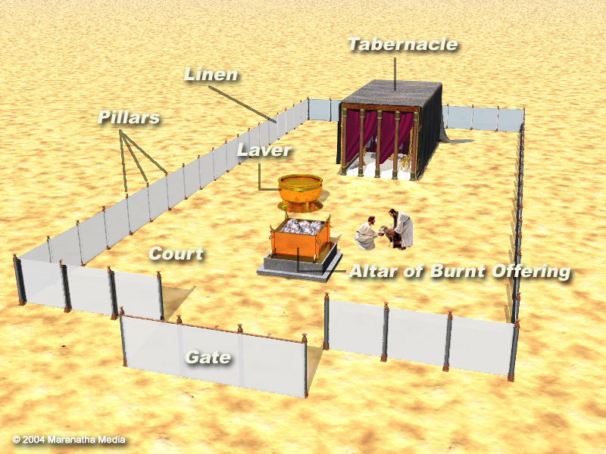
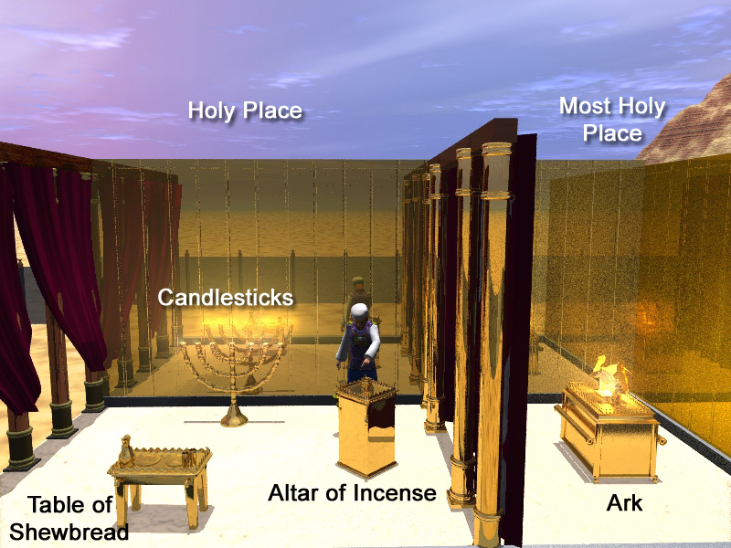
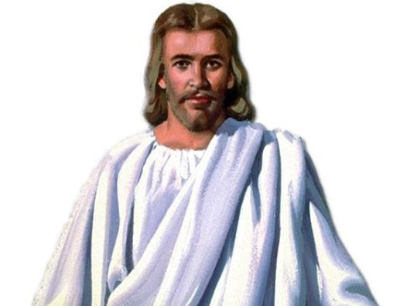
The Map for Following Jesus Through the Plan of Salvation
“Your WAY O God is in the Sanctuary” Psalms 77:13
I am the Way…
Court
Holy Place
Most Holy Place
Washed by the Word Eph 5:26
I am the light John 8:12
Behold the Lamb Jn 1:29
Advocate, Jesus Christ 1 Jn 2:1
Judge
John 5:22
I am the door John 10:9
I am the bread John 6:35
Creator
Michael
Messiah
Life
Priest
Judge
King

Slide 19
The Veil of His Flesh
Holy Place
Most Holy Place
Court
Veil

Slide 20
The Enmity Slain
Men are "laden with iniquity." So also was he: for, "The Lord hath laid on him the iniquity of us all." {November 16, 1897 ATJ, ARSH 728.5}
The flesh of men is sinful flesh. His flesh was just like it; for God sent "his own Son in the likeness of sinful flesh." "He hath made him to be sin." {November 16, 1897 ATJ, ARSH 728.6}
But thank the Lord, we do not have to go this way alone. "Our old man is crucified with him." He was made "in the likeness of sinful flesh" for us. He was "in all things made like unto his brethren." He "was in all points tempted like as we are." "The Lord hath laid on him the iniquity of us all." And he was crucified. He was crucified for us. He was crucified as us. He was "the last Adam." He was humanity. And in him the old Adam—the old, sinful humanity—was crucified. And "our old man is crucified with him," in order "that the body of sin might be destroyed, that henceforth we should not serve sin." {April 26, 1898 ATJ, ARSH 268.7}

Slide 21
Christ the Way
Way is in the Sanctuary
Holy Place
Most Holy Place
Court
Human Nature
Meeting Man at the point of Enmity
Divine Nature
Veil of Flesh

Slide 22
Christ the Way
Way is in the Sanctuary
Holy Place
Most Holy Place
Court
Enmity
Meeting Man at the point of Enmity
Divine Nature
Mirror

Slide 23
Christ the Way
Way is in the Sanctuary
Holy Place
Most Holy Place
Court
Enmity
Meeting Man at the point of Enmity
Mediator
Veil of Christ’s Flesh Absorbs enmity

Slide 24
Jesus absorbs human perception of God
I saw four angels who had a work to do on the earth, and were on their way to accomplish it. Jesus was clothed with priestly garments. He gazed in pity on the remnant, then raised His hands, and with a voice of deep pity cried, "My blood, Father, My blood, My blood, My blood!" Then I saw an exceeding bright light come from God, who sat upon the great white throne, and was shed all about Jesus. Then I saw an angel with a commission from Jesus, swiftly flying to the four angels who had a work to do on the earth, and waving something up and down in his hand, and crying with a loud voice, "Hold! Hold! Hold! Hold! until the servants of God are sealed in their foreheads." {EW 38.1}

Slide 25
Jesus absorbs human perception of God
God permits His Son to be delivered up for our offenses. He Himself assumes toward the Sin Bearer the character of a judge, divesting Himself of the endearing qualities of a father. {TM 245.2}

Slide 26
And there was given me a reed like unto a rod: and the angel stood, saying, Rise, and measure the temple of God, and the altar, and them that worship therein. But the court which is without the temple leave out, and measure it not; for it is given unto the Gentiles: and the holy city shall they tread under foot forty and two months.(Rev 11:1-2)
Holy Place
Most Holy Place
Court
Enmity
Court Left Out
Enmity Slain
Mediator
Heb 9:8 The Holy Ghost this signifying, that the way into the holiest of all was not yet made manifest, while as the first tabernacle was yet standing:

Slide 27
Obtained Eternal Redemption for Us
But Christ being come an high priest of good things to come, by a greater and more perfect tabernacle, not made with hands, that is to say, not of this building; Neither by the blood of goats and calves, but by his own blood he entered in once into the holy place, having obtained eternal redemption for us. For if the blood of bulls and of goats, and the ashes of an heifer sprinkling the unclean, sanctifieth to the purifying of the flesh: How much more shall the blood of Christ, who through the eternal Spirit offered himself without spot to God, purge your conscience from dead works to serve the living God? And for this cause he is the mediator of the new testament, that by means of death, for the redemption of the transgressions that were under the first testament, they which are called might receive the promise of eternal inheritance.(Heb 9:11-15)

