Slide 1

The Nature of the Atonement

Slide 2
George Fifield
The word “atonement” means at-one-ment. Sin had brought misery, and misery had brought a misunderstanding of God’s character. Thus men had come to hate God instead of loving him; and hating him, the one Father, men also hated man, their brother. Thus, instead of the one family and the one Father, men were separated from God and from each other, and held apart by hatred and selfishness. There must be an atonement. – God is Love, page 48

Slide 3
George Fifield
An atonement can be made only by God’s so revealing his love, in spite of sin and sorrow, that men’s hearts will be touched to tenderness; and they, being delivered from Satan’s delusions, may see how fully and terribly they have misunderstood the divine One, and so have done despite to the Spirit of his grace. Thus they may be led, as returning brethren, to come back to the Father’s house in blissful unity.– God is Love, page 48

Slide 4
George Fifield
The atonement is not to appease God’s wrath, so that men dare come to him, but it is to reveal his love, so that they will come to him. It was not Christ reconciling God unto the world, but God in Christ reconciling the world unto himself. It is nowhere said that God needed to be reconciled unto us; he says, “I have not forsaken you, but you have forsaken me.” God is Love, page 48

Slide 5
E.J Waggoner
“But,” someone will say, “You have made the reconciliation all on the part of men; I have always been taught that the death of Christ reconciled God to man; that Christ died to satisfy God’s justice, and to appease Him.” Well, we have left the matter of reconciliation just where the Scriptures have put it; and while they have much to say about the necessity for man to be reconciled to God, they never once hint of such a thing as the necessity for God to be reconciled to man. To intimate the necessity for such a thing is to bring a grave charge against the character of God. The idea has come into the Christian Church from the Papacy, which in turn brought it from Paganism, in which the only idea of God was of a being whose wrath must be appeased by a sacrifice. E.J. Waggoner, Present Truth UK, September 21, 1893, page 386.7

Slide 6
E.J Waggoner
The idea of a propitiation or sacrifice is that there is wrath to be appeased. But take particular notice that it is we who require the sacrifice, and not God. He provides the sacrifice. The idea that God’s wrath has to be propitiated in order that we may have forgiveness finds no warrant in the Bible. It is the height of absurdity to say that God is so angry with men that He will not forgive them unless something is provided to appease His wrath, and that therefore He Himself offers the gift to Himself, by which He is appeased... The Christian idea of propitiation is that set forth above. The heathen idea, which is too often held by professed Christians, is that men must provide a sacrifice to appease the wrath of their god.

Slide 7
E.J Waggoner
All heathen worship is simply a bribe to their gods to be favourable to them. If they thought that their gods were very angry with them, they would provide a greater sacrifice, and so human sacrifices were offered in extreme cases. They thought, as the worshipers of Siva in India do to-day, that their god was gratified by the sight of blood. The persecution that was carried on in so-called Christian countries in times past and is to some extent even now, is but the outcropping of this heathen idea of propitiation. Ecclesiastical leaders imagine that salvation is by works and that men by works can atone for sin, and so they offer the one whom they think rebellious as a sacrifice to their god not to the true God, because He is not pleased with such sacrifices. Present Truth UK, August 30, 1894, page 550

Slide 8
Luther
You my son must pay the world’s iniquity. The law growls “All right. If your Son is taking the sin of the world, I see no sins anywhere else but in Him. He shall die on the cross” And the law kills Christ, but we go free. – Luther Commentary on Galatians.

Slide 9
J.H Waggoner
He [the wrong doer] deserves punishment (the infliction of a penalty) for the action; and if justice is ever vindicated, he will be punished, according to his intention and his commission of a great moral wrong. The admission that all sin will be punished makes necessary the admission of a future judgment; for without that, justice will never be vindicated, and our aspirations for the right will never be satisfied. {1884 JHW, The Atonement in the Light of Nature and Revelation 24.1}

Slide 10
Satisfaction of Divine Justice
In addition to penal substitution, any biblical adequate atonement theory must include the notion of propitiation, that is to say, the appeasement of God’s just wrath against sin. The source of God’s wrath is His retributive justice, and so appeasement of wrath is fundamentally a matter of satisfaction of divine justice. How are the demands of divine justice satisfied? Biblically speaking, the satisfaction of God’s justice primarily takes place, not as Anslem thought, through compensation, but through punishment.
William Lane Craig, Atonement and the Death of Christ page 195

Slide 11
Satan’s demand of God
In the opening of the great controversy, Satan had declared that the law of God could not be obeyed, that justice was inconsistent with mercy, and that, should the law be broken, it would be impossible for the sinner to be pardoned. Every sin must meet its punishment, urged Satan; and if God should remit the punishment of sin, He would not be a God of truth and justice. DA 761.4

Slide 12
George Fifield
An atonement can be made only by God’s so revealing his love, in spite of sin and sorrow, that men’s hearts will be touched to tenderness; and they, being delivered from Satan’s delusions, may see how fully and terribly they have misunderstood the divine One, and so have done despite to the Spirit of his grace. Thus they may be led, as returning brethren, to come back to the Father’s house in blissful unity.– God is Love, page 48

Slide 13
A Completed Atonement
John 17:4 I have glorified You on the earth. I have finished the work which You have given Me to do.
Psalm 40:6 Sacrifice and offering You did not desire; My ears You have opened. Burnt offering and sin offering You did not require.

Slide 14
The Typology
"This shall be a statute forever for you: In the seventh month, on the tenth day of the month, you shall afflict your souls, and do no work at all, whether a native of your own country or a stranger who dwells among you. For on that day the priest shall make atonement for you, to cleanse you, that you may be clean from all your sins before the LORD. It is a sabbath of solemn rest for you, and you shall afflict your souls. It is a statute forever. And the priest, who is anointed and consecrated to minister as priest in his father's place, shall make atonement, and put on the linen clothes, the holy garments; then he shall make atonement for the Holy Sanctuary, and he shall make atonement for the tabernacle of meeting and for the altar, and he shall make atonement for the priests and for all the people of the assembly. This shall be an everlasting statute for you, to make atonement for the children of Israel, for all their sins, once a year." And he did as the LORD commanded Moses. (Lev 16:29-34)

Slide 15
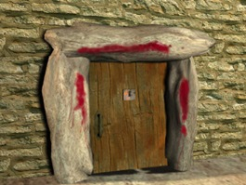
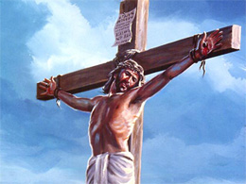
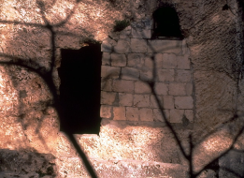
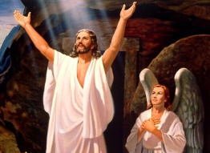
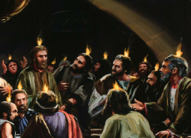
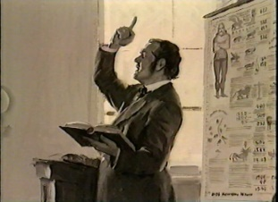
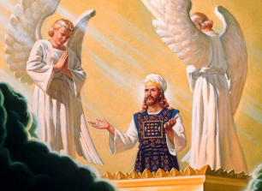

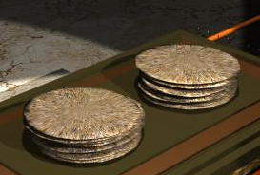
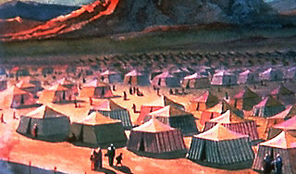

Type and Anti-type
Spring Feasts
Autumn Feasts
50 Days (Seven Sabbaths + 1 Day)
Passover
Nissan 14
First Month
Lev 23:5; Ex 12
Unleavened Bread
Nissan 15-21
First Month
Lev 23:6-8
First Fruits
Nissan 16
First Month
Lev 23:9-14
Feast of Weeks
Sivan 6
Third Month
Lev 23:15-21
Trumpets
Tishri 1
Seventh Month
Lev 23:23-26
Day of Atonement
Tishri 10
Seventh Month
Lev 23:27-32
Feast of Tabernacles
Tishri 15-21
Seventh Month
Lev 23:33-36
Crucifixion
1 Cor 5:7
Christ in Tomb
John 6:51; John 12:24
Resurrection
1 Cor 15:20
Pentecost
Acts 2:1-4; Rev 5:6
Second Advent Movement
Rev 14:6,7
Pre-Advent Judgement
Dan 7:9,10;
Rev 11:19; 14:7
Homegoing at Second Advent
Rev 14:14-16
1844
Court Ministry
First Apartment Ministry
Second Apartment Ministry

Slide 16
The Typology
"This shall be a statute forever for you: In the seventh month, on the tenth day of the month, you shall afflict your souls, and do no work at all, whether a native of your own country or a stranger who dwells among you. For on that day the priest shall make atonement for you, to cleanse you, that you may be clean from all your sins before the LORD. It is a sabbath of solemn rest for you, and you shall afflict your souls. It is a statute forever. And the priest, who is anointed and consecrated to minister as priest in his father's place, shall make atonement, and put on the linen clothes, the holy garments; then he shall make atonement for the Holy Sanctuary, and he shall make atonement for the tabernacle of meeting and for the altar, and he shall make atonement for the priests and for all the people of the assembly. This shall be an everlasting statute for you, to make atonement for the children of Israel, for all their sins, once a year." And he did as the LORD commanded Moses. (Lev 16:29-34)

Slide 17
When is Atonement Completed?
Final Atonement of Adventism
Atonement of Christianity
Passover
Nissan 14
First Month
Lev 23:5; Ex 12
Day of Atonement
Tishri 10
Seventh Month
Lev 23:27-32
Crucifixion
1 Cor 5:7
Pre-Advent Judgement
Dan 7:9,10;
Rev 11:19; 14:7
1844

Slide 18
Atonement begun at the Cross not ended
In the one sacrifice of Christ, all the daily sacrifices, and the sacrifices of all the yearly atonement days, found their complete fulfillment. Christ was offered "once for all." But since in the figure the atonement was not made when the offering was slain, but was made with his blood afterwards, so it must be in the reality. The death of the offered victim was only the preparation for the atonement; it furnished the means by which the atonement could be made; and as in the figure the blood was taken into the sanctuary, in order to make the atonement, so Christ has entered into the holy places in Heaven, with his own blood to make an atonement for his people. We cannot here go into the particulars of the atonement, but can merely show that the atonement was only begun and was not completed on the cross. {June 15, 1888 EJW, SITI 362.5}

Slide 19
Work of Reconciliation Given to Us
Now all things are of God, who has reconciled us to Himself through Jesus Christ, and has given us the ministry of reconciliation, that is, that God was in Christ reconciling the world to Himself, not imputing their trespasses to them, and has committed to us the word of reconciliation. Now then, we are ambassadors for Christ, as though God were pleading through us: we implore you on Christ's behalf, be reconciled to God. (2Co 5:18-20)

Slide 20
When is Atonement Completed?
Final Atonement of Adventism
Christ’s Life Reveals Father
Our Lives Reveal Christ
Passover
Nissan 14
First Month
Lev 23:5; Ex 12
Day of Atonement
Tishri 10
Seventh Month
Lev 23:27-32
Crucifixion
1 Cor 5:7
Pre-Advent Judgement
Dan 7:9,10;
Rev 11:19; 14:7
1844

Slide 21
Christ in You the Hope of Glory
1John 4:17 Love has been perfected among us in this: that we may have boldness in the day of judgment; because as He is, so are we in this world.
Christ is waiting with longing desire for the manifestation of Himself in His church. When the character of Christ shall be perfectly reproduced in His people, then He will come to claim them as His own. {COL 69.1}
It is the darkness of misapprehension of God that is enshrouding the world. Men are losing their knowledge of His character. It has been misunderstood and misinterpreted. At this time a message from God is to be proclaimed, a message illuminating in its influence and saving in its power. His character is to be made known. Into the darkness of the world is to be shed the light of His glory, the light of His goodness, mercy, and truth. {COL 415.3}

Slide 22
Faces lighted Up
Servants of God, with their faces lighted up and shining with holy consecration, will hasten from place to place to proclaim the message from heaven. By thousands of voices, all over the earth, the warning will be given. Miracles will be wrought, the sick will be healed, and signs and wonders will follow the believers. Satan also works, with lying wonders, even bringing down fire from heaven in the sight of men. Revelation 13:13. Thus the inhabitants of the earth will be brought to take their stand. {GC 612.1}
The message will be carried not so much by argument as by the deep conviction of the Spirit of God. The arguments have been presented. The seed has been sown, and now it will spring up and bear fruit. The publications distributed by missionary workers have exerted their influence, yet many whose minds were impressed have been prevented from fully comprehending the truth or from yielding obedience. Now the rays of light penetrate everywhere, the truth is seen in its clearness, and the honest children of God sever the bands which have held them. Family connections, church relations, are powerless to stay them now. Truth is more precious than all besides. Notwithstanding the agencies combined against the truth, a large number take their stand upon the Lord's side. {GC 612.2}

