Slide 1
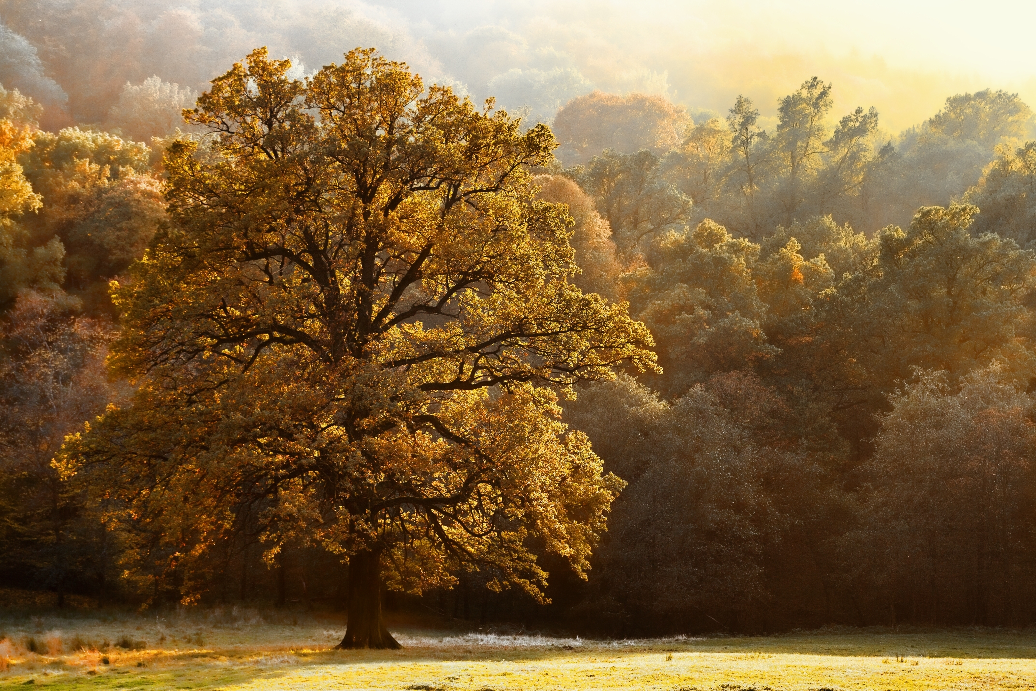
Out of the Cities

Slide 2
As soon as possible…
Get out of the cities as soon as possible and purchase a little piece of land where you can have a garden, where your children can watch the flowers growing and learn from them lessons of simplicity and purity.--2SM 356 (1903). {LDE 95.1}

Slide 3
Fire and Brimstone…
Out of the cities, is my message at this time. Be assured that the call is for our people to locate miles away from the large cities. One look at San Francisco as it is today would speak to your intelligent minds, showing you the necessity of getting out of the cities. . . . {LDE 95.2}
The Lord calls for His people to locate away from the cities, for in such an hour as ye think not, fire and brimstone will be rained from heaven upon these cities. Proportionate to their sins will be their visitation. When one city is destroyed, let not our people regard this matter as a light affair, and think that they may, if favorable opportunity offers, build themselves homes in that same destroyed city. . . . {LDE 95.3}

Slide 4
Proportionate to their sins will be their visitation.
Exo 20:5 you shall not bow down to them nor serve them. For I, the LORD your God, am a jealous God, visiting the iniquity of the fathers upon the children to the third and fourth generations of those who hate Me,
Gal 6:7 Do not be deceived, God is not mocked; for whatever a man sows, that he will also reap.
Psa 9:16 The LORD is known by the judgment He executes; The wicked is snared in the work of his own hands. Meditation. Selah

Slide 5
Invisible Influence
The influence of every man's thoughts and actions surrounds him like an invisible atmosphere, which is unconsciously breathed in by all who come in contact with him. This atmosphere is frequently charged with poisonous influences, and when these are inhaled, moral degeneracy is the sure result. {5T 111.1}

Slide 6
Man’s dominion effect on nature
In drooping flower and falling leaf Adam and his companion witnessed the first signs of decay. Vividly was brought to their minds the stern fact that every living thing must die. Even the air, upon which their life depended, bore the seeds of death. {Ed 26.3}
Continually they were reminded also of their lost dominion. Among the lower creatures Adam had stood as king, and so long as he remained loyal to God, all nature acknowledged his rule; but when he transgressed, this dominion was forfeited. The spirit of rebellion, to which he himself had given entrance, extended throughout the animal creation. Thus not only the life of man, but the nature of the beasts, the trees of the forest, the grass of the field, the very air he breathed, all told the sad lesson of the knowledge of evil. {Ed 26.4}

Slide 7
Transgression affects the earth.
The earth is also defiled under its inhabitants, Because they have transgressed the laws, Changed the ordinance, Broken the everlasting covenant. Therefore the curse has devoured the earth, And those who dwell in it are desolate. Therefore the inhabitants of the earth are burned, And few men are left. (Isa 24:5-6)
Gen 4:11 So now you are cursed from the earth, which has opened its mouth to receive your brother's blood from your hand.
Lev 18:25 For the land is defiled; therefore I visit the punishment of its iniquity upon it, and the land vomits out its inhabitants.

Slide 8
We must leave the cities…
As God's commandment-keeping people we must leave the cities. As did Enoch, we must work in the cities but not dwell in them.--Ev 77, 78 (1899)
The cities are to be worked from outposts. Said the messenger of God, "Shall not the cities be warned? Yes, not by God's people living in them but by their visiting them, to warn them of what is coming upon the earth."--2SM 358 (1902). {LDE 96.3}

Slide 9
Leave the cities…
We say again, "Out of the cities." Do not consider it a great deprivation that you must go into the hills and mountains, but seek for that retirement where you can be alone with God, to learn His will and way. . . . {LDE 97.1}
I urge our people to make it their lifework to seek for spirituality. Christ is at the door. This is why I say to our people, "Do not consider it a privation when you are called to leave the cities and move out into the country places. Here there await rich blessings for those who will grasp them. By beholding the scenes of nature, the works of the Creator, by studying God's handiwork, imperceptibly you will be changed into the same image."--2SM 355, 356 (1908). {LDE 97.2}

