Slide 1
Sabbath Vibration

Slide 2
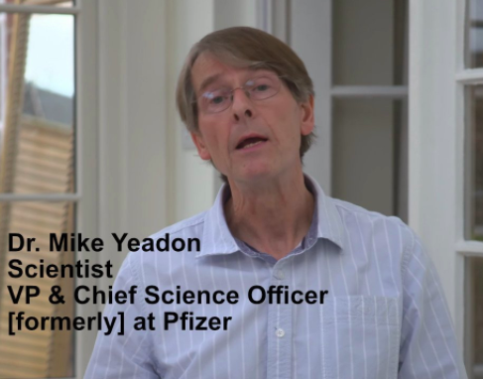
Some Context
May 19, 2021– Dozens of medical experts issued a warning this month about COVID-19 vaccines, slamming the jabs as “unnecessary, ineffective and unsafe” and likely to lead to “foreseeable mass deaths.”
“In short, the available evidence and science indicate that COVID-19 vaccines are unnecessary, ineffective and unsafe,” Doctors for COVID-19 Ethics said in an open letter two weeks ago. “Actors authorizing, coercing or administering experimental COVID-19 vaccination are exposing populations and patients to serious, unnecessary, and unjustified medical risks.”
Doctors for COVID-19 Ethics, a group co-founded by former Pfizer vice president Michael Yeadon, counts more than 160 medical experts from around the world among its signatories. Other founding members include Prof. Sucharit Bhakdi MD, former chair of the Institute of Medical Microbiology and Hygiene at Johannes Gutenberg University of Mainz, Germany and Dr. Wolfgang Wodarg, former head of the health committee of the Parliamentary Assembly of the Council of Europe.

Slide 3
Some Context
The doctors have penned multiple letters to the European Medicines Agency on COVID-19 vaccine issues and are facing censorship, though their most recent letter can be found archived here. [blocked]. … Their testimony reflects growing calls from experts, like Dr. Janci Chunn Lindsay
In their letter earlier this month, Doctors for COVID-19 Ethics emphasized serious health implications of the vaccines for both the healthy and ill, saying that the shots “are not safe, either for recipients or for those who use them or authorize their use.”
They pointed to risks of “lethal and non-lethal disruptions of blood clotting including bleeding disorders, thrombosis in the brain, stroke and heart attack,” “antibody-dependent enhancement of disease,” autoimmune reactions, and potential effects of “vaccine impurities due to rushed manufacturing and unregulated production standards.” and Dr. Peter McCullough, to halt the jabs.

Slide 4
VAERS – US Stats – Vaccine Deaths

Slide 5
Reaction - Snopes
Through much of the COVID-19 pandemic, Yeadon has peddled conspiracy theories surrounding vaccines, previously writing that “there is absolutely no need for vaccines to extinguish the pandemic” and arguing that it’s possible women who receive the vaccine could become infertile. Fringe website and individuals who contest the safety and efficacy of available vaccines in one form or another inaccurately report Yeadon’s former title as “vice president and chief science officer for Pfizer,” one of three pharmaceutic companies whose COVID-19 vaccines have been approved in the U.S. under emergency use authorizations. But this title is inaccurate. As Snopes has previously reported, Yeadon worked in a drug discovery research unit at Pfizer that worked on allergy and respiratory medical research. The division he ran had nothing to do with vaccines or infectious disease and, at the time of its closure in 2011, was focused on developing compounds that targeted asthma and chronic obstructive pulmonary disease.

Slide 6
Interview – “In Harms Way” Dr Mike Yeadon with Del Bigtree
I am not a religious man but when I realised the magnitude of what is unfolding I realised I was looking into the face of evil

Slide 7
Lockdowns…
98 of the 193 countries of the world went into Lockdown or states within these countries. - https://en.wikipedia.org/wiki/COVID-19_lockdowns
This included all of the western world except Sweden.
Most of these occurred around March of 2020.
Australia – March 23,2020

Slide 8
No Church Attendance Allowed in Lockdowns
April 25 1980, Adventist Church Accepts Trinity
March 2020 – Church taken captive by Secular humanism
40 Years Since the Begotten Son of God officially crucified in the Adventist Church

Slide 9
Adventist Review June 2, 2021
Light at the End of the Tunnel
On Wednesday, March 11, 2020, the World Health Organization (WHO) director-general, … declared the novel coronavirus (COVID-19) outbreak a global pandemic. More than a year and 3 million-plus deaths later, the situation remains disruptive and challenging.
Regardless of the consequences, the COVID-19 vaccines shine light at the end of the tunnel. Worldwide, at the time of writing, 1 billion shots have been given. Vaccination centers have been set up throughout the U.S. to provide accessibility to those more than 16 years of age….
Although vaccination against COVID-19 is strongly recommended by the Adventist Church, it’s not mandated for church members. The decision is left to each individual’s conscience and choice. It’s important to note that the vaccines are still under Emergency Use Authorization (EUA).
The Church embraces the vaccine roll out of these pharmaceutical companies as the saviour of the world.
A manufactured crisis which that promises freedom to the world and yet destroys all freedom.

Slide 10
Physicist – Barrie Trower
Background - Pro
Barrie Trower is a British physicist and former microwave weapons expert for the Royal Navy and the British Secret Service. During the 1960’s, he was trained at the “Government Microwave Warfare Establishment”.
Background - Against
Barrie Trower is a pseudoscientist, conspiracy theorist, and crank who believes that microwaves and related technologies are a major threat to public health. He is frequently cited by other conspiracy theorists and cranks, especially the paranoid crowd that believes that electromagnetic radiation is part of various nefarious plots against humanity.
Barrie Trower
In his lecture ‘The Truth about 5G and Wi-Fi’, held on February 3, 2020, in Phoenix, UK, physicist Barrie Trower revealed his findings on 5G, ICNIRP, WHO, top secrets, military, industry, governments, Wi-Fi, cell phones, children at risk, brain cancer, heart attacks, schools, trees, birds, bees, fishes, and… the abyss, if 5G will not be stopped.
“It is expected and anticipated, there will be two billion deaths.”

Slide 11
How Shall We Respond
For God has not given us a spirit of fear, but of power and of love and of a sound mind.
2 Timothy 1:7

Slide 12
Divine Pattern = Key to Everything
Being | Pattern | Definition (From Strong’s Concordance)
Father | ἐκ Of Whom | ek, ex - A primary preposition denoting origin, source (the point whence motion or action proceeds)
Jesus Christ | dia By Whom | dia dee-ah' - A primary preposition denoting the channel of an act; through.

Slide 13
Divine Pattern Elements
Passage |  | Origin (Father) - ἐκ → | Channel (Son) - dia
He [Christ] is the image of the invisible God, the firstborn over all creation. Colossians 1:15 | 1 | Invisible | Visible
[Christ] who being the brightness of His [Father’s] glory and the express image of His person… has by inheritance obtained a more excellent name… Hebrews 1:3, 4 Therefore God exalted him to the highest place and gave him the name that is above every name…to the glory of God the Father. Philippians 2:9-11 | 2 | Glory | Brightness (Magnifier)
The Son can do nothing by himself; he can do only what he sees his Father doing, John 5:19. But I want you to realize that… the head of Christ is God. 1 Corinthians 11:3 | 3 | Headship | Submission

Slide 14
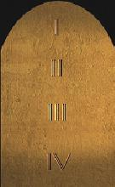
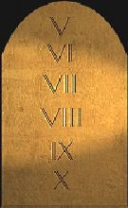
Your Way is in the Sanctuary
10 Commandments
Book of the Law
Channel
Source

Slide 15
Tablets and Book
10 Commandments
Tablets
Source
"Do not think that I came to destroy the Law [Torah] or the Prophets. I did not come to destroy but to fulfill. For assuredly, I say to you, till heaven and earth pass away, one jot or one tittle will by no means pass from the law till all is fulfilled. (Mat 5:17-18)
Book of the Law
Channel
Jesus said unto him, Thou shalt love the Lord thy God with all thy heart, and with all thy soul, and with all thy mind. This is the first and great commandment. And the second is like unto it, Thou shalt love thy neighbour as thyself. On these two commandments hang all the law and the prophets.(Matt 22:37-40)

Slide 16
Tablets and Book
10 Commandments
Tablets
But He did not stop with giving them the precepts of the Decalogue. The people had shown themselves so easily led astray that He would leave no door of temptation unguarded. Moses was commanded to write, as God should bid him, judgments and laws giving minute instruction as to what was required. These directions relating to the duty of the people to God, to one another, and to the stranger were only the principles of the Ten Commandments amplified and given in a specific manner, that none need err. They were designed to guard the sacredness of the ten precepts engraved on the tables of stone. {PP 364.1}
Source
Book of the Law
Channel

Slide 17
Law of Moses is Law of Christ
Moses of himself framed no law. Christ, the angel whom God had appointed to go before his chosen people, gave to Moses statutes and requirements necessary to a living religion and to govern the people of God. Christians commit a terrible mistake in calling this law severe and arbitrary, and then contrasting it with the gospel and mission of Christ in his ministry on earth, as though he were in opposition to the just precepts which they call the law of Moses. {RH, May 6, 1875 par. 12}
10 Commandments
Tablets
Source
Book of the Law
Channel
The instructions given to Moses for ancient Israel, with their sharp, rigid outlines, are to be studied and obeyed by the people of God today (Letter 259, 1903).

Slide 18
Divine Pattern of Sabbath
Origin (Sabbath) - ἐκ → | Channel (Feasts) - dia
Glory | Brightness (Magnifier) | Heb 1:3
Headship | Submission | 1 Cor 11:3
The Source | The Way to | John 14:6

Slide 19
Sabbath More Fully
In the holiest I saw an ark; on the top and sides of it was purest gold. On each end of the ark was a lovely cherub, with its wings spread out over it. Their faces were turned toward each other, and they looked downward. Between the angels was a golden censer. Above the ark, where the angels stood, was an exceeding bright glory, that appeared like a throne where God dwelt. Jesus stood by the ark, and as the saints' prayers came up to Him, the incense in the censer would smoke, and He would offer up their prayers with the smoke of the incense to His Father. In the ark was the golden pot of manna, Aaron's rod that budded, and the tables of stone which folded together like a book. Jesus opened them, and I saw the ten commandments written on them with the finger of God. On one table were four, and on the other six. The four on the first table shone brighter than the other six. But the fourth, the Sabbath commandment, shone above them all; for the Sabbath was set apart to be kept in honor of God's holy name. The holy Sabbath looked glorious--a halo of glory was all around it. I saw that the Sabbath commandment was not nailed to the cross. If it was, the other nine commandments were; and we are at liberty to break them all, as well as to break the fourth. I saw that God had not changed the Sabbath, for He never changes. But the pope had changed it from the seventh to the first day of the week; for he was to change times and laws. {EW 32.3}

Slide 20
Sabbath More Fully
And I saw that if God had changed the Sabbath from the seventh to the first day, He would have changed the writing of the Sabbath commandment, written on the tables of stone, which are now in the ark in the most holy place of the temple in heaven; and it would read thus: The first day is the Sabbath of the Lord thy God. But I saw that it read the same as when written on the tables of stone by the finger of God, and delivered to Moses on Sinai. "But the seventh day is the Sabbath of the Lord thy God." I saw that the holy Sabbath is, and will be, the separating wall between the true Israel of God and unbelievers; and that the Sabbath is the great question to unite the hearts of God's dear, waiting saints. {EW 33.1}
I saw that God had children who do not see and keep the Sabbath. They have not rejected the light upon it. And at the commencement of the time of trouble, we were filled with the Holy Ghost as we went forth and proclaimed the Sabbath more fully. This enraged the churches and nominal Adventists, as they could not refute the Sabbath truth. And at this time God's chosen all saw clearly that we had the truth, and they came out and endured the persecution with us. I saw the sword, famine, pestilence, and great confusion in the land. The wicked thought that we had brought the judgments upon them, and they rose up and took counsel to rid the earth of us, thinking that then the evil would be stayed. {EW 33.2}

Slide 21
Light, Health and Special Strength
All heaven was represented to me as beholding and watching upon the Sabbath those who acknowledge the claims of the fourth commandment and are observing the Sabbath. Angels were marking their interest in, and high regard for, this divine institution. Those who sanctified the Lord God in their hearts by a strictly devotional frame of mind, and who sought to improve the sacred hours in keeping the Sabbath to the best of their ability, and to honor God by calling the Sabbath a delight--these the angels were specially blessing with light and health, and special strength was given them. But, on the other hand, the angels were turning from those who failed to appreciate the sacredness of God's sanctified day, and were removing from them their light and their strength. I saw them overshadowed with a cloud, desponding, and frequently sad. They felt a lack of the Spirit of God. {2T 704.3}

Slide 22
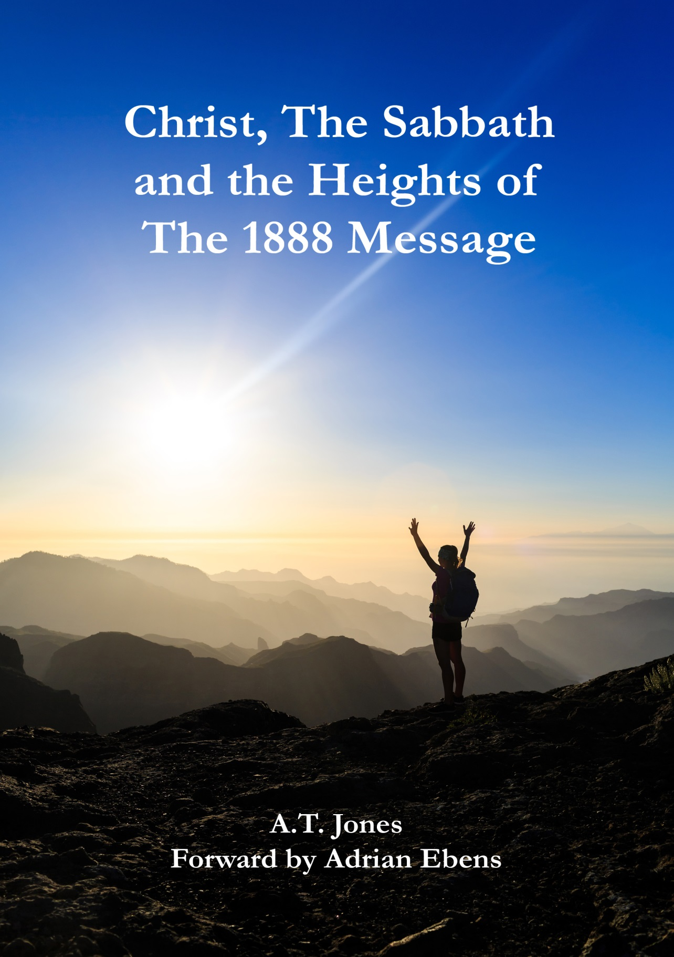
Additional Blessings in the Sabbath
Now referring to the first chapter of Genesis, there we read in the twenty-seventh and twenty-eighth verses: "God created man in his own image, in the image of God created he him; male and female created he them. And God blessed them." What day was that? [Congregation: "The sixth day."] Then God blessed the man before He blessed the seventh day. That is settled, is it not? [Congregation: "Yes."] Now is it as much of a certainty that He blessed the day as it is that He blessed the man? [Congregation: "Yes."] Is the blessing with which He blessed the day, as real as the blessing with which He blessed the man? [Congregation: "Just the same."] It is as real. What was the blessing? Whose blessing was it that He put upon the man? [Congregation: "The blessing of God."] Whose blessing did He put upon the day? [Congregation: "God's blessing."] Well, then, when that blessed man came to that blessed day, did he receive additional blessing in the day beyond what he had, before he came to the day? [Congregation: "Yes."] – A.T. Jones Sermon 20, 1893

Slide 23
Additional Blessings in the Sabbath
Well then He made the day holy. But what made the day holy? Now I need not go through the texts on this; you have had these in Brother Prescott's talk Sabbath before last. What was it that made the day holy? [Congregation: "The presence of God."] The presence of God makes things holy. It makes a place holy. It makes a man holy. The presence of God made the day holy. Then the holiness of God is attached to the day. The presence of God, the holy presence of God, is attached to the seventh or Sabbath day. Well then when the man comes to that day, as only man can come to it, spiritually-minded--with the mind of the Spirit of God--and receives the spiritual rest, the spiritual refreshing that is in it, the spiritual blessing that is in it, does he not also receive that presence, become a partaker of that presence, in which is the holiness of God to transform him? He does indeed. And that is Sabbath-keeping. – A.T. Jones Sermon 20, 1893

Slide 24
Christ the Lord of the Sabbath
Now another thing: Who was the real present agent in creating? [Congregation: "Christ."] Who was it that rested? [Congregation: "Christ."] Who was refreshed? [Congregation: "Christ."] Who blessed? [Congregation: "Christ."] Whose presence made it holy? [Congregation: "Christ's"] Whose presence is in the day? [Congregation: "Christ's."] Then the man whom the presence of Jesus Christ does not sanctify, and does not make holy and does not bless and to whom it does not bring rest, why, he can't keep the Sabbath. Don't you see, it is only with Christ in the man that the Sabbath can be kept; because the Sabbath brings and has in it the presence of Christ. – A.T. Jones Sermon 20, 1893

Slide 25
Christ the Lord of the Sabbath
Now another thing: Who was the real present agent in creating? [Congregation: "Christ."] Who was it that rested? [Congregation: "Christ."] Who was refreshed? [Congregation: "Christ."] Who blessed? [Congregation: "Christ."] Whose presence made it holy? [Congregation: "Christ's"] Whose presence is in the day? [Congregation: "Christ's."] Then the man whom the presence of Jesus Christ does not sanctify, and does not make holy and does not bless and to whom it does not bring rest, why, he can't keep the Sabbath. Don't you see, it is only with Christ in the man that the Sabbath can be kept; because the Sabbath brings and has in it the presence of Christ. – A.T. Jones Sermon 20, 1893

Slide 26
The Holy Spirit of Christ
“The Lord is soon to come. We want that complete and perfect understanding which the Lord alone can give. It is not safe to catch the spirit from another. We want the Holy Spirit, which is Jesus Christ.” (Ellen G. White, Letter 66, 1894 to E. W. Prescott, April 10t1894)
“It is not essential for you to know and be able to define just what the Holy Spirit is. Christ tells us that the Holy Spirit is the Comforter, and the Comforter is the Holy Ghost, “the Spirit of truth, which the Father shall send in my name.” [John 14:26.] “I will pray the Father, and he shall send you another Comforter, that he may abide with you forever, even the Spirit of truth, whom the world cannot receive, because it seeth him not, neither knoweth him; but ye know him, for he dwelleth with you, and shall be in you.” [John 14:16, 17.] This refers to the omnipresence of the Spirit of Christ, called the Comforter”.(Ellen G. White, letter 7 1891 to Brother Chapman June 11th 1891)
“The Holy Spirit, which proceeds from the only begotten Son of God, binds the human agent, body, soul, and spirit, to the perfect, divine-human nature of Christ.” (Ellen G. White, Review and Herald, 5th April 1906, ‘The Word made Flesh’)

Slide 27
Mighty Energies of the Holy Spirit
Pray that the mighty energies of the Holy Spirit, with all their quickening, recuperative, and transforming power, may fall like an electric shock on the palsy-stricken soul, causing every nerve to thrill with new life, restoring the whole man from his dead, earthly, sensual state to spiritual soundness. {5T 267.2}
The striking feature of divine operations is the accomplishment of the greatest work that can be done in our world, by very simple means. It is God's plan that every part of his government shall depend on every other part, the whole as a wheel within a wheel, working with entire harmony. He moves upon human forces, causing his Spirit to touch invisible chords, and the vibration rings to the extremity of the universe. {SpTA10 36.3} The prince of the power of evil can only be held in check by the power of God in the third person of the Godhead, the Holy Spirit. {SpTA10 37.1}

Slide 28
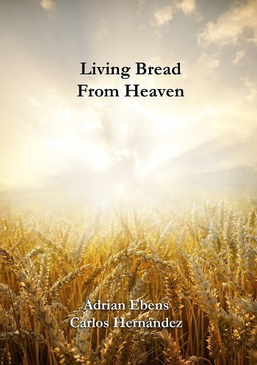
The Holy Spirit of Christ
Christ revealed Himself as the bread of life in John 6. The unleavened bread made of flour and oil was a channel pointing to the life available in Christ. How did this true bread come down from heaven? It came through the offering of Christ’s life for the world. How was this recognised in the daily service? It was through the offering of the lamb. So the offering of the lamb was a recognition of the life of Christ given in order to receive the Holy Spirit. This truth was shown in the flour and oil combined as bread to be eaten by the priests. They in turn were to be ministers of grace to the rest of Israel. Today, those who believe in Christ are part of the royal priesthood and all can partake of this living bread.
Page 9

Slide 29
Sabbath Fountain
I am the bread of life. John 6:48
Sacrifice | Flour | Oil | Ezekiel 47:1-7 River
Daily | 4.4kgs | 1.8 ltrs | Waters coming out of Sanctuary
Sabbath | 8.8kgs | 3.6 ltrs | At 1000 cubits it reaches the ankles
New Moon | 37.4kgs | 15.3 ltrs | At 2000 cubits it reached the knees
Unleavened Bread | 266.2kgs (30 x Sab. offerings) | 108.9 ltrs | At 3000 cubits it reached the waist
Seventh Month Feasts | 869kgs (~100x Sab. offerings) | 359.2 ltrs | At 4000 cubits it was over the head
Page 76

Slide 30
Sword Famine and Pestilence
Afterward Moses and Aaron went in and told Pharaoh, "Thus says the LORD God of Israel: 'Let My people go, that they may hold a feast to Me in the wilderness.' " And Pharaoh said, "Who is the LORD, that I should obey His voice to let Israel go? I do not know the LORD, nor will I let Israel go." So they said, "The God of the Hebrews has met with us. Please, let us go three days' journey into the desert and sacrifice to the LORD our God, lest He fall upon us with pestilence or with the sword." Exo 5:1-3
And at the commencement of the time of trouble, we were filled with the Holy Ghost as we went forth [Hosea 6:2, 3.] and proclaimed the Sabbath more fully. This enraged the church, and nominal Adventists, as they could not refute the Sabbath truth. And at this time, God's chosen, all saw clearly that we had the truth, and they came out and endured the persecution with us. And I saw the sword, famine, pestilence, and great confusion in the land. [Ezekiel 7:10-19. 2 ESDRAS 15:5-27] The wicked thought that we had brought the judgments down on them. They rose up and took counsel to rid the earth of us, thinking that then the evil would be stayed. [2 ESDRAS 16:68-74.] {Word to the Little Flock 18.4} (Early Writings 33.2)

Slide 31
Sealed in the Feasts of the Lord
2 Esdras 2:38 Arise up and stand, behold the number of those that be sealed in the feast of the Lord;
Origin (Sabbath) - ἐκ → | Channel (Feasts) - dia
Glory | Brightness (Magnifier) | Heb 1:3
Headship | Submission | 1 Cor 11:3
The Source | The Way to | John 14:6

