Slide 1
The Use of Force

Slide 2
The Spirit of Freedom
So speak and so do as those who will be judged by the law of liberty. James 2:12
Therefore if the Son makes you free, you shall be free indeed. John 8:36

Slide 3
Love Cannot be Commanded
The exercise of force is contrary to the principles of God's government; He desires only the service of love; and love cannot be commanded; it cannot be won by force or authority. Only by love is love awakened. To know God is to love Him; His character must be manifested in contrast to the character of Satan. DA 22

Slide 4
Last Resort
Trial and persecution will come to all who, in obedience to the Word of God, refuse to worship this false sabbath. Force is the last resort of every false religion. At first it tries attraction, as the king of Babylon tried the power of music and outward show. If these attractions, invented by men inspired by Satan, failed to make men worship the image, the hungry flames of the furnace were ready to consume them. So it will be now. The papacy has exercised her power to compel men to obey her, and she will continue to do so. We need the same spirit that was manifested by God's servants in the conflict with paganism (ST May 6, 1897).

Slide 5
Spirit of Romanism
"The pacific tone of Rome in the United States does not imply a change of heart. She is tolerant where she is helpless. Says Bishop O'Connor: 'Religious liberty is merely endured until the opposite can be carried into effect without peril to the Catholic world.'. . . The archbishop of St. Louis once said: 'Heresy and unbelief are crimes; and in Christian countries, as in Italy and Spain, for instance, where all the people are Catholics, and where the Catholic religion is an essential part of the law of the land, they are punished as other crimes.'. . . {GC 565.1}

Slide 6
Spirit of Romanism
But Romanism as a system is no more in harmony with the gospel of Christ now than at any former period in her history. The Protestant churches are in great darkness, or they would discern the signs of the times. The Roman Church is far-reaching in her plans and modes of operation. She is employing every device to extend her influence and increase her power in preparation for a fierce and determined conflict to regain control of the world, to re-establish persecution, and to undo all that Protestantism has done. Catholicism is gaining ground upon every side. See the increasing number of her churches and chapels in Protestant countries. Look at the popularity of her colleges and seminaries in America, so widely patronized by Protestants. Look at the growth of ritualism in England and the frequent defections to the ranks of the Catholics. These things should awaken the anxiety of all who prize the pure principles of the gospel. {GC 565.4}

Slide 7
Spirit of Romanism
Protestants have tampered with and patronized popery; they have made compromises and concessions which papists themselves are surprised to see and fail to understand. Men are closing their eyes to the real character of Romanism and the dangers to be apprehended from her supremacy. The people need to be aroused to resist the advances of this most dangerous foe to civil and religious liberty. {GC 566.1}

Slide 8
No Condemnation
John 5:22 For the Father judges no one

Slide 9
Dr E.J. Waggoner
The Church Times, commenting on the failure of the proposal in Parliament to make vaccination universally compulsory says: "If there is anything in vaccination statistics, or if it is believed to be a safeguard against the disease of small-pox, it is absurd to allow the conscientious objector to roam at large. He is as great a danger to the community as a mad dog." Without expressing any opinion as to the value of vaccination, it seems evident that such language as this breathes the very spirit of the Roman Catholic Inquisition. If it is considered absurd to allow the conscientious objector to the opinions of the majority on this subject to roam at large, the next step would be to cage the conscientious dissenter from the Established Church. And a question arises here: If vaccination be indeed a safeguard against small-pox, how can a conscientious objector be as dangerous as a mad dog? What harm could he do in a community of vaccinated persons? {March 6, 1902 EJW, PTUK 157.15}

Slide 10
Daniel’s Example
Daniel 1 – The Health Test as to what you allow in your body
- Daniel request for the ability to take an alternative
Daniel 3 – The religious test of who you will worship
Shadrach, Meshach and Abednego are not cautious to answer the king in their decision even while remaining courteous.

Slide 11
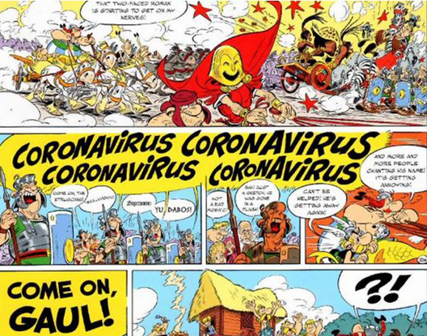
Asterix and Obelix 2017 Great Chariot Race
“When you think Coronavirus, Think Rome”

Slide 12
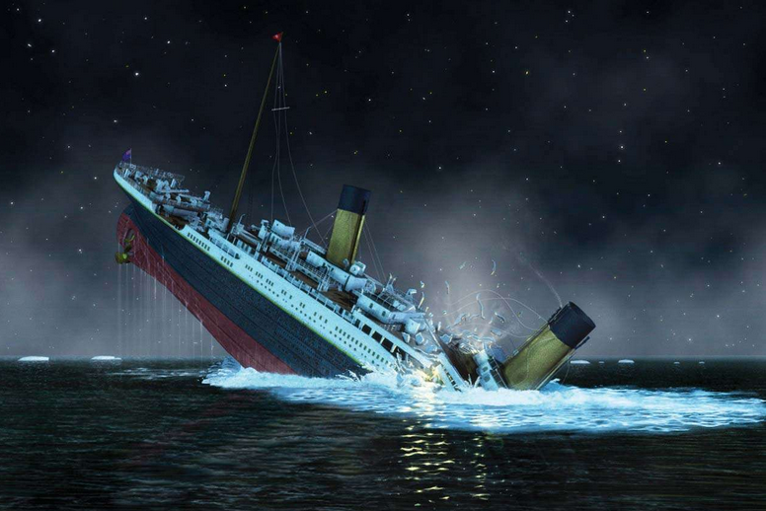
The Titanic

