Slide 1
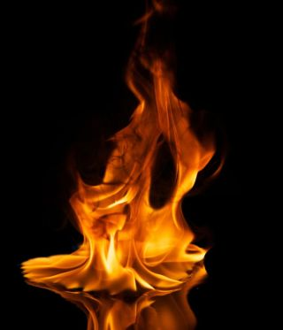
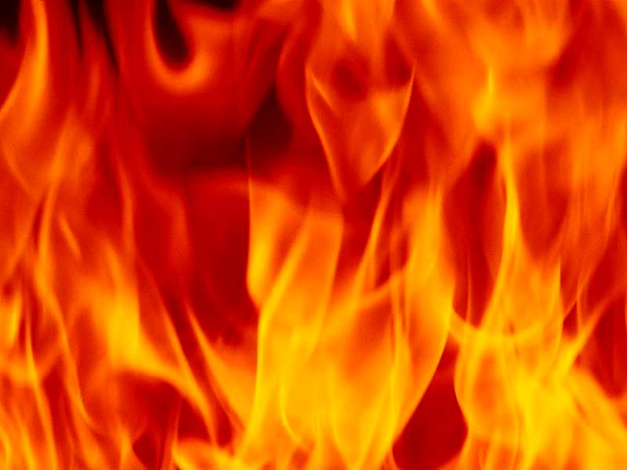
What the Hell
From Tradition
To Truth

Slide 2
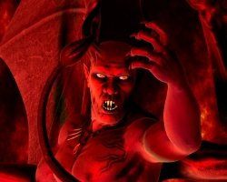
What do you think about when you think of hell?
Suffering
Torture
Screaming
Guilty
Fire
Devil
Eternal Punishment
Damned
Pitch fork
2

Slide 3
The world agrees – there is a hell and it is bad!
Egypt
Budhists
Etc.
But what does the Bible say?
Europe
Africa
Oceania
Middle East
Asia
Americas
Christians
Moslems
Jews
Catholics
3

Slide 4
Rev 20:14 And death and hell were cast into the lake of fire. This is the second death.
Rev 20:15 And whosoever was not found written in the book of life was cast into the lake of fire.
Rev 1:18 I am he that lives, and was dead; and, behold, I am alive for evermore, Amen; and have the keys of hell and of death.
4

Slide 5
Jesus spoke about hell 15 times
Mat 5:22 But I say unto you, … but whosoever shall say, Thou fool, shall be in danger of hell fire.
1
5

Slide 6
Jesus spoke about hell 15 times
Mat 5:29 And if thy right eye offend thee, pluck it out, and cast it from thee: for it is profitable for thee that one of thy members should perish, and not that thy whole body should be cast into hell.
2
6

Slide 7
Jesus spoke about hell 15 times
Mat 5:30 And if thy right hand offend thee, cut it off, and cast it from thee: for it is profitable for thee that one of thy members should perish, and not that thy whole body should be cast into hell.
3
7

Slide 8
Jesus spoke about hell 15 times
Mat 10:28 And fear not them which kill the body, but are not able to kill the soul: but rather fear him which is able to destroy both soul and body in hell.
4
8

Slide 9
Jesus spoke about hell 15 times
Mat 11:23 And thou, Capernaum, which art exalted unto heaven, shall be brought down to hell …
5
9

Slide 10
Jesus spoke about hell 15 times
Mat 16:18 And I say also unto thee, That thou art Peter, and upon this rock I will build my church; and the gates of hell shall not prevail against it.
6
10

Slide 11
Jesus spoke about hell 15 times
Mat 18:9 And if thine eye offend thee, pluck it out, and cast it from thee: it is better for thee to enter into life with one eye, rather than having two eyes to be cast into hell fire.
7
11

Slide 12
Jesus spoke about hell 15 times
Mat 23:15 Woe unto you, scribes and Pharisees, hypocrites! for ye compass sea and land to make one proselyte, and when he is made, ye make him twofold more the child of hell than yourselves.
8
12

Slide 13
Jesus spoke about hell 15 times
Mat 23:33 Ye serpents, ye generation of vipers, how can ye escape the damnation of hell?
9
13

Slide 14
Jesus spoke about hell 15 times
Mar 9:43 And if thy hand offend thee, cut it off: it is better for thee to enter into life maimed, than having two hands to go into hell, into the fire that never shall be quenched:
10
14

Slide 15
Jesus spoke about hell 15 times
Mar 9:45 And if thy foot offend thee, cut it off: it is better for thee to enter halt into life, than having two feet to be cast into hell, into the fire that never shall be quenched:
11
15

Slide 16
Jesus spoke about hell 15 times
Mar 9:47 And if thine eye offend thee, pluck it out: it is better for thee to enter into the kingdom of God with one eye, than having two eyes to be cast into hell fire:
12
16

Slide 17
Jesus spoke about hell 15 times
Luke 10:15 And thou, Capernaum, which art exalted to heaven, shalt be thrust down to hell.
13
17

Slide 18
Jesus spoke about hell 15 times
Luke 12:5 But I will forewarn you whom ye shall fear: Fear him, which after he hath killed hath power to cast into hell; yea, I say unto you, Fear him.
14
18

Slide 19
Jesus spoke about hell 15 times
Luke 16:23 And in hell he lift up his eyes, being in torments, and seeth Abraham afar off, and Lazarus in his bosom.
15
The tale of Kaemwese - Egypt
19

Slide 20
Jesus spoke about hell 16 times
Rev 1:18 I am he that liveth, and was dead; and, behold, I am alive for evermore, Amen; and have the keys of hell and of death.
16
20

Slide 21
We have looked at some very convincing evidence from the mouth of Jesus Himself regarding hell. There is enough evidence in the Bible to confirm in people’s minds that hell must be a real place; and surely we don’t want to go there.
What other evidence is there that fire plays a great part in the destruction of the wicked?
21

Slide 22
Mat 5:22 But I say unto you, That whosoever is angry with his brother without a cause shall be in danger of the judgment: and whosoever shall say to his brother, Raca, shall be in danger of the council: but whosoever shall say, Thou fool, shall be in danger of hell fire.
22

Slide 23
Mat 7:19 Every tree that bringeth not forth good fruit is hewn down, and cast into the fire.
23

Slide 24
Mat 13:40 As therefore the tares are gathered and burned in the fire; so shall it be in the end of this world.
41 The Son of man shall send forth his angels, and they shall gather out of his kingdom all things that offend, and them which do iniquity;
42 And shall cast them into a furnace of fire: there shall be wailing and gnashing of teeth.
24

Slide 25
Mat 25:41 Then shall he say also unto them on the left hand, Depart from me, ye cursed, into everlasting fire, prepared for the devil and his angels:
25

Slide 26
John 15:6 If a man abide not in me, he is cast forth as a branch, and is withered; and men gather them, and cast them into the fire, and they are burned.
26

Slide 27
2Th 1:6 Seeing it is a righteous thing with God to recompense tribulation to them that trouble you;
2Th 1:7 And to you who are troubled rest with us, when the Lord Jesus shall be revealed from heaven with his mighty angels,
2Th 1:8 In flaming fire taking vengeance on them that know not God, and that obey not the gospel of our Lord Jesus Christ:
27

Slide 28
Rev 19:20 And the beast was taken, and with him the false prophet that wrought miracles before him, with which he deceived them that had received the mark of the beast, and them that worshipped his image. These both were cast alive into a lake of fire burning with brimstone.
28

Slide 29
Rev 20:9 And they went up on the breadth of the earth, and compassed the camp of the saints about, and the beloved city: and fire came down from God out of heaven, and devoured them.
10 And the devil that deceived them was cast into the lake of fire and brimstone, where the beast and the false prophet are, and shall be tormented day and night for ever and ever.
29

Slide 30
2Pet 3:7 But the heavens and the earth, which are now, by the same word are kept in store, reserved unto fire against the day of judgment and perdition of ungodly men.
But what about these verses?
Rev 20:14 And death and hell were cast into the lake of fire. This is the second death.
15 And whosoever was not found written in the book of life was cast into the lake of fire.
30

Slide 31
We learned in our last study that life ceases when we die. The body returns to dust and the spirit returns to God who gave it. Until Jesus returns at His second coming the dead remain in their graves, in what Jesus calls a state of sleep; but as we understand it, death. This being the case what would be the use of a hell fire to continually burn the wicked forever if they have perished?
We need to resolve this conflict of ideas.
31

Slide 32
Let’s start asking some questions about hell to determine if the ‘obvious’ can stand the test of a thorough biblical examination.
32

Slide 33
What does the word we call ‘hell’ mean?
There is one Hebrew word and three Greek words which are translated ‘hell’.
SHEOL (Hebrew)
7585
Used 65 times in Old Testament
שְׁאֹל שְׁאוֹל
sh^{e}'ôl sh^{e}'ôl
sheh-ole', sheh-ole'
From H7592; hades or the world of the dead (as if a subterranian retreat), including its accessories and inmates: - grave, hell, pit.
33

Slide 34
Gen 37:35 And all his sons and all his daughters rose up to comfort him; but he refused to be comforted; and he said, For I will go down into the grave7585 unto my son mourning. Thus his father wept for him.
Psalm 16:10 For thou wilt not leave my soul in hell7585; neither wilt thou suffer thine Holy One to see corruption.
34

Slide 35
G1067 Greek
γέεννα
geenna
gheh'-en-nah
Of Hebrew origin ([H1516] and [H2011]); valley of (the son of) Hinnom; gehenna (or Ge-Hinnom), a valley of Jerusalem, used (figuratively) as a name for the place (or state) of everlasting punishment: - hell.
Total KJV occurrences: 12
35

Slide 36
G86 Greek
ᾅδης
hadēs
hah'-dace
From G1 (as a negative particle) and G1492; properly unseen, that is, “Hades” or the place (state) of departed souls: - grave, hell.
Total KJV occurrences: 11
36

Slide 37
G5020
ταρταρόω
tartaroō
tar-tar-o'-o
From Τάρταρος Tartaros̄ (the deepest abyss of Hades); to incarcerate in eternal torment: - cast down to hell.
Total KJV occurrences: 1
2Pet 2:4 For if God spared not the angels that sinned, but cast them down to hell, and delivered them into chains of darkness, to be reserved unto judgment;
Notice the Greek culture had more words to describe ‘hell’ than the Hebrews.
37

Slide 38
If hell is a place under the earth where the devil rules, and people are sent there and burned forever for their sin, some questions need to be asked.
38

Slide 39
Question 1.
Creation is recorded in Genesis chapter 1.
On which day did God create hell?
Day 1,2,3,4,5 or 6?
Surely not on day 7 – rest day
39

Slide 40
Question 2.
Did God know man was going to sin; and therefore, made hell as a necessary place of punishment for our sin?
40

Slide 41
Question 3.
What does this tell us about God’s character?
41

Slide 42
Question 4.
Is it fair to create somebody, knowing they will sin, and then punish them eternally for it?
Live for 1 – 100 years … suffering forever??
Does the time fit the crime?
LOVE
42

Slide 43
What Burns?
Question 5.
Last time we learned that when we die we perish.
What is the purpose of hell if souls perish: the body becomes dust and the spirit, breath or life force returns to God who gave it?
43

Slide 44
Literal or Spiritual
When discussing the fires of hell and the coals of fire, we need to ask another question:
Are these terms literal or spiritual?
44

Slide 45
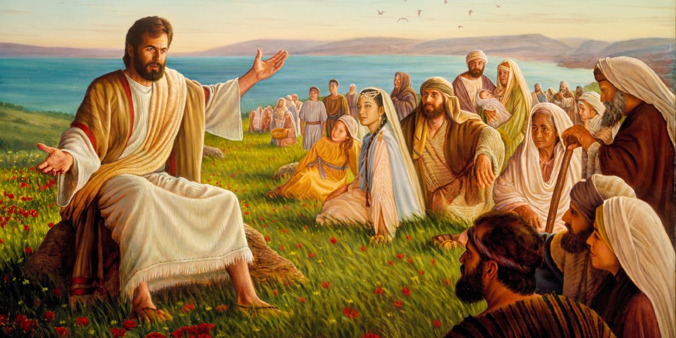
Let’s look at some of Jesus statements and ask are these statements to be read literally or spiritually.
45

Slide 46
John the Baptist - Matthew 3:11 I indeed baptize you with water unto repentance: but he that cometh after me is mightier than I, whose shoes I am not worthy to bear: he shall baptize you with the Holy Ghost, and with fire:
46

Slide 47
Mat 7:15 Beware of false prophets, which come to you in sheep's clothing, but inwardly they are ravening wolves.
16 Ye shall know them by their fruits. Do men gather grapes of thorns, or figs of thistles?
17 Even so every good tree brings forth good fruit; but a corrupt tree brings forth evil fruit.
18 A good tree cannot bring forth evil fruit, neither can a corrupt tree bring forth good fruit.
19 Every tree that brings not forth good fruit is hewn down, and cast into the fire.
20 Wherefore by their fruits ye shall know them.
47

Slide 48
Mat 9:16 No man puts a piece of new cloth unto an old garment, for that which is put in to fill it up taketh from the garment, and the rent is made worse.
17 Neither do men put new wine into old bottles: else the bottles break, and the wine runs out, and the bottles perish: but they put new wine into new bottles, and both are preserved.
48

Slide 49
Matthew 13 –
Parable of the sower
Wheat and Tares
Mustard Seed
Hidden Treasure
Goodly Pearl
Matthew 15:14 – the blind leading the blind
Parables are symbolic
teaching a
spiritual truth
49

Slide 50
Matthew 16:5 And when his disciples were come to the other side, they had forgotten to take bread.
Mat 16:6 Then Jesus said unto them, Take heed and beware of the leaven of the Pharisees and of the Sadducees.
Mat 16:7 And they reasoned among themselves, saying, It is because we have taken no bread.
50

Slide 51
Matthew 16:8 Which when Jesus perceived, he said unto them, O ye of little faith, why reason ye among yourselves, because ye have brought no bread?
Mat 16:9 Do ye not yet understand, neither remember the five loaves of the five thousand, and how many baskets ye took up?
Mat 16:10 Neither the seven loaves of the four thousand, and how many baskets ye took up?
51

Slide 52
Matthew 16:11 How is it that ye do not understand that I spake it not to you concerning bread, that ye should beware of the leaven of the Pharisees and of the Sadducees?
Mat 16:12 Then understood they how that he bade them not beware of the leaven of bread, but of the doctrine of the Pharisees and of the Sadducees.
Leaven = doctrine or teachings
52

Slide 53
Mattew 25:31 When the Son of man shall come in his glory, and all the holy angels with him, then shall he sit upon the throne of his glory: 32 And before him shall be gathered all nations: and he shall separate them one from another, as a shepherd divideth his sheep from the goats:
53

Slide 54
Jesus is the:
Word of God – John 1:1
Lamb of God – John 1:29
Living Bread – John 6:51
Light of the World – John 8:12
Door – John 10:7
Good Shepherd – John 10:11
True Vine – John 15:1
Literal
or
Symbolic
54

Slide 55
Jesus said:
You must be born again – John 3:7
Lazarus is asleep – John 11 = death
The bread is my body – Luke 22:19
Eat my flesh and drink my blood – John 6:54
Destroy this temple, and in three days I will raise it up – John 2:19
Q. Is everything that Jesus says literal?
Literal
or
Symbolic
55

Slide 56
John the Baptist - Matthew 3:11 I indeed baptize you with water unto repentance: but he that cometh after me is mightier than I, whose shoes I am not worthy to bear: he shall baptize you with the Holy Ghost, and with fire:
water – literal --- fire - ???
56

Slide 57
James 3:5 Even so the tongue is a little member, and boasteth great things. Behold, how great a matter a little fire kindleth!
6 And the tongue is a fire, a world of iniquity: so is the tongue among our members, that it defiles the whole body, and sets on fire the course of nature; and it is set on fire of hell.
57

Slide 58
Rom 12:20 Therefore if thine enemy hunger, feed him; if he thirst, give him drink: for in so doing thou shalt heap coals of fire on his head.
58

Slide 59
1Cor 3:13 Every man's work shall be made manifest: for the day shall declare it, because it shall be revealed by fire; and the fire shall try every man's work of what sort it is.
1Co 3:14 If any man's work abide which he hath built thereupon, he shall receive a reward.
1Co 3:15 If any man's work shall be burned, he shall suffer loss: but he himself shall be saved; yet so as by fire.
59

Slide 60
1Peter 1:7 That the trial of your faith, being much more precious than of gold that perishes, though it be tried with fire, might be found unto praise and honour and glory at the appearing of Jesus Christ:
60

Slide 61
2Peter 3:12 Looking for and hasting unto the coming of the day of God, wherein the heavens being on fire shall be dissolved, and the elements shall melt with fervent heat.
Literal or symbolic
But what burns at that time?
61

Slide 62
Rev 3:18 I counsel thee to buy of me gold tried in the fire, that you may be rich;
Gold = ?????
Gold = faith
Fire = ?????
Fire = trials
1Peter 1:7 That the trial of your faith, being much more precious than of gold that perishes, though it be tried with fire, might be found unto praise and honour and glory at the appearing of Jesus Christ:
62

Slide 63
James 3:5 Even so the tongue is a little member, and boasts great things. Behold, how great a matter a little fire kindles!
6 And the tongue is a fire, a world of iniquity: so is the tongue among our members, that it defiles the whole body, and sets on fire the course of nature; and it is set on fire of hell.
63

Slide 64
So we have seen ‘fire’ is used in the Bible in many different ways. Sometimes literal and sometimes symbolic. It can be a real fire like when food is cooked on a fire. It can be used to describe a tough time like a trial or difficult period of life. It can also be used to describe strong emotions.
Therefore, we need to look closely and ask questions each time to decide whether the ‘fire’ we are reading about is real or symbolic.
64

Slide 65
We’ll now look at a few other places where fire is used in the Bible.
65

Slide 66
James 3:5 Even so the tongue is a little member, and boasts great things. Behold, how great a matter a little fire kindles!
6 And the tongue is a fire, a world of iniquity: so is the tongue among our members, that it defiles the whole body, and sets on fire the course of nature; and it is set on fire of hell.
66

Slide 67
Heb 12:29 For our God is a consuming fire.
Rev 1:14 His head and his hairs were white like wool, as white as snow; and his eyes were as a flame of fire;
15 And his feet like unto fine brass, as if they burned in a furnace; and his voice as the sound of many waters.
67

Slide 68
Psa 18:6 In my distress I called upon the LORD, and cried unto my God: he heard my voice out of his temple, and my cry came before him, even into his ears. 7 Then the earth shook and trembled; the foundations also of the hills moved and were shaken, because he was wroth. 8 There went up a smoke out of his nostrils, and fire out of his mouth devoured: coals were kindled by it. 9-11 …
12 At the brightness that was before him his thick clouds passed, hail stones and coals of fire. 13 The LORD also thundered in the heavens, and the Highest gave his voice; hail stones and coals of fire.
68

Slide 69
Coals of Fire
2 Samuel 22:1-15 (Psalm 18:1-4)
Psalm 140:1-13 Psa 140:9 As for the head of those that compass me about, let the mischief of their own lips cover them.
Psa 140:10 Let burning coals fall upon them: let them be cast into the fire; into deep pits, that they rise not up again.
Consequences of their
actions or words
Burning coals = Strong regret
69

Slide 70
Proverb 25:21 If thine enemy be hungry, give him bread to eat; and if he be thirsty, give him water to drink:
22 For thou shalt heap coals of fire upon his head, and the LORD shall reward thee.
Coals of fire = Strong emotion
70

Slide 71
Pro 26:20 Where no wood is, there the fire goes out: so where there is no talebearer, the strife ceases. 21 As coals are to burning coals, and wood to fire; so is a contentious man to kindle strife. 22 The words of a talebearer are as wounds, and they go down into the innermost parts of the belly. 23 Burning lips and a wicked heart are like a potsherd covered with silver dross.
his attitude
the outcome
reflect his attitude
the outcome
Coals of fire = Strong emotion
71

Slide 72
Song of Solomon 8:6 Set me as a seal upon thine heart, as a seal upon thine arm: for love is strong as death; jealousy is cruel as the grave: the coals thereof are coals of fire, which hath a most vehement flame.
Coals of fire = Strong emotion
72

Slide 73
Summary:
Coals of fire are used throughout the Bible to reflect strong emotion: both positive and negative. Both strong love and strong regret are considered as coals of fire or burning coals.
73

Slide 74
Deut 4:12 And the LORD spake unto you out of the midst of the fire: ye heard the voice of the words, but saw no similitude; only ye heard a voice.
Deut 4:36 Out of heaven he made thee to hear his voice, that he might instruct thee: and upon earth he shewed thee his great fire; and thou heardest his words out of the midst of the fire.
74

Slide 75
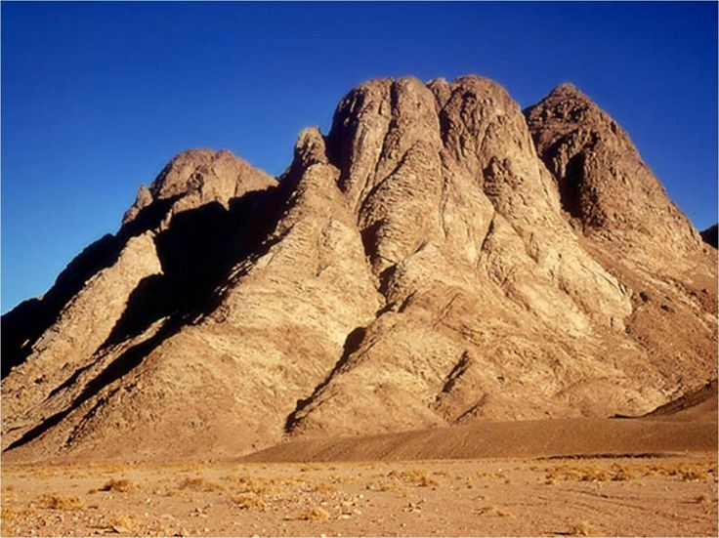
Deut 5:22 These words the LORD spake unto all your assembly in the mount out of the midst of the fire, of the cloud, and of the thick darkness, with a great voice: and he added no more. And he wrote them in two tables of stone, and delivered them unto me.
75
75

Slide 76
Deut 9:10 And the LORD delivered unto me two tables of stone written with the finger of God; and on them was written according to all the words, which the LORD spake with you in the mount out of the midst of the fire in the day of the assembly.
76

Slide 77
Jer 5:14 Wherefore thus saith the LORD God of hosts, Because ye speak this word, behold, I will make my words in thy mouth fire, and this people wood, and it shall devour them.
77

Slide 78
Now let’s apply what we have learned to this very interesting statement in Revelation 20.
Rev 20:7 And when the thousand years are expired, Satan shall be loosed out of his prison,
Rev 20:8 And shall go out to deceive the nations which are in the four quarters of the earth, Gog and Magog, to gather them together to battle: the number of whom is as the sand of the sea.
78

Slide 79
Rev 20:9 And they went up on the breadth of the earth, and compassed the camp of the saints about, and the beloved city: and fire came down from God out of heaven, and devoured them.
Rev 20:10 And the devil that deceived them was cast into the lake of fire and brimstone, where the beast and the false prophet are, and shall be tormented day and night for ever and ever.
79

Slide 80
Pro 18:7 A fool's mouth is his destruction, and his lips are the snare of his soul.
Rev 20:9 And the devil that deceived them was cast into the lake of fire and brimstone
Eze 28:18 Thou hast defiled thy sanctuaries by the multitude of thine iniquities, by the iniquity of thy traffick; therefore will I bring forth a fire from the midst of thee, it shall devour thee, and I will bring thee to ashes upon the earth in the sight of all them that behold thee.
80
Notes:
Your lies will come to nothing.

Slide 81
Can you now explain to me what this verse means?
Heb 12:29 For our God is a consuming fire.
81

Slide 82
Either God’s word will devour the sin in us – purify us like gold in the fire or
If we reject God’s word now, coals of fire will devour us if we stand before Him at the end of the thousand years.
I do not believe God will literally burn His children. Their own torment – coals of fire – will, when convicted by His word – fire.
82

Slide 83
Men’s hearts will fail them in the presence of God Almighty and the Lamb. Thus our God is a consuming fire. His word will purify or devour: the choice is ours.
83

Slide 84
John 8:9 And they which heard it, being convicted by their own conscience, went out one by one, beginning at the eldest, even unto the last: and Jesus was left alone, and the woman standing in the midst.
These men could not remain in the presence of the Word when convicted of their sin. So shall it be on that great day.
84

Slide 85
The tradition of hell has gone up in flames in the light of testimony of Scripture. Fire will come down from God out of heaven, and devour them; just as we found in Jeremiah - “Because ye speak this word, behold, I will make my words in thy mouth fire, and this people wood, and it shall devour them.”
85

Slide 86
May we take comfort from these words this morning, and allow God to do His good work in us through the baptism of fire, to His honour and glory, and to the saving of our souls. Amen.
86

Slide 87
John 14:27 Peace I leave with you, my peace I give unto you: not as the world giveth, give I unto you. Let not your heart be troubled, neither let it be afraid.
end

Slide 88
John the Baptist - Matthew 3:11 I indeed baptize you with water unto repentance: but he that cometh after me is mightier than I, whose shoes I am not worthy to bear: he shall baptize you with the Holy Ghost, and with fire:

Slide 89
Coals of Fire
2 Sam 22:1-15 esp. 9, 13-15 = Psalm 18:1-14
Psalm 140:1-13
Proverbs 25:20 = Rom 12:20
Proverbs 26:20-23
Song of Solomon 8:6
Luke 12:49 fire already kindled

