Slide 1
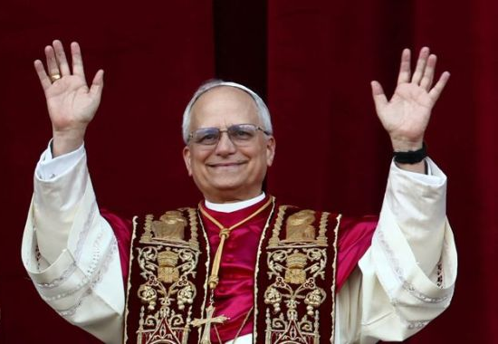
Present Developments in the USA

Slide 2
The Significance of Martin Luther
For nearly 500 years, Martin Luther's view of "conscience" has been the subject of a consistent, occasionally cantankerous, controversy-and this controversy has grown into an impressive tradition of scholarly research. Luther has been called, with respect to conscience, a "…Christopher Columbus in the world of faith, who finds new and good land on the other side of what was thought to be the abyss." Similarly, others have labeled Luther "the discoverer of conscience." As initiator of the "Luther-Renaissance," Karl Holl, lecturing at the University of Berlin in 1917 to mark the 400th anniversary of the posting of the 95 Theses, spoke these famous words, "Luther's religion is a religion of conscience, in its most graphic sense. Journal of Lutheran Ethics “https://elca.org/JLE/Articles/654

Slide 3
The Heart of the Issue
The controversy between the Christians and the Romans was not a dispute between individuals, or a contention between sects or parties. It was a contest between antagonistic principles. It was, therefore, a contest between Christianity and Rome, rather than between Christians and Romans. On the part of Christianity it was the proclamation of the principle of genuine liberty; on the part of Rome it was the assertion of the principle of genuine despotism. On the part of Christianity it was the assertion of the principle of the rights of conscience and of the individual; on the part of Rome it was the assertion of the principle of the absolute absorption of the individual, and his total enslavement to the State in all things, divine as well as human, religious as well as civil A.T. Jones, The Two Republics (1891) p.137.2

Slide 4
Separation of Church and State Defined by Christ
Christianity was directly opposed to this, as shown by the word of Christ, who, when asked by the Pharisees and the Herodians whether it was lawful to give tribute to Caesar or not, answered: "Render therefore unto Caesar the things which are Caesar's; and unto God the things that are God's." In this Christ established a clear distinction between Caesar and God, and between religion and the State. He separated that which pertains to God from that which pertains to the State. Only that which was Caesar's was to be rendered to Caesar, while that which is God's was to be rendered to God and with no reference whatever to Caesar. {1891 A.T. Jones, The Two Republics 144.2}

Slide 5
The Jurisdiction of Caesar as servant of God
Wherefore ye must needs be subject, not only for wrath, but also for conscience sake. For for this cause pay ye tribute also: for they are God's ministers, attending continually upon this very thing. Render therefore to all their dues: tribute to whom tribute is due; custom to whom custom; fear to whom fear; honour to whom honour. Owe no man any thing, but to love one another: for he that loveth another hath fulfilled the law. For this, Thou shalt not (7) commit adultery, (6) Thou shalt not kill, (8) Thou shalt not steal, (9) Thou shalt not bear false witness, (10) Thou shalt not covet; and if there be any other commandment, it is briefly comprehended in this saying, namely, Thou shalt love thy neighbour as thyself. Romans 13:5-9
The Last 5 of the 10 Commandments.

Slide 6
The Jurisdiction of God directly
"You shall have no other gods before Me.
"You shall not make for yourself a carved image--any likeness of anything that is in heaven above, or that is in the earth beneath, or that is in the water under the earth; you shall not bow down to them nor serve them….
"You shall not take the name of the LORD your God in vain, for the LORD will not hold him guiltless who takes His name in vain.
"Remember the Sabbath day, to keep it holy. Six days you shall labor and do all your work, but the seventh day is the Sabbath of the LORD your God.
"Honor your father and your mother, that your days may be long upon the land which the LORD your God is giving you. Exodus 20:3-12

Slide 7
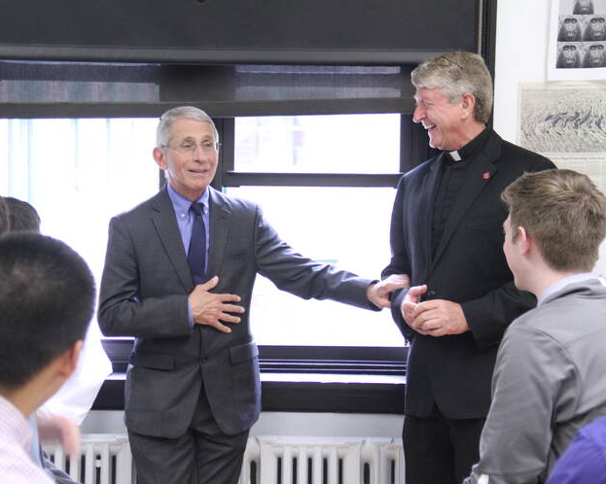
The Most Trusted Man in America?
“Every Jesuit graduate can take pride in knowing that they are part of an educational system that is nearly five centuries old, and has impacted the lives of so many people around the world,” Father Lahart continued. “Today, we also can all take pride that the man [Anthony Fauci] who is probably the most trusted person in the United States is a graduate of a Jesuit high school and a Jesuit college. He takes great pride in his Jesuit education, and as he proudly professes, it has formed his life and his career.”
https://www.americamagazine.org/faith/2020/05/12/dr-anthony-fauci-jesuit-grads-now-time-us-care-selflessly-about-one-another

Slide 8
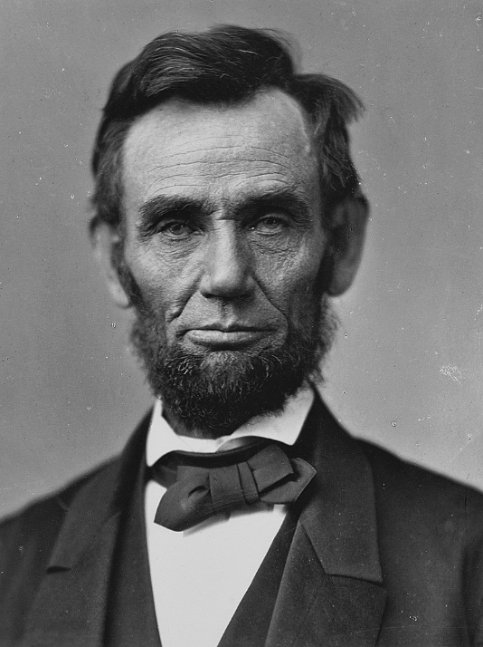
Abraham Lincoln on the Jesuits
“I feel more and more every day that it is not against the Americans of the South alone I am fighting. It is more against the Pope of Rome, his perfidious Jesuits and their blind and bloodthirsty slaves, than against American Protestants. …
“It is Rome who wants to rule and degrade the North, as she has ruled and degraded the South from the very day of its discovery. She divides our nation in order to weaken, subdue, and rule it.
“Morse has told me of the plots made in Rome to undermine our institutions and our laws, destroy our schools, and prepare a reign of anarchy here, as they have done in Ireland, in Mexico, in Spain, and wherever there are any people who want to be free.”
https://seanmaclarenbooks.com/what-president-abraham-lincoln-warned-about-the-jesuits/

Slide 9
Freedom of Conscience?
Mandates?
Border closures?
Army involvement in civilian affairs?
Forced out of work if you don’t submit to experimental science
Silencing of proper scientific debate
Police brutality, body slamming people to the ground?
The case of Novak Djokovic coming to Australian Open?
Forced vaccination of Children?
Giving Health decisions of Australia to the WHO
Dan 1:8 But Daniel purposed in his heart that he would not defile himself [allow into his body] with the portion of the king's delicacies [health mandates], nor with the wine which he drank; therefore he requested of the chief of the eunuchs that he might not defile himself.

Slide 10
History Repeats
The Church Times, commenting on the failure of the proposal in Parliament to make vaccination universally compulsory says: "If there is anything in vaccination statistics, or if it is believed to be a safeguard against the disease of small-pox, it is absurd to allow the conscientious objector to roam at large. He is as great a danger to the community as a mad dog." Without expressing any opinion as to the value of vaccination, it seems evident that such language as this breathes the very spirit of the Roman Catholic Inquisition. If it is considered absurd to allow the conscientious objector to the opinions of the majority on this subject to roam at large, the next step would be to cage the conscientious dissenter from the Established Church. And a question arises here: If vaccination be indeed a safeguard against small-pox, how can a conscientious objector be as dangerous as a mad dog? What harm could he do in a community of vaccinated persons? {March 6, 1902 Dr E.J. Waggoner, Present Truth UK 157.15}

Slide 11
Another Beast Rises
And I beheld another beast coming up out of the earth; and he had two horns like a lamb, and he spake as a dragon. And he exerciseth all the power of the first beast before him, and causeth the earth and them which dwell therein to worship the first beast, whose deadly wound was healed.
Revelation 13:11-12
But the beast with lamblike horns was seen “coming up out of the earth.” …What nation of the New World was in 1798 rising into power, giving promise of strength and greatness, and attracting the attention of the world? The application of the symbol admits of no question. One nation, and only one, meets the specifications of this prophecy; it points unmistakably to the United States of America. Great Controversy page 440.1

Slide 12
May 4 2025.
WASHINGTON, DC: President Donald Trump took the stage on National Prayer Day and delivered what sounded more like a sermon than a presidential speech, and not everyone’s saying amen.
Trump's White House Faith Office is fully functional with his longtime televangelist confidante Paula White at the helm. His Task Force to Eradicate Anti-Christian Bias is pushing forward.
And while signing an executive order creating a new Presidential Commission on Religious Liberty, Trump appeared to show his disregard for one of the Constitution’s core tenets — the separation of church and state.

Slide 13
Donald Trump on Separation
“They say ‘separation between church and state,’ they told me,” Donald Trump said at the White House. “I said, alright, let's forget about that for one time.”
That “one time” was the moment he invited his faith advisors to set up shop right inside the West Wing. He added, “They work right out of the White House. That's never been done before. No other president allowed that."
He continued, “We said, separation, really, is that a good thing or a bad thing? I'm not sure, but whether there's separation or not, you guys are in the White House, where you should be, and you're representing our country. We're bringing religion back to our country. And it's a big deal.”
https://www.msn.com/en-us/politics/government/people-are-not-happy-after-trump-said-let-s-forget-about-the-separation-of-church-and-state/ar-AA1E4M0i

Slide 14
May 1 – New Religious Liberty Commission
Today, the President signed an Executive Order establishing the Religious Liberty Commission during the National Day of Prayer event in the Rose Garden. President Trump designated the following individuals to serve on the Religious Liberty Commission.
Texas Lieutenant Governor Dan Patrick (Chair) Conservative. Pushing for 10 Commandments in Schools
Dr. Ben Carson (Vice Chair). Seventh-day Adventist.
Ryan T. Anderson. – Roman Catholic
Bishop Robert Barron. – Roman Catholic
Carrie Prejean Boller. Former Miss California. Became Catholic on April 30 2025.
Cardinal Timothy Dolan. – Roman Catholic.
Pr Franklin Graham. – Protestant. Calling for lowering of wall between Church and State in some cases
Allyson Ho. – Lawyer
Dr Phil Mcgraw Christian Psychologist
Eric Metaxis – Protestant – against separation of church and state. “Christians should be in politics”
Kelly Shackelford. President, CEO and Chief Counsel, First Liberty Institute
Rabbi Meir Soloveichik. Jewish.
Pastor Paula White. Protestant. Propserity Gospel.
https://www.whitehouse.gov/briefings-statements/2025/05/president-trump-announces-religious-liberty-commission-members/

Slide 15
Religious Liberty Commission Purpose.
By the authority vested in me as President by the Constitution and the laws of the United States of America, it is hereby ordered:
Section 1. Purpose and Policy. It shall be the policy of the executive branch to vigorously enforce the historic and robust protections for religious liberty enshrined in Federal law. The Founders (of what? The commission?) envisioned a Nation in which religious voices and views are integral to a vibrant public square and human flourishing and in which religious people and institutions are free to practice their faith without fear of discrimination or hostility from the Government. Indeed, the roots of religious liberty stretch back to the early settlers who fled religious persecution in Europe, seeking a new world where they could choose, follow, and practice their faith without interference from the Government. https://www.whitehouse.gov/presidential-actions/2025/05/establishment-of-the-religious-liberty-commission/

Slide 16
Dr Ben Carson…
Ben Carson, a Christian nationalist advocate and former secretary of the U.S. Department of Housing and Urban Development, attacked separation of church and state during a February address at the U.S. Air Force Academy in Colorado.
Carson was speaking at the Academy’s National Character and Leadership Symposium and during a question period told the crowd, “And those people that like to criticize America – criticize people in America – and always talking about separation of church and state, which is not in the Constitution, by the way – do they realize that our founding document, the Declaration of Independence, talks about certain unalienable rights given to us by our creator, aka God? Do they realize that the Pledge of Allegiance to our flag says we are one nation under God? In many courtrooms, on the wall, it says ‘In God We Trust’? Every coin in our pocket, every bill in our wallet says, ‘In God We Trust.’ So, if it’s in our founding documents, it’s in our Pledge, it’s on our courts, it’s on our money, but we’re not supposed to talk about it. What in the world is that? In medicine we call it schizophrenia.” https://www.au.org/the-latest/church-and-state/articles/ben-carson-assails-church-state-separation/

Slide 17
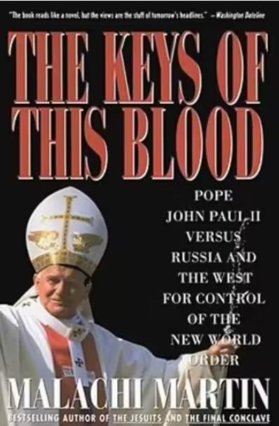
Does Rome have Global Ambition?
Only Malachi Martin, consummate Vatican insider and intelligence expert, could reveal the untold story behind the Vatican's role in today's winner-take-all race against time to establish, maintain, and control the first one-world government. Sept 1991

Slide 18
History Repeats
That which is has already been, And what is to be has already been; And God requires an account of what is past. Ecc 3:15
Rom 15:4 For whatever things were written before were written for our learning, that we through the patience and comfort of the Scriptures might have hope.

Slide 19
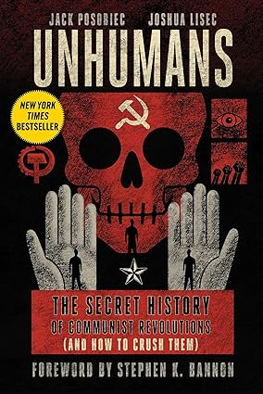
UnHumans
Jack Posobiec is senior editor at Human Events and host of Human Events Daily, which has more than 250 million downloads. He is a veteran US Navy intelligence officer with deployments to Guantanamo Bay and East Asia. Posobiec's final deployment was as intelligence director for Navy Expeditionary Forces Command Pacific - Task Force 75. Posobiec has authored three books: Citizens for Trump: The Inside Story of the People's Movement to Take Back America, 4D Warfare: A Doctrine for a New Era of Political Warfare, and The Antifa: Stories from Inside the Black Bloc. In 2019, Posobiec was awarded a Lincoln Fellowship by the Claremont Institute. A Temple University - Philadelphia, graduate, Posobiec lived in China before settling in Washington, DC with his wife and two sons.
Joshua Lisec writes books of consequence. He is a Wall Street Journal bestselling ghostwriter with more than eighty books ghostwritten that have been translated into a dozen languages. Lisec is best known for his literary collaborations with controversial public figures, capturing their authentic voice and conveying the whole story. Lisec is also the author of the bestselling irreverent guide to entrepreneurship So Good They Call You a Fake and creator of The Best Way to Say It(R) writing programs. In 2021, he was executive producer of Better Left Unsaid, an award-winning documentary exposing the suppressed history of communist uprisings. Joshua has been featured in Publishers Weekly, Newsweek, Forbes, BBC, TEDx, Sky News, and TMZ, among others. Joshua lives with his wife and children near Dayton, Ohio.

Slide 20
UnHumans - Reviews
"In the past, communists marched in the streets waving red flags. Today, they march through HR, college campuses, and courtrooms to wage lawfare against good, honest people. In Unhumans, Jack Posobiec and Joshua Lisec reveal their plans and show us what to do to fight back.“ --J. D. Vance, Senator (R-OH) Now Vice President.
"Jack Posobiec sees the big picture and isn't afraid to describe it. He's been punished for that, but it makes him one of the rare people worth listening to.“--Tucker Carlson
"The far Left murdered 100 million people in the twentieth century and have repeatedly shown that they will stop at nothing to achieve their totalitarian goals. They have torn down countless societies using a sophisticated playbook of propaganda. The only way to stop them in the future is to use their own subversive (unhuman?) playbook against them. Unhumans reveals that playbook and teaches us how to deploy it immediately to save the West."--Donald Trump, Jr.

Slide 21
UnHumans – Contra Reviews
A quick summary of the book could be communists bad, fascists good, and anyone that is not a far right extremists is a communist. Even Hitler wasn’t so bad. The foes of conservatism are not merely misguided souls pushing the wrong policies but people who seek to annihilate civilization. This is literally the worst book I have ever read! Not even worthy of 1 star. Because I am incapable of not finishing a book I slogged through it with groans, sighs, and eye rolls. My wife mentioned it to me as something that J.D. Vance had endorsed so I thought I would give it a go to understand a bit more about Mr. Vance, since Vance seems to be a different guy than the one that wrote “Hillbilly Elegy”. This book is ghost written because Porobiec isn’t smart enough to put together a coherent argument.
The book is a convoluted jumble of poorly constructed conspiracy theories and alarmist rhetoric, presented in an exaggerated and heavy-handed way that fails to deliver any real insight or even entertainment. It is a clumsy attempt to push a political agenda, with every twist feeling as predictable as it is misguided.

Slide 22
UnHumans – Contra Reviews
The narrative barrels ahead with a relentless onslaught of over-the-top paranoia. Posobiec seems to believe that louder is better, but the result is a book that lacks any real depth or intelligence. He recounts a history of revolutions around the world. In every single case right wing dictators are the good guys. For example his description of the “Golpe Miltar” in Chile lacks truth, facts, and reason. In his telling Pinochet is a wonderful Christian doing God’s work and the 20,000+ disappeared and 2000+ murdered were a necessary cleansing of the unhumans. I’d be happy to provide Mr. Posobiec a list of families I know in Chile that lost loved ones. – David Cook – goodreads.com
Hitler, Pinochet, Franco are presented as examples of how to deal with anyone not following a far right agenda.
Endorsed by the vice present, Tucker Carson, the Presidents Son, Steve Bannon, General Michael Flynn. Of 612 reviews the overall rating was 4.09/5 on Good reads. On Amazon it received a 4.7/5 on 733 reviews.

Slide 23

In the Spirit of Babylon
You, O king, have made a decree that everyone who hears the sound of the horn, flute, harp, lyre, and psaltery, in symphony with all kinds of music, shall fall down and worship the gold image; and whoever does not fall down and worship shall be cast into the midst of a burning fiery furnace. Dan 3:10-11
He was granted power to give breath to the image of the beast, that the image of the beast should both speak and cause as many as would not worship the image of the beast to be killed. Rev 13:15

Slide 24
Pope Leo XIV – First US Pope
Pope Leo XIV's chosen new name signals he will continue the work of his predecessor, experts have said.
The former Cardinal, Robert Prevost, was yesterday elected as the new head of the Catholic Church following a second day of the conclave.
After white smoke billowed from the chimney of the Sistine Chapel, the first American pontiff, born in Chicago, emerged from St Peter's Basilica in front of the faithful gathered at St Peter's Square.
A Vatican spokesman confirmed the choice was a reference to Leo XIII, who was the head of the Church from 1878 and 1903.
Leo XIII laid the foundation for modern Catholic social thought, most famously with his 1891 encyclical Rerum Novarum, which addressed workers' rights and capitalism at the dawn of the industrial age.
https://www.dailymail.co.uk/news/article-14694529/Why-Pope-chose-Leo-XIV-name.html

Slide 25
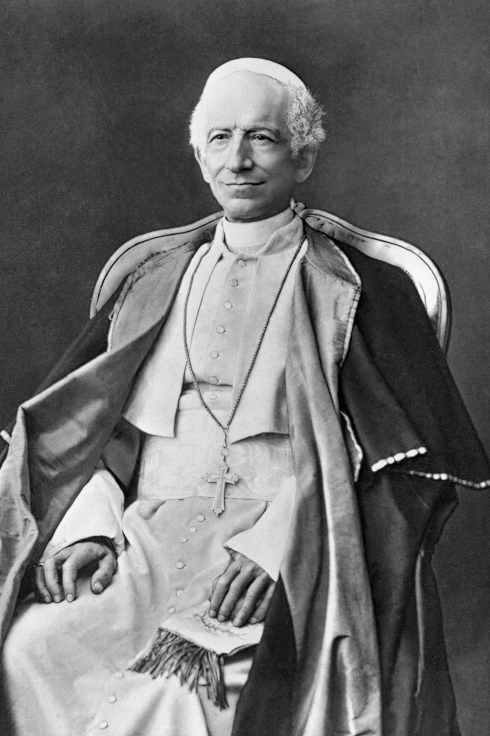
Pope Leo XIII
“We hold upon this earth the place of God Almighty...”
(Pope Leo XIII, Praeclara Gratulationis Publicae June 20, 1894)
“The Almighty, therefore, has given the charge of the human race to two powers, the ecclesiastical (Church) and the civil, (State) the one being set over divine, and the other over human things... There must, accordingly, exist between these two powers a certain orderly connection, which may be compared to the union of the soul and body in man.” (Pope Leo XIII, Rerum Novarum)

Slide 26
Pope Leo XIII
"We exhort all Catholics who would devote careful attention to public matters, to take an active part in all municipal affairs and elections, and to further the principles of the church in all public services, meetings, and gatherings. All Catholics must make themselves felt as active elements in daily political life in the countries where they live. They must penetrate wherever possible in the administration of civil affairs; must constantly exert their utmost vigilance and energy to prevent the usages of liberty from going beyond the limits fixed by God's law. All Catholics should do all in their power to cause the Constitutions of States, and legislation, to be modeled in the principles of the true church. All Catholic writers and journalists should never lose for an instant from view, the above prescriptions. All Catholics should redouble their submission to authority, and unite their whole heart, soul, and body, and mind, in the defense of the church." - Pope Leo XIII 1885 Encyclical {1891 A.T. Jones, The Two Republics 732.1}

Slide 27
Pope Leo XIII
“The working man, too, has interests in which he should be protected by the State; and first of all, there are the interests of his soul. Life on earth, however good and desirable in itself, is not the final purpose for which man is created... No man may with impunity outrage that human dignity which God Himself treats with great reverence, nor stand in the way of that higher life which is the preparation of the eternal life of heaven... To consent to any treatment which is calculated to defeat the end and purpose of his being is beyond his right; he cannot give up his soul to servitude, for it is not man's own rights which are here in question, but the rights of God, the most sacred and inviolable of rights. (41) From this follows the obligation of the cessation from work and labor on Sundays and certain holy days.” (Pope Leo XIII, Rerum Novarum)

Slide 28
Pope Leo XIII
So, too, the liberty of thinking, and of publishing, whatsoever each one likes, without any hindrance, is not in itself an advantage over which society can wisely rejoice... A well-spent life is the only way to heaven, whither all are bound, and on this account the State is acting against the laws and dictates of nature whenever it permits the license of opinion and of action to lead minds astray from truth and souls away from the practice of virtue. To exclude the Church, founded by God Himself, from life, from laws, from the education of youth, from domestic society is a grave and fatal error. A State from which religion is banished can never be well regulated...” (Libertas; Encyclical of Pope Leo XIII on the nature of human liberty, June 20th, 1888

Slide 29

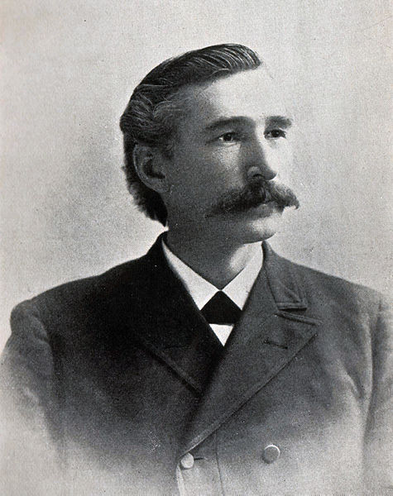
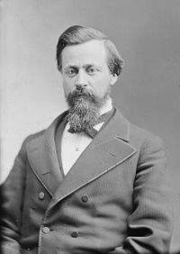
A.T. Jones Before the US Senate Dec 1888
Arguments against a National Sunday Law
If Pope Leo XIV is basing his papacy on the work
of Leo XIII, could he also press for a national
Sunday law?
Is the government and sizable proportion of the
US population motivated to bring religion back to
The US?
Will the US be galvanized by a US Pope to take
Such action of the Pope calls for it?

Slide 30
How shall we respond?
What would Jesus wish us to do?
How do we avoid simply forming an oppositional principle to any force applied
2020-2022 gave to us the Daniel 1 test.
Will the next few years begin for us the Daniel 3 test?
Are we secure in our relationship to our Father in heaven.
Can we have His peace in the midst of a terrible storm?
Will your anchor hold in the coming storm?

Slide 31
Force is the last resort of every false Religion
Trial and persecution will come to all who, in obedience to the Word of God, refuse to worship this false sabbath. Force is the last resort of every false religion. At first it tries attraction, as the king of Babylon tried the power of music and outward show. If these attractions, invented by men inspired by Satan, failed to make men worship the image, the hungry flames of the furnace were ready to consume them. So it will be now. The Papacy has exercised her power to compel men to obey her, and she will continue to do so. We need the same spirit that was manifested by God’s servants in the conflict with paganism. Giving an account of the treatment of the Christians by the emperor of Rome, Tertullian says, “We are thrown to the wild beasts to make us recant; we are burned in the flames; we are condemned to prisons and to mines; we are banished to islands,—such as Patmos,—and all have failed.” So it was in the case of the three Hebrew worthies; their eye was single to the glory of God; their souls were steadfast; the power of the truth held them firmly to their allegiance to God. It is in the power of God alone that we shall be enabled to be loyal to him. { ST May 6, 1897, par. 16 }

Slide 32
No Fear in Love…
1 John 4:18 There is no fear in love; but perfect love casts out fear, because fear involves torment. [Penal infliction or punishment] But he who fears has not been made perfect in love.
Where ever there is the threat of penal infliction or punishment there is fear and where there is fear there is no true love.
Force the Last Resort of EVERY FALSE Religion.
Do we worship a God who uses threats of death for not complying?

Slide 33
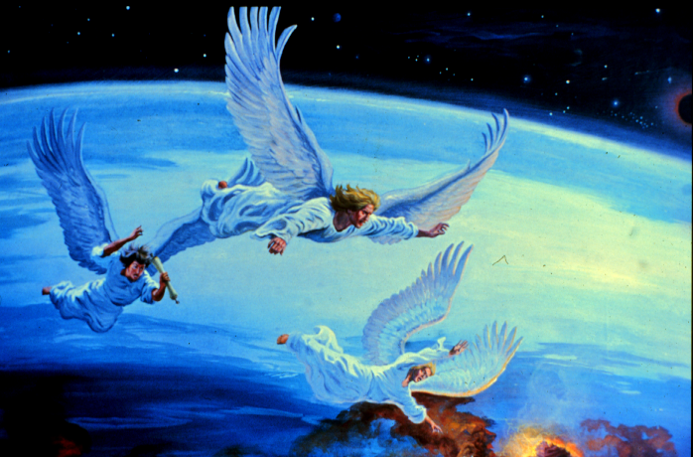
The Third Angel’s Message
Next Session

