Slide 1

2520 and Adventist Identity

Slide 2
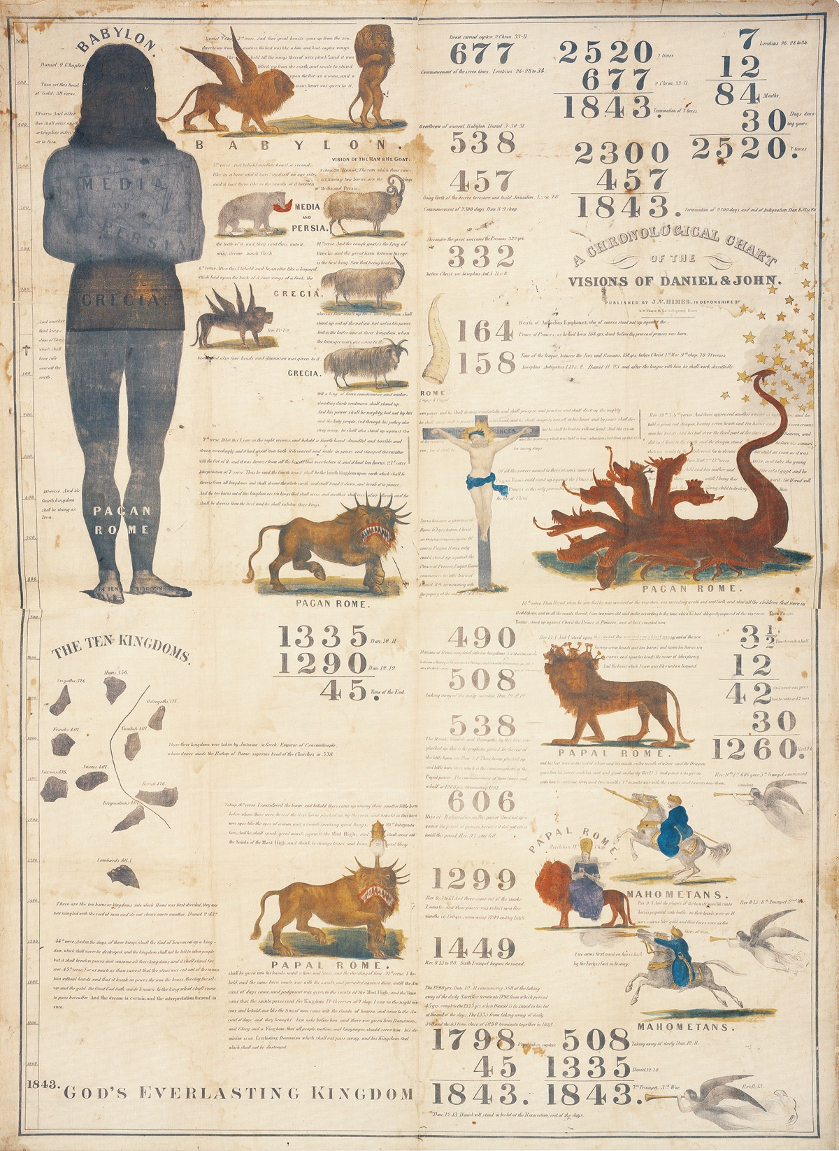
1843 Chart

Slide 3
1843 Chart

Slide 4
Spirit of Prophecy on 1843 Chart
I have seen that the 1843 chart was directed by the hand of the Lord, and that it should not be altered; that the figures were as He wanted them; that His hand was over and hid a mistake in some of the figures, so that none could see it, until His hand was removed. EW 74.1
March
457 BC
456.75
Oct
457 BC
456.25
March
1843.25- 1844.25
Oct
1843.75- 1844.75

Slide 5
1843 Chart

Slide 6
Happiest Year of Ellen White’s Life
Our hopes now centered on the coming of the Lord in 1844. This was also the time for the message of the second angel, who, flying through the midst of heaven, cried, "Babylon is fallen, is fallen, that great city." Revelation 14:8. That message was first proclaimed by the servants of God in the summer of 1844. As a result, many left the fallen churches. In connection with this message the "midnight cry" [See Matthew 25:1-13.] was given: "Behold, the Bridegroom cometh; go ye out to meet Him." In every part of the land light was given concerning this message, and the cry aroused thousands. It went from city to city, from village to village, and into the remote country regions. It reached the learned and talented, as well as the obscure and humble. This was the happiest year of my life. My heart was full of glad expectation; {CET 50, 51}

Slide 7
The Midnight Cry
The tenth day of the seventh month, the great Day of Atonement, the time of the cleansing of the sanctuary, which in the year 1844 fell upon the twenty-second of October, was regarded as the time of the Lord's coming. This was in harmony with the proofs already presented that the 2300 days would terminate in the autumn, and the conclusion seemed irresistible.
In the parable of Matthew 25 the time of waiting and slumber is followed by the coming of the bridegroom. This was in accordance with the arguments just presented, both from prophecy and from the types. They carried strong conviction of their truthfulness; and the "midnight cry" was heralded by thousands of believers.
Like a tidal wave the movement swept over the land. From city to city, from village to village, and into remote country places it went, until the waiting people of God were fully aroused. Fanaticism disappeared before this proclamation like early frost before the rising sun. Believers saw their doubt and perplexity removed, and hope and courage animated their hearts. GC 399,400

Slide 8
The great Second Advent Movement pp 523,524
So the battle went on until July 1844, when the greatest campmeeting that was ever held by Adventists, assembled at the same Exeter, N.H. It was reported that there were three thousand in that encampment. It was held in the woods, in the open, no cloth pavilion for the camp services, but plenty of seats. On Sunday forenoon Elder Joseph Bates was preaching, when a man came riding at full speed into the camp, placed his horse where they kept their stock, then came into the audience, and seated himself by the family of Elder John Couch, and with open Bible, in a whisper, explained to them the cause of their disappointment, and the midnight cry that was now due.

Slide 9
The great Second Advent Movement pp 523,524
Brother Bates was using as an illustration of their course in patient waiting, his experience on nearing home on a sea voyage, after a long absence. The power of God came upon Sister Couch, as she arose, and beckoned to Brother Bates. He said, "Sister, what is it?" She replied, "What you are saying is all very good, but here is a man who has light on the midnight cry." "Well," said Brother Bates, "then let him come up here on the platform, and give it to the people," and he sat down.
The minister who thus walked into the stand was S. S. Snow, who in a few sentences gave them the path of his midnight cry message. Elder James White was in that audience; I was not there, but got my light on the subject from those who were there.

Slide 10
The great Second Advent Movement pp 523,524
The Midnight Cry
Brother Snow thus questioned them; "Where are we in our Advent experience?"
Answer from the audience: "In the tarrying time.“ (Since April 1844)
Question: "How long was the vision to tarry?"
Answer: "Until midnight"
Question: "What is a day in prophecy?"
Answer: "A year."
Question: "Then what would a night be?"
Answer: "Six months."
Question: "Then what would Midnight be?"
Answer: "Three months."
Question: "How long have we been in the tarrying time?"
Answer: "Just three months." (May – June – July)

Slide 11
The great Second Advent Movement pp 523,524
He said, "Then it is just the midnight now, and I am here with the midnight cry." In a few sentences he explained that it was the fall of 457 that the decree went forth, and so they were short six months in their reckoning, showing them that the 2300 days would terminate Oct. 22, 1844, instead of the spring as they had previously supposed. Then, in a strong voice he said, "Behold the Bridegroom cometh on the tenth day of the seventh month, Oct. 22, 1844. Go ye out to meet Him."

Slide 12
The great Second Advent Movement pp 523,524
As he uttered those words the mighty power of God swept over that camp, prostrating many to the ground, suddenly turning that camp into a most powerful confessing and testimony meeting. That was only the beginning of the midnight cry message. Of that movement Brother Southard said, in the Midnight Cry, the paper of which he was the editor, "It swept over the land with the velocity of a tornado, and it reached hearts in different and distant places almost simultaneously, and in a manner which can be accounted for only on the supposition that God was in it." J.N. Loughborough, The Great Second Advent Movement, p 523

Slide 13
Ellen White Sees Midnight Cry in Vision
While I was praying at the family altar, the Holy Ghost fell upon me, and I seemed to be rising higher and higher, far above the dark world. I turned to look for the Advent people in the world, but could not find them, when a voice said to me, "Look again, and look a little higher." At this I raised my eyes, and saw a straight and narrow path, cast up high above the world. On this path the Advent people were traveling to the city, which was at the farther end of the path. They had a bright light set up behind them at the beginning of the path, which an angel told me was the midnight cry. This light shone all along the path and gave light for their feet so that they might not stumble. EW 14

Slide 14
The Elements of the Midnight Cry
The 6000 years (World is 6000 Years Old)
The 2520 year prophecy
The 2300 year prophecy
The Seventy Weeks of Daniel Nine
The year of the crucifixion being AD 31
Friday is the day Christ died that year.
The Karaite Jewish Calendar being the correct calendar by which to determine the biblical festivals and thus determine the date Oct 22 1844 as the date for the day of atonement that year.
The giving of the law on Mt Sinai was a type of the outpouring of the Holy Spirit on the day of Pentecost.
The coming of Christ is connected to the Jubilee and then the anti type of the feast of tabernacles will occur with the marriage supper of the Lamb.
The period of the 1000 years after the coming of Christ is a Millennial Sabbath of Rest.

Slide 15
Midnight Cry Samuel Snow
The seven times of Gentile domination over the church of God, spoken of in Lev. xxvi., began with the breaking of the pride of their power. at the captivity of Manasseh, king of Judah, B. C. 677. See Isa. 10:5-12. Jer. 15:3-9; Jer. 1:17; 2 Chron. 32:9-11. This is the date assigned by all chronologers for that event. The seven prophetic times amount to 2520 years. As proof of this, see Rev, 12:6,14, where 3½ times are equivalent to 1260 years. A time therefore consists of 360 solar years, which multiplied by 7, make 2520. Had this period commenced with the first day of B.C. 677, it would have terminated with the first day of A. D. 1844, for 677 full years on one hand, and 1843 on the other, make 2520 complete years. It has been supposed that the period would end in A. D. 1843. But as a part of B.C. 677 is left out, a corresponding part of A. D. 1844 must be taken in to make the period complete. It must have been in autumn that Manasseh was taken captive. – Midnight Cry Samuel Snow

Slide 16
Midnight Cry Samuel Snow
September 23, the Lord showed me that He had stretched out His hand the second time to recover the remnant of His people, and that efforts must be redoubled in this gathering time. In the scattering, Israel was smitten and torn, but now in the gathering time God will heal and bind up His people. In the scattering, efforts made to spread the truth had but little effect, accomplished but little or nothing; but in the gathering, when God has set His hand to gather His people, efforts to spread the truth will have their designed effect. All should be united and zealous in the work. I saw that it was wrong for any to refer to the scattering for examples to govern us now in the gathering; for if God should do no more for us now than He did then, Israel would never be gathered. I have seen that the 1843 chart was directed by the hand of the Lord, and that it should not be altered; that the figures were as He wanted them; that His hand was over and hid a mistake in some of the figures, so that none could see it, until His hand was removed. EW 74.1

Slide 17
Scattering and Gathering of Israel
Seven Times
677 BC
Scattering
1844 AD
Gathering
2520 Years
Captivity of
King Manasseh in Babylon
2 Chron 33:11
Sanctuary
Cleansed

Slide 18
The Scattering Seven Times
'And if by these things you are not reformed by Me, but walk contrary to Me, then I also will walk contrary to you, and I will punish you yet seven times for your sins. And I will bring a sword against you that will execute the vengeance of the covenant; when you are gathered together within your cities I will send pestilence among you; and you shall be delivered into the hand of the enemy. When I have cut off your supply of bread, ten women shall bake your bread in one oven, and they shall bring back your bread by weight, and you shall eat and not be satisfied. 'And after all this, if you do not obey Me, but walk contrary to Me, then I also will walk contrary to you in fury; and I, even I, will chastise you seven times for your sins. You shall eat the flesh of your sons, and you shall eat the flesh of your daughters. I will destroy your high places, cut down your incense altars, and cast your carcasses on the lifeless forms of your idols; and My soul shall abhor you. I will lay your cities waste and bring your sanctuaries to desolation, and I will not smell the fragrance of your sweet aromas. I will bring the land to desolation, and your enemies who dwell in it shall be astonished at it. I will scatter you among the nations and draw out a sword after you; your land shall be desolate and your cities waste. Leviticus 26:23-33

Slide 19
William Miller
The decree against Judah, was the same as against Israel. They must be scattered among all nations. It could not be revoked, notwithstanding their repentance and partial reformation. Jeremiah xv.4, - "And I will cause them to be removed into all kingdoms of the earth, because of Manasseh, the son of Hezekiah, king of Judah, for that which he did in Jerusalem," - tells us of the same thing, that Judah as well as Israel must be made captives. Israel began to be carried away in the days of Hoshea, 722 B. C., and from that time to 1798 after Christ, is exactly 2520 years, or the seven prophetic years. How remarkable, that when the seven years ended, God began to deliver his church from her bondage, which for ages had been made subject to the kings of the earth. In 1798 the church came out of the wilderness, and began to be delivered from her captivity. But the completion of her slavery to the kingdoms of the earth, is reserved for another period. Beginning B. C., 677 years, seven prophetic years, or 2520 common years, would end in A. D. 1843.

Slide 20
William Miller
Therefore, beginning at the captivity of Manasseh and the final dispersion of the ten tribes of Israel, where God has fixed the time for the dispersion of the people of God and the scattering of the holy people, until the year 1843, will be the end of the seven years, when the acceptable year of the LORD will commence; and, in my humble opinion, the children of God will be delivered from all the evils enumerated by Moses in Leviticus xxvi., and Jeremiah xv.; from war or the sword, from pestilence and famine, from captivity and spoil, from death and corruption; and all will be comforted, and all tears be wiped from off all faces; sighs and sorrows shall cease forever, and there shall be no more curse, for the throne of the Lamb shall be there, and he shall dwell with them, and be their God, and they shall be his people. This will take place in the acceptable year of the Lord, the antitypical year of release. {1842 William Miller Lecture on the Typical Sabbaths and Great Jubilee 18.1}

Slide 21
Scattering and Gathering of Israel/Church
722 BC
Seven Times
1798 AD
2520 Years
538 AD
Times of the Gentiles Luke 21:24, Rev 11:2
1260 Years (3½ Times)
1260 Years (3½ Times)
677 BC
Israel under Pagan Rule
Daily Desolator - Visible
Israel under Papal Rule
Desolator - Spiritual
1844 AD
2520 Years
508 AD
1290 Years
1335 Years
Captivity of
King Manasseh in Babylon
2 Chron 33:11
Pope taken
Captive – Yoke Broken
Daily taken
Away/Exalted
European Kings
Now become the Papal
Armies RH Dec 9 1851.
Captivity of
Northern
Kingdom
by Assyria
2 Kings 17:24
Sanctuary
Cleansed

Slide 22
2520 and the Everlasting Covenant
722 BC
Seven Times
1798 AD
2520 Years – Everlasting Covenant
538 AD
1260 Years (3½ Times)
1260 Years (3½ Times)
677 BC
1844 AD
2520 Years – Everlasting Covenant
508 AD
1290 Years
1335 Years
For he is not a Jew who is one outwardly, nor is circumcision that which is outward in the flesh; but he is a Jew who is one inwardly; and circumcision is that of the heart, in the Spirit, not in the letter; whose praise is not from men but from God. Romans 2:28-29
Church Scattered
Source
Church Gathered
Channel
Same Church

Slide 23
The 2520
Part of the Midnight Cry that lights the path to the city
Connects the current church to Israel of old. This means of the identity of the true church is connected to Israel.
This means the true church has not come from Rome but from Israel.
Maintains the Everlasting Covenant with God and His People. It destroys the idea that New Covenant made with Church after 31AD. God made the everlasting covenant with Israel which was renewed in Christ, the seed.
The remnant are not protestants, protesting against mother Rome. The remnant are not a remnant of Rome but of Israel – True Israel.
The Protestant Reformation is not the foundation of restored Christianity. It is a window to escape Babylon and come back to True Israel.

