Slide 1

Facing Ourselves

Slide 2
The Laodicean Problem
Rev 3:17 Because thou sayest, I am rich, and increased with goods, and have need of nothing; and knowest not that thou art wretched, and miserable, and poor, and blind, and naked:

Slide 3
The 4 points of inheritance
Shame – “hid themselves” “made fig leaves”
Fear – “I was afraid”
Projection – “The woman”
Enmity – “Whom you gave” Penal substitution.

Slide 4
The process explained
After Adam and Eve had partaken of the forbidden fruit, they were filled with a sense of shame and terror. [1] At first their only thought was, how to excuse their sin before God, [2] and escape the dreaded sentence of death …[3] The spirit of self-justification originated in the father of lies, and has been exhibited by all the sons and daughters of Adam. (5T 637, 638).

Slide 5
The Seed of the Cross
The original sin of Adam and Eve was to the cross at Calvary what the acorn is to the oak. The seed or resentment against God is evident in Adam’s statement blaming Him. But Adam would have been horrified had he fully realized how this seed would grow into the eventual murder of the Son of God. He would have been unable to endure the full disclosure of the real dimensions of his guilt.

Slide 6
All guilty of the Cross
That prayer of Christ for His enemies embraced the world. It took in every sinner that had lived or should live, from the beginning of the world to the end of time. Upon all rests the guilt of crucifying the Son of God. (DA 745).

Slide 7
Evidence of Repressed Guilt
Shame
Fear
Judging others
Enmity/Hatred

Slide 8
The Murder of Jesus rests on the whole world
“Let us all remember that we are still in a world where Jesus, the Son of God, was rejected and crucified, where the guilt of despising Christ and preferring a robber rather than the spotless Lamb of God still rests. … The whole world stands charged today with the deliberate rejection and murder of the Son of God. … All classes and sects who reveal the same spirit of envy, hatred, prejudice, and unbelief manifested by those who put to death the Son of God would act the same part, were the opportunity granted, as did the Jews and people of the time of Christ. They would be partakers of the same spirit that demanded the death of the Son of God.” (TM 38).

Slide 9
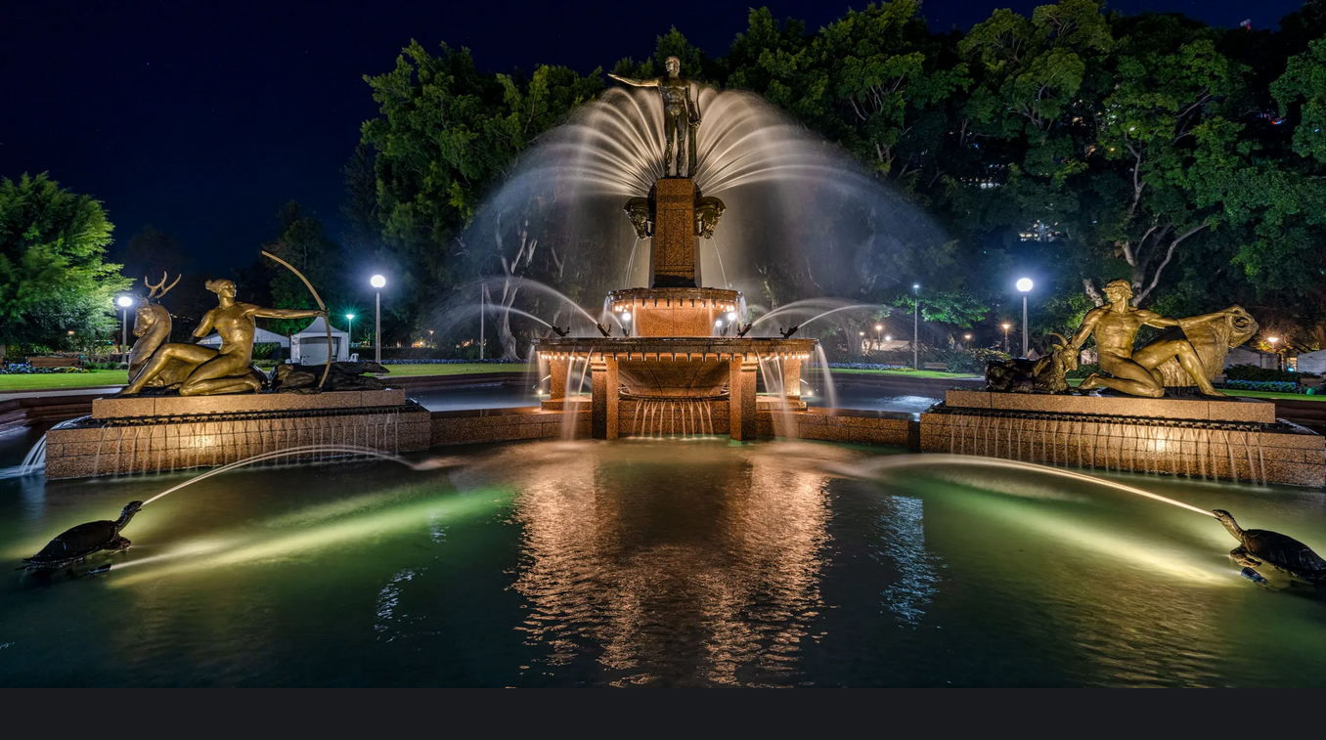

Slide 10
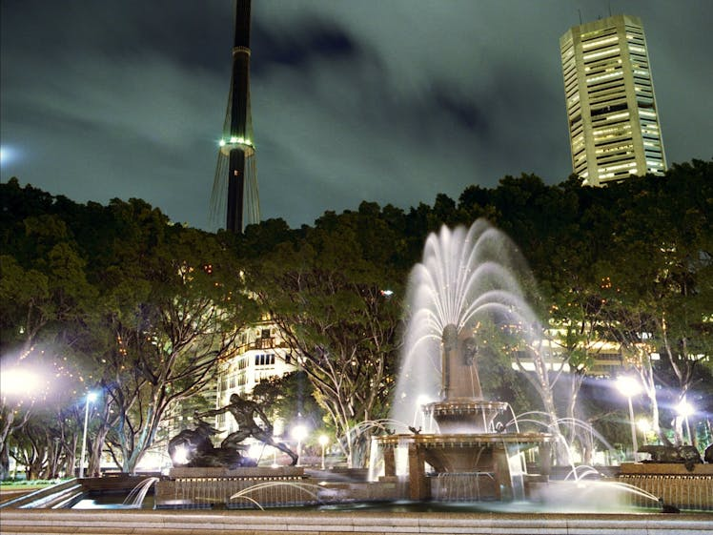

Slide 11
Escaping the Pentagon of Lies
Looking into the fountain, the light of the moon reflected the image of Apollo. Maatan, in his research, had discovered that the other characters were Diana, Pan and Theseus at the back. Diana and Pan were beside Apollo reflected in the water. Suddenly there appeared in the reflected surface what appeared to be a Cross rising from the earth. Apollo appeared to leap from his position and spat in the face of the dying form upon the Cross. He spoke in thunderous tones, “We have a law and by our law you must die.”
Maatan shuddered at the sound of the voice and took a few steps back as he watched the drama unfold in the reflected mirror surface of the water. He then looked up out of the water’s reflection, and the statue of Apollo was as still and as quiet as it always had been.

Slide 12
Escaping the Pentagon of Lies
At that moment, at the edge of the fountain, there appeared to Maatan that all the inhabitants of the city were watching the person upon the Cross. Some were railing and cursing, while others were laughing and mocking. A few looked sorrowful and concerned for the One upon the Cross.
A light began to come up out of the Cross and fell upon the watching crowd.

Slide 13
Escaping the Pentagon of Lies
Pan raced towards the Cross and appeared to be wrapping thin threads around the form of the One upon the Cross. It seemed as though he were trying to alter the perception of what was actually taking place. Through his musical skills and his talents in philosophy, he cast a spell over the people to interpret for them the meaning of the event. Diana dressed herself in the garments of a priest and started to enact a ritual service before the Cross, waving incense and speaking words in Latin. The crowd seemed transfixed by the enchantments of Diana. Her form and her beauty captivated the majority of the crowd. Her dress had a split in it that went right to her thigh. She could not conceal the true nature of her trade in the light of the moon, yet only those who were resonating in the atmosphere of heaven could detect these things. The whole world seemed to wonder after this woman who, aided by Pan’s mystical philosophy, kept the people subdued to the authority of Apollo. Apollo himself stood with majesty, seeking to affect the appearance of a king.

Slide 14
Escaping the Pentagon of Lies
After this, Maatan could hear the whispering of the wind through the water spraying from the fountain, crying: “Crucify him! Crucify him!” A voice was heard that said:
“Come down from the Cross and we will believe you!
He saved others but Himself he cannot save!”

Slide 15
Escaping the Pentagon of Lies
Maatan’s heart was racing with a mixture of sorrow and terror. The sound of thunder, at first far but coming closer and closer, caught his attention. Suddenly the sky lit up with the power of lightning that seemed to strike the Cross. It would appear that Apollo’s father, Zeus, had come to see that justice was done. Maatan cried out in terror as he fell to the ground. In the blaze of lightning, he saw the face of Jesus; the man of sorrows and acquainted with grief. Tears fell from Maatan’s face and he was crying out to all in this theatre that had sprung to life in the light of the new moon, “Leave him alone! He has done nothing worthy of death!” The lightning struck again in exactly the same place and the ground shook violently, and the suffering Saviour remained silent upon the Cross.

Slide 16
Escaping the Pentagon of Lies
Maatan’s heart was racing with a mixture of sorrow and terror. The sound of thunder, at first far but coming closer and closer, caught his attention. Suddenly the sky lit up with the power of lightning that seemed to strike the Cross. It would appear that Apollo’s father, Zeus, had come to see that justice was done. Maatan cried out in terror as he fell to the ground. In the blaze of lightning, he saw the face of Jesus; the man of sorrows and acquainted with grief. Tears fell from Maatan’s face and he was crying out to all in this theatre that had sprung to life in the light of the new moon, “Leave him alone! He has done nothing worthy of death!” The lightning struck again in exactly the same place and the ground shook violently, and the suffering Saviour remained silent upon the Cross.

Slide 17
Escaping the Pentagon of Lies
The crowd seemed not to notice Maatan’s cry when suddenly Theseus came from the back part of the fountain with his great sword.
He seemed ready to slay the victim on the Cross as a sacrifice before Apollo, Pan and Diana; the three great gods at the front of the fountain.
Pan and Diana appeared to merge into the form of Apollo until He seemed utterly Omnipotent, towering with a look of rage over the victim on the Cross. Theseus knelt before this three-in-one god, and as he arose the command was given to slay the sacrifice for the good of humanity.

Slide 18
Escaping the Pentagon of Lies
At that moment, a voice came forth from the Cross, “It is finished!” The entire face of Jesus was lit up, and the crowd around the fountain fell back to the ground. Theseus picked himself up in anger after having been prostrated to the ground. He leaped forward towards the Cross and thrust his sword into the side of the Saviour, much to the satisfaction of the three-in-one form. Its wrath seemed satisfied in the expiry of the victim.
As Maatan looked up towards the form of Apollo, the light of the moon revealed more clearly the face of this august being. In complete anguish and horror, Maatan saw his own face imprinted upon the form of Apollo.

Slide 19
Escaping the Pentagon of Lies
At that moment, the ground seemed to open and there spewed forth a legion of evil angels that came and surrounded Maatan, intent in preventing him from looking towards the crucified form upon the Cross in faith.
Maatan cried out in anguish of spirit. Lord Jesus, forgive me for this great sin. I abhor myself and I can’t explain to You why this is happening. He fell to the ground, and the heavens opened and rain fell in torrents, soaking him instantly to the bone. There also came forth fiery hail. Diana leapt forth from the form of Apollo and tried to grab Maatan by the throat and choke him to prevent him from making his confession.

Slide 20
Escaping the Pentagon of Lies
“I have not come this far to die at the hands of this prostituted woman,” cried Maatan. His flesh started to rise up to strike the woman, and sensing this happening, Theseus offered Maatan his sword with a wicked smile. He then spoke, “We plan to burn this whore with fire when we are done with her, but if you wish, I can prepare you to join us for that event.”
Maatan recoiled in horror at the feelings rising inside of him. The desire to murder, the sense of justice demanding death - he was overwhelmed by it.

Slide 21
Escaping the Pentagon of Lies
Why did I demand this of the crucified Saviour, and why do I now desire to murder this woman?
Maatan cried out in despair, “Lord, remember me when you come into your kingdom.” Instantly the scene ended, the crowd was gone and Maatan was alone again, feeling completely dry. Maatan spun around trying to understand what had just happened. Where did everyone go? The night shadows over the fountain seemed completely still except for the soft breeze through the water of the fountain.

Slide 22
WhAt Enables You to Ask the Lord to Remember you When He Comes?
The assurance that our Father is not a destroyer
That our Father is ever merciful and freely forgives
The Jesus is the full revelation of the Father.
That you have embraced the truth that you are beloved of the Father.
That you know by faith that your Father does not condemn you nor ever has or will become impatient with you.

Slide 23
Final reconciliation
Zec 12:10 "And I will pour on the house of David and on the inhabitants of Jerusalem the Spirit of grace and supplication; then they will look on Me whom they pierced. Yes, they will mourn for Him as one mourns for his only son, and grieve for Him as one grieves for a firstborn.
We face ourselves and accept that we are indeed murderers of the Son of God.
We confess our shame, fear, judgment and enmity are all fruit of this truth.
We pray for the Latter Rain.
We shall pass through a deep anguish of soul in realising the full implications of our actions towards God and His Son.
The present message of God’s loving character aided by the Spirit will allow us to survive the process and still live. Otherwise we would be crushed.
We receive the seal of God and our Sin/sins are blotted out.

