Slide 1
Name:
    Ian – John (Scottish) The beloved
    David – Man after Gods Heart
    ANQUETIL – Nordic 1100ad – Gods Cauldron/Kettle

Slide 2
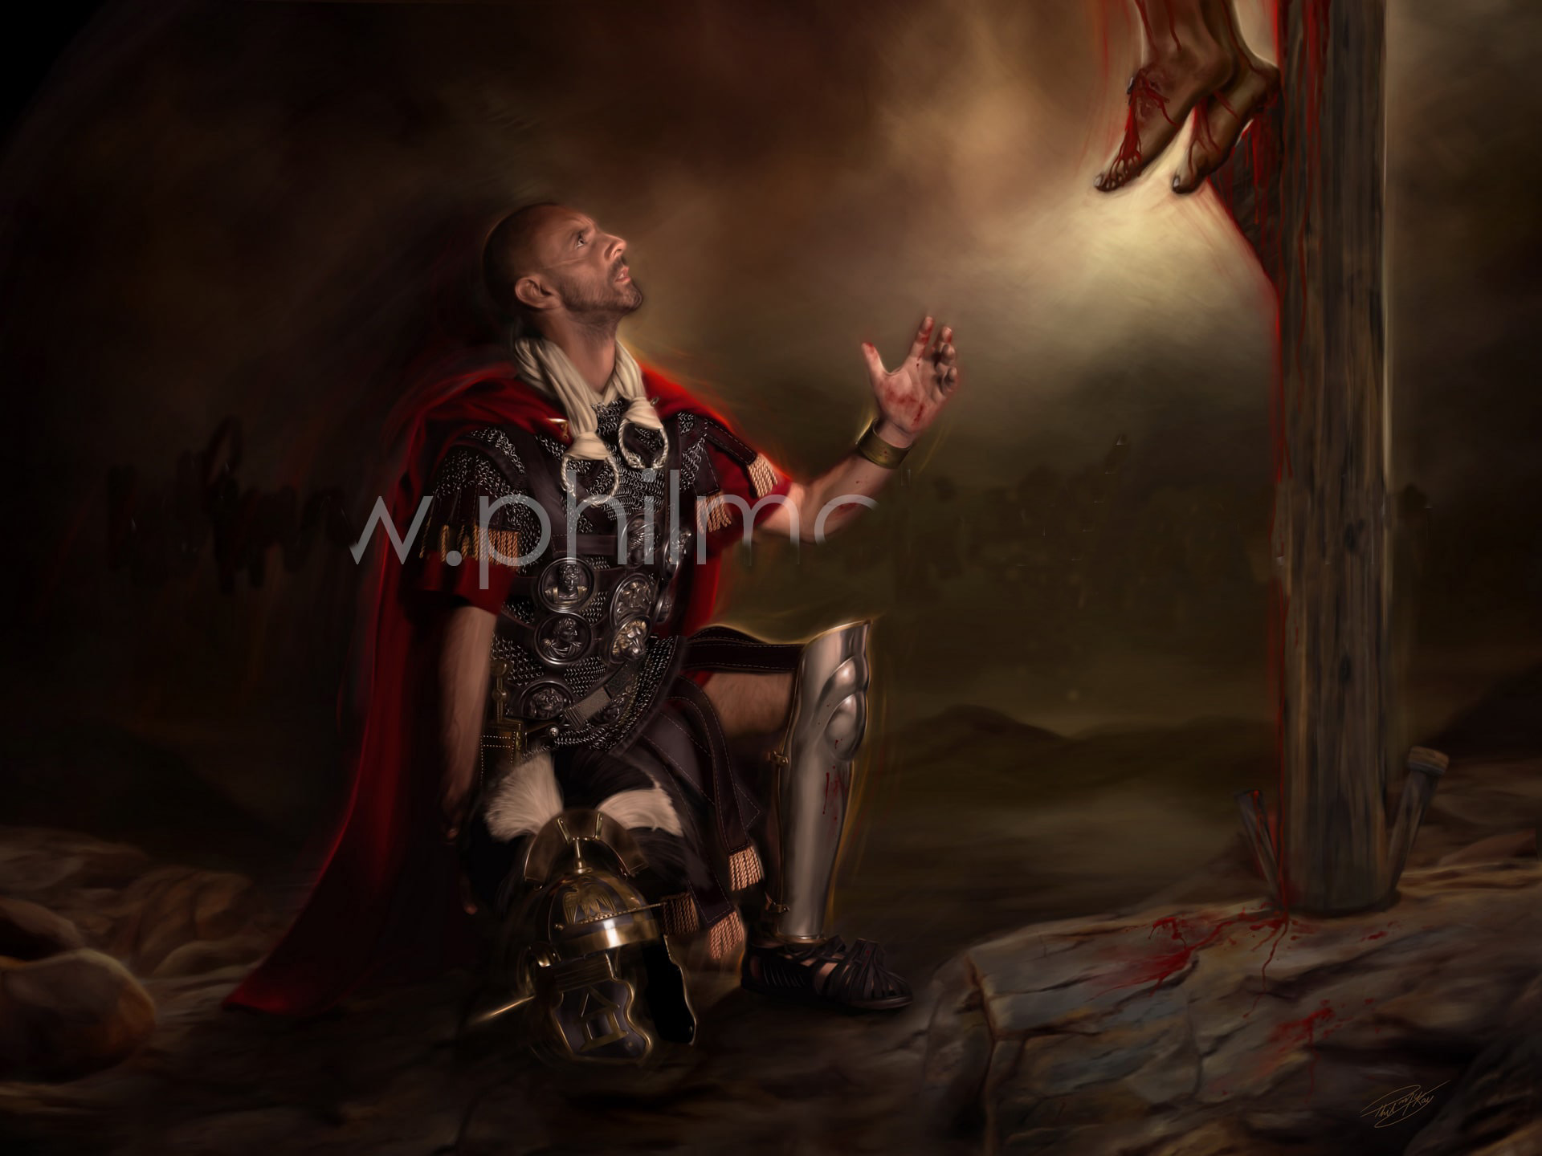

Slide 3
How did I get here? (Glenwood)
When I look back, I can see Yehovah’s hand on my/our lives.
  1968-83 Indoctrinated by the world
  1983-88 Independent thought – pursuit of Identity
  1989 Marriage covenant – Megan becomes my wife
  1990-96 Children - Luke, Cherice and Samantha
  1992 The little voice – Go to church
  1997 Tattoo - Salvation
  2006 Mathew 5:17 Think not that I am come to destroy the law, or the prophets: I am not come to detroy , but fulfil
  2007 The law entered: Romans 7:8-11

Slide 4
How did I get here? (Glenwood)
When I look back, I can see Yehovah’s hand on my/our lives.
  2009 The Darkness
  2011 Conversion and light enters
  2012 Apologise and Baptism (Old Covenant)
  2015 ARISE and struggle.
  2016 Bible work and
  2017-19 OTG and disunity
  2020-25 New covenant Glory

