Slide 1

Identity War

Slide 2
The Blessing
And it came to pass in those days, that Jesus came from Nazareth of Galilee, and was baptized of John in Jordan. And straightway coming up out of the water, he saw the heavens opened, and the Spirit like a dove descending upon him: And there came a voice from heaven, saying, Thou art my beloved Son, in whom I am well pleased. Mark 1:9-11

Slide 3
Outside the Channel Of Blessing
It is crucial to remember that in God’s kingdom a person’s identity and value are bound up in their relationship to the Creator God, our heavenly Father. When Lucifer stepped out of that relationship, he mentally and emotionally suicided and opened an unexpected floodgate of dark emotions. Prior to Lucifer’s rebellion, if you had asked him – “Who are you?” he would have said with calm assurance and confidence, “I am a son of God, and He loves me.” Once Lucifer rejected his Father, if you had asked him the same question, “Who are you Lucifer?” what could he say? He no longer had an identity, he had destroyed it. Whatever identity he would seek to create for himself from that point forward, would never, never fill that emptiness and sense of loss he experienced from breaking his close relationship with his heavenly Father. – Identity Wars page 28.

Slide 4
Christ Has Reconnected US Through the Blessing
And the word that was spoken to Jesus at the Jordan, “This is My beloved Son, in whom I am well pleased,” embraces humanity. God spoke to Jesus as our representative. With all our sins and weaknesses, we are not cast aside as worthless. “He hath made us accepted in the Beloved.” Ephesians 1:6. The glory that rested upon Christ is a pledge of the love of God for us. It tells us of the power of prayer,—how the human voice may reach the ear of God, and our petitions find acceptance in the courts of heaven. By sin, earth was cut off from heaven, and alienated from its communion; but Jesus has connected it again with the sphere of glory. His love has encircled man, and reached the highest heaven. The light which fell from the open portals upon the head of our Saviour will fall upon us as we pray for help to resist temptation. The voice which spoke to Jesus says to every believing soul, This is My beloved child, in whom I am well pleased. DA 113.1

Slide 5
The Blood/Wine of Jesus
Then He took the cup, and gave thanks, and gave it to them, saying, "Drink from it, all of you. For this is My blood of the new covenant, which is shed for many for the remission of sins. Matthew 26:27-28
and from Jesus Christ, the faithful witness, the firstborn from the dead, and the ruler over the kings of the earth. To Him who loved us and washed us from our sins in His own blood, Rev 1:5
Binding his donkey to the vine, And his donkey's colt to the choice vine, He washed his garments in wine, And his clothes in the blood of grapes. Genesis 49:11

Slide 6
Wine = Blessing that Makes Glad
Thus saith the LORD, As the new wine is found in the cluster, and one saith, Destroy it not; for a blessing is in it: so will I do for my servants' sakes, that I may not destroy them all. Isaiah 65:8
"Then the trees said to the vine, 'You come and reign over us!' But the vine said to them, 'Should I cease my new wine, Which cheers [H8055] both God and men, And go to sway over trees?' Judges 9:12-13
And wine that makes glad [H8055] the heart of man, Oil to make his face shine, And bread which strengthens man's heart. Psalms 104:15

Slide 7
Wine = Gladness, Rejoicing or Delight From Sonship
Anxiety in the heart of man causes depression, But a good word makes it glad. [H8055] Proverbs 12:25
Then I was by him, one brought up: and I was daily his delight, rejoicing always before him; Proverbs 8:30
And lo there came a voice from heaven saying: this is that my dear son, in whom is my delight. Matthew 3:17 Tyndale
There is a river whose streams shall make glad [H8055] the city of God, The holy place of the tabernacle of the Most High. Psalms 46:4
The Spirit itself beareth witness with our spirit, that we are the children of God: Romans 8:16

Slide 8
The WINE of Satan
Many times he [Satan] wished he could regain what he had lost, but his pride would never let him. In addition to that, deep down inside he would never believe that he could be forgiven after his brazen ingratitude and open rebellion. Lucifer, now Satan, which means ‘opposer’, stands alone. There is no one to hold him, no parental figure to turn to, and no place to call home. Now Satan is animated by all the emotions of worthlessness: insecurity, fear, emptiness, jealousy, pride, self-justification, arrogance, rage, anger and a controlling spirit.
Satan did not know which way was up anymore. He had to redefine who he was and somehow smother that emptiness, that worthlessness, that nothingness that he felt inside. Like any child who feels worthless, Satan carries all the marks of insecurity, fear, insanity and a desperate need for approval from whomever he can get it. He craves attention, and to satisfy that emptiness, his perverted nature yearns to be worshipped, adored and loved – anything to take away the pain, the loneliness and the worthlessness – anything. Identity Wars pages 28,29

Slide 9
The Wine of Satan
The wretchedness he realized in losing the sweet light of Heaven, and the sense of guilt which forced itself upon him, and the disappointment he experienced himself in not finding his expectations realized, were the cause of his grief. To be commander out of Heaven, was vastly different from being thus honored in Heaven. The loss he had sustained of all the privileges of Heaven seemed too much to be borne. He wished to regain these. { 1SP 30.1 }

Slide 10
Satan Continues His War on Earth
Cush begot Nimrod; he began to be a mighty one on the earth. He was a mighty hunter before the LORD; therefore it is said, "Like Nimrod the mighty hunter before the LORD." And the beginning of his kingdom was Babel, Erech, Accad, and Calneh, in the land of Shinar.
Genesis 10:8-10
The warfare against God’s law commenced in heaven. Satan was determined to bring God to his ideas, his way, to force Him to change the law of His government. This was the cause of the war in heaven. Satan worked upon the sympathies of the angelic host by his deceptive attitude, but he was expelled from heaven, and now he is determined to carry out on this earth the plans [he] instituted in heaven. { 12MR 37.1 }

Slide 11
Extension of Satan’s Kingdom
With the setting up of Nimrod's kingdom, the entire ancient world entered a new historical phase. The oriental tradition which makes that warrior the first man who wore a kingly crown, points to a fact more significant than the assumption of a new ornament of dress, or even the conquest of a province. His reign introduced to the world a new system of relations between the governor and the governed. The authority of former rulers had rested upon the feeling of kindred, and the ascendancy of the chief was an image of parental control. Nimrod, on the contrary, was a sovereign of territory, and of men just so far as they were its inhabitants, and irrespective of personal ties. Hitherto there had been tribes—enlarged families—Society; now there was a nation, a political community—the State. A.T Jones. Empires of the Bible. 1904 Page 51

Slide 12
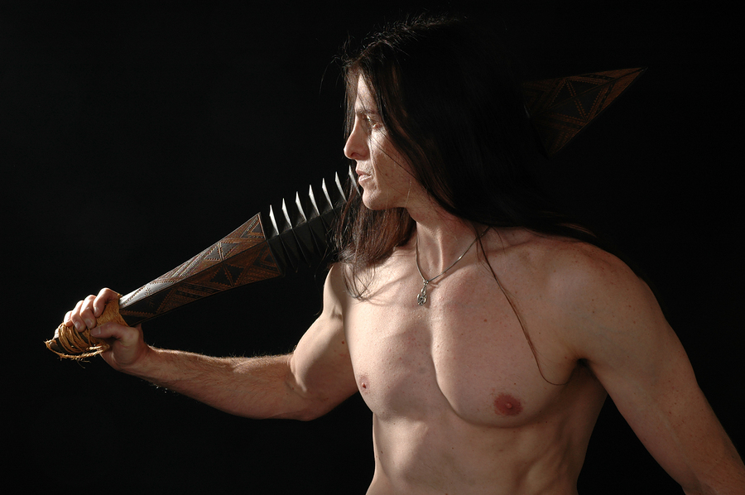

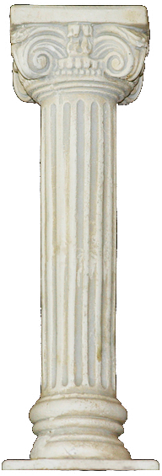
The Curse of Babylon
Nimrod, The Mighty (Tyrant) Hunter
Perverted
Family
Insecure
Rebellious
Controlling
Kingdom Pillars

Slide 13
Foundations of Babylon
1. Perverted family relationships | Ham’s act towards his father resulted in cursing his genealogy and laid the seeds for Nimrod’s perverted family structure.
2. Rejection of family blessing and authority structure | Dominion ruled by territory rather than the affection of family ties. The forming of his own kingdom apart from God.
3. Insecurity, worthlessness and confused identity | The loss of the family blessing caused Nimrod to seek worship by becoming a mighty one. The name Babylon means confusion.
4. Controlling | The attribute of tyranny is the spirit of the need to control others by force, since there is no connection via family ties to cause respect. The desire for empire is reflected in the list of territories attributed to his ownership.

Slide 14

The Curse of Babylon
Broken family relationships can turn into despotic ruling powers
Tit 2:3-5 the older women likewise, that they be reverent in behavior, not slanderers, not given to much wine, teachers of good things-- 4 that they admonish the young women to love their husbands, to love their children, 5 to be discreet, chaste, homemakers, good, obedient to their own husbands, that the word of God may not be blasphemed.

Slide 15

World Dominion Under Babylon
Dan 4:20-22 The tree that you saw, which grew and became strong, whose height reached to the heavens and which could be seen by all the earth, 21 whose leaves were lovely and its fruit abundant, in which was food for all, under which the beasts of the field dwelt, and in whose branches the birds of the heaven had their home-- 22 it is you, O king, who have grown and become strong; for your greatness has grown and reaches to the heavens, and your dominion to the end of the earth.

Slide 16
World Dominion Under Babylon
Dan 4:30 The king spoke, saying, "Is not this great Babylon, that I have built for a royal dwelling by my mighty power and for the honor of my majesty?"

Slide 17
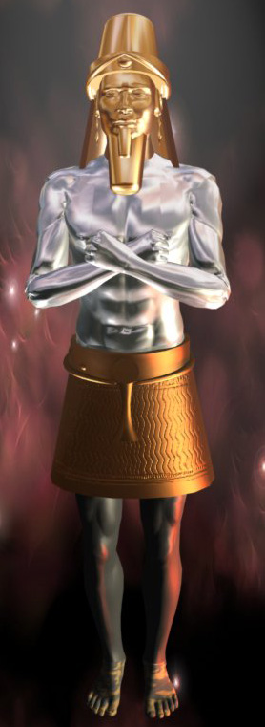
A Litany of Family Tragedy
Nimrod – founder of Babylon married his mother.
Babylonian Sun Worship required prostitution – to consort with a stranger in the temple
Cyrus had to be hidden from his father who wanted to kill him
Philip of Macedon told his son at age 12 to get his own kingdom as there was not enough room for both of them.
Alexander slept with both male and female. After his death his wife Roxana and child and brother were all murdered. Alexander’s mother also was murdered after doing some killing of her own.
BABYLON
MEDO-PERSIA
GREECE
ROME

Slide 18
A Litany of Family Tragedy
King of the North Antiochus Theos after having been defeated by Ptolemy Philadephus made peace by putting away his family and promising to marry Philadelphus’ daughter Berenice. After Philadelphus died Antiochus Theos put away his new wife and recalled his former wife – Laodice. Laodice having learned well from her husband, Murdered him to make sure she would not be put away and that her son would rule the kingdom. She also murdered Berenice and her son for good measure.
Rome was founded by Romulus – who murdered his brother, smashing his skull with a rock. When setting up Rome he invited all the robbers and thieves and any who would come to be part of his town. Plenty of men came but no woman. To build an empire you need women, so he invited the neighouring tribes to a feast and then surprised them by carrying of 30 of the young maidens. What fine families would have been created from that episode.
As you read the annals of Rome Leaders. You read of murder, intrigue and butchery within families.
The so called Christian Constantine drowned his wife in a hot bath and murdered his son’s to keep them from threatening his throne.
The medieval church did little to represent families – having their priest celibate and presenting the model relationship as Madonna and child rather than husband and wife.

Slide 19
Worthlessness Rises
Dan 4:17 'This decision is by the decree of the watchers, And the sentence by the word of the holy ones, In order that the living may know That the Most High rules in the kingdom of men, Gives it to whomever He will, And sets over it the lowest of men.'

Slide 20
Tempted of Satan; Wild Beasts
Immediately the Spirit drove Him into the wilderness. And He was there in the wilderness forty days, tempted by Satan, and was with the wild beasts; [G2342] and the angels ministered to Him. Mark 1:12-13
Wild Political Beasts grow out of worthlessness, lack of blessing. Fermented Wine, the blood of Satan.

Slide 21
Wild Beasts
Immediately the Spirit drove Him into the wilderness. And He was there in the wilderness forty days, tempted by Satan, and was with the wild beasts; [G2342] and the angels ministered to Him. Mark 1:12-13
Wild Political Beasts grow out of worthlessness, lack of blessing. Fermented Wine, the blood of Satan.

Slide 22
Wild Beasts
Immediately the Spirit drove Him into the wilderness. And He was there in the wilderness forty days, tempted by Satan, and was with the wild beasts; [G2342] and the angels ministered to Him. Mark 1:12-13
Rev 13:1 Then I stood on the sand of the sea. And I saw a beast [G2342] rising up out of the sea, having seven heads and ten horns, and on his horns ten crowns, and on his heads a blasphemous name.
Rev 13:11 Then I saw another beast [G2342] coming up out of the earth, and he had two horns like a lamb and spoke like a dragon.

Slide 23
Overcoming the beast and its Image
Live by Every Word of God. You are my beloved Son.
Win the Identity War – If you are a son/daughter of God.
Victory of appetite. Daniel 1 test/Not live by bread alone.
Victory over presumption – throw yourself down.
Worship the Only True God and His Son.

