Slide 1
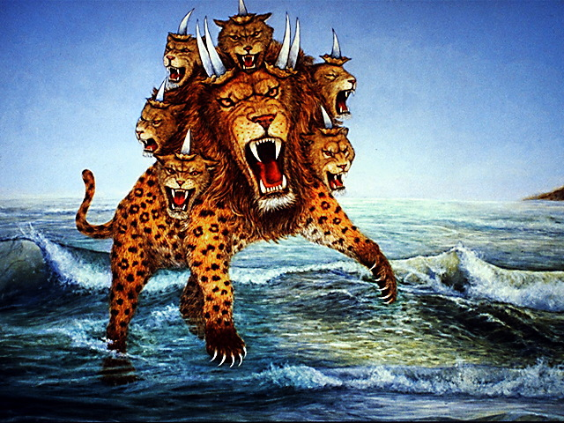
Render Unto Caesar

Slide 2
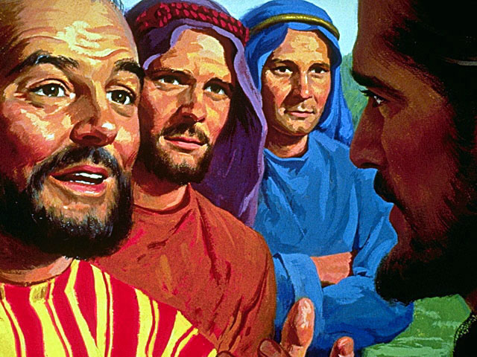
Jesus Says Read the Book of Daniel
And this gospel of the kingdom will be preached in all the world as a witness to all the nations, and then the end will come. "Therefore when you see the 'Abomination [idolatry] of Desolation,' spoken of by Daniel the prophet, standing in the holy place" (whoever reads, let him understand), Matthew 24:14-15

Slide 3
Authority over every nation
Then he opened his mouth in blasphemy against God, to blaspheme His name, His tabernacle, and those who dwell in heaven. It was granted to him to make war with the saints and to overcome them. And authority was given him over every tribe, tongue, and nation. All who dwell on the earth will worship him, whose names have not been written in the Book of Life of the Lamb slain from the foundation of the world. Rev 13:6-8

Slide 4
Bible Definition of Blasphemy
1. Man Claiming to be God
The Jews answered Him, saying, "For a good work we do not stone You, but for blasphemy, and because You, being a Man, make Yourself God." John 10:33
2. Man Claiming Power to Forgive Sins
"Why does this Man speak blasphemies like this? Who can forgive sins but God alone?" Mark 2:7

Slide 5
Claims to be God on Earth
Hence the Pope is crowned with a triple crown, as king of heaven and of earth and of the lower regions. Moreover the superiority and the power of the Roman Pontiff by no means pertain only to heavenly things, to earthly things, and to things under the earth, but are even over angels, than whom he is greater. So that if it were possible that the angels might err in the faith, or might think contrary to the faith, they could be judged and excommunicated by the Pope. For he is of so great dignity and power that he forms one and the same tribunal with Christ. So that whatever the Pope does, seems to proceed from the mouth of God, as according to most doctors, etc. The Pope is as it were God on earth, sole sovereign of the faithful of Christ, chief king of kings, having plenitude of power, to whom has been intrusted by the omnipotent God direction not only of the earthly but also of the heavenly kingdom. The Pope is of so great authority and power that he can modify, explain, or interpret even divine laws. —Extracts from Ferraris's Ecclesiastical Dictionary (R. C.), article on the Pope.

Slide 6
Claims for Papal Authority
We hold upon this earth the place of God Almighty.—Pope Leo XIII, in an encyclical letter dated June 20, 1894, "The Great Encyclical Letters of Leo XIII," p. 304. New York: Benziger Brothers.
It is shown with sufficient clearness that by the secular power the Pope cannot in any way be bound or loosed, who it is certain was called God by the pious leader Constantine, and it is clear that God cannot be judged by man.—Decree of Gratian, part 1, div. 96, chap. 7.
All names which in the Scriptures are applied to Christ, by virtue of which it is established that he is over the church, all the same names are applied to the Pope.—"On the Authority of Councils," Bellarmine (R. C.), book 2, chap. 17 (Vol. II, p. 266), ed. 1619.

Slide 7
Freedom of Conscience?
So, too, the liberty of thinking, and of publishing, whatsoever each one likes, without any hindrance, is not in itself an advantage over which society can wisely rejoice... A well-spent life is the only way to heaven, whither all are bound, and on this account the State is acting against the laws and dictates of nature whenever it permits the license of opinion and of action to lead minds astray from truth and souls away from the practice of virtue. To exclude the Church, founded by God Himself, from life, from laws, from the education of youth, from domestic society is a grave and fatal error. A State from which religion is banished can never be well regulated...” (Libertas; Encyclical of Pope Leo XIII on the nature of human liberty, June 20th, 1888

Slide 8
Freedom of Conscience?
The absurd and erroneous doctrines or ravings in defense of liberty of conscience, are a most pestilential error—a pest, of all others, most to be dreaded in a State. – Pope Pius IX., in his Encyclical Letter of August 15, 1854,
"The pacific tone of Rome in the United States does not imply a change of heart. She is tolerant where she is helpless. Says Bishop O'Connor: 'Religious liberty is merely endured until the opposite can be carried into effect without peril to the Catholic world.'. . . The archbishop of St. Louis once said: 'Heresy and unbelief are crimes; and in Christian countries, as in Italy and Spain, for instance, where all the people are Catholics, and where the Catholic religion is an essential part of the law of the land, they are punished as other crimes.'. . . Great Controversy 565.1

Slide 9
The Significance of Martin Luther
For nearly 500 years, Martin Luther's view of "conscience" has been the subject of a consistent, occasionally cantankerous, controversy-and this controversy has grown into an impressive tradition of scholarly research. Luther has been called, with respect to conscience, a "…Christopher Columbus in the world of faith, who finds new and good land on the other side of what was thought to be the abyss." Similarly, others have labeled Luther "the discoverer of conscience." As initiator of the "Luther-Renaissance," Karl Holl, lecturing at the University of Berlin in 1917 to mark the 400th anniversary of the posting of the 95 Theses, spoke these famous words, "Luther's religion is a religion of conscience, in its most graphic sense. Journal of Lutheran Ethics “https://elca.org/JLE/Articles/654

Slide 10
The Heart of the Issue
Because your serene majesty and your lordships seek a simple answer, I will give it in this manner, neither horned nor toothed. Unless I am convinced by the testimony of the Scriptures or by clear reason (for I do not trust either in the pope or in councils alone, because we well know that they have often erred and contradicted themselves). I am bound by the Scriptures I have quoted. My conscience is captive to the Word of God. I cannot and I will not retract anything, because it is neither safe nor right to go against conscience. – Martin Luther

Slide 11
The Heart of the Issue
The controversy between the Christians and the Romans was not a dispute between individuals, or a contention between sects or parties. It was a contest between antagonistic principles. It was, therefore, a contest between Christianity and Rome, rather than between Christians and Romans. On the part of Christianity it was the proclamation of the principle of genuine liberty; on the part of Rome it was the assertion of the principle of genuine despotism. On the part of Christianity it was the assertion of the principle of the rights of conscience and of the individual; on the part of Rome it was the assertion of the principle of the absolute absorption of the individual, and his total enslavement to the State in all things, divine as well as human, religious as well as civil A.T. Jones, The Two Republics (1891) p.137.2

Slide 12
The Heart of the Issue
When the republic as represented by the Senate and people of Rome was merged in the imperial power, and the emperor became the embodiment of the State, he represented the dignity, the majesty, and the power of the State, and likewise, in that, represented the divinity of the State. Hence divinity attached to the Caesars.
Christianity was directly opposed to this, as shown by the word of Christ, who, when asked by the Pharisees and the Herodians whether it was lawful to give tribute to Caesar or not, answered: "Render therefore unto Caesar the things which are Caesar's; and unto God the things that are God's." In this Christ established a clear distinction between Caesar and God, and between religion and the State. He separated that which pertains to God from that which pertains to the State. Only that which was Caesar's was to be rendered to Caesar, while that which is God's was to be rendered to God and with no reference whatever to Caesar. {1891 ATJ, TTR 144.2}

Slide 13
The principle defined
Then an herald cried aloud, To you it is commanded, O people, nations, and languages, That at what time ye hear the sound of the cornet, flute, harp, sackbut, psaltery, dulcimer, and all kinds of musick, ye fall down and worship the golden image that Nebuchadnezzar the king hath set up: And whoso falleth not down and worshippeth shall the same hour be cast into the midst of a burning fiery furnace.
Daniel 3:4-6

Slide 14
The principle defined
Nebuchadnezzar spake and said unto them, Is it true, O Shadrach, Meshach, and Abednego, do not ye serve my gods, nor worship the golden image which I have set up? Now if ye be ready that at what time ye hear the sound of the cornet, flute, harp, sackbut, psaltery, and dulcimer, and all kinds of musick, ye fall down and worship the image which I have made; well: but if ye worship not, ye shall be cast the same hour into the midst of a burning fiery furnace; and who is that God that shall deliver you out of my hands? [Force of conscience] Shadrach, Meshach, and Abednego, answered and said to the king, O Nebuchadnezzar, we are not careful to answer thee in this matter. If it be so, our God whom we serve is able to deliver us from the burning fiery furnace, and he will deliver us out of thine hand, O king. But if not, be it known unto thee, O king, that we will not serve thy gods, nor worship the golden image which thou hast set up. Daniel 3:14-18

Slide 15
The Principle Defined
These men knew that they had been made subject to the king of Babylon by the Lord himself. It had not only been prophesied by Isaiah (chap. xxxix), but also by Jeremiah. At the final siege of Jerusalem by Nebuchadnezzar, the Lord, through Jeremiah, told the people to submit to the king of Babylon, and that whosoever would do it, it should be well with them; whosoever would not do it, it should be ill with them. Yet these men, knowing all this, made answer to Nebuchadnezzar thus: "O Nebuchadnezzar, we are not careful to answer thee in this matter. If it be so, our God whom we serve is able to deliver us from the burning fiery furnace, and he will deliver us out of thy hand, O king. But if not, be it known unto thee, O king, that we will not serve thy gods, nor worship the golden image which thou hast set up." {1891 A.T. Jones, The Two Republics 678.2}

Slide 16
The Principle Defined
Here stand the following facts: First, God gave power to the kingdom of Babylon; second, he suffered his people to be subjected as captives to that power; third, by a wonderful miracle he defended his people from a certain exercise of that power. Did God contradict or oppose himself? -- Far from it. What, then, do these facts show? -- They show conclusively that this was an undue exercise of the power which God had given. By this it is demonstrated that the power of the kingdom of Babylon, although ordained of God, was not ordained unto any such purpose as that for which it was exercised; that though ordained of God, it was not ordained to be exercised in things pertaining to God, or men's rights of religion; and it was written for the instruction of future ages, and for our admonition upon whom the ends of the world are come. {1891 A.T. Jones, The Two Republics 679.1}

Slide 17
The Principle Repeated
Another example: Darius, king of Media and Persia, made Daniel prime minister of his dominion. But a number of the presidents and princes, envious of the position given to Daniel, attempted to undermine and displace him. After earnest efforts to find occasion against him in matters pertaining to the kingdom, they were forced to confess that there was neither error nor fault anywhere in his conduct. Then said these men, "We shall not find any occasion against this Daniel, except we find it against him concerning the law of his God." They therefore assembled together to the king, and told him that all the presidents of the kingdom, and the governors, and the princes, and the captains, had consulted together to establish a royal statute, and to make a decree that whoever should ask a petition of any god or man, except the king, for thirty days, should be cast into the den of lions. Darius, not suspecting their object, signed the decree. {1891 A.T. Jones, The Two Republics 679.2}

Slide 18
Are we not called to Obey Government?
Every person is to be in subjection to the governing authorities. For there is no authority except from God, and those which exist are established by God. Therefore whoever resists authority has opposed the ordinance of God; and they who have opposed will receive condemnation upon themselves. For rulers are not a cause of fear for good behavior, but for evil. Do you want to have no fear of authority? Do what is good and you will have praise from the same; Romans 13:1-3
Submit yourselves for the Lord's sake to every human institution, whether to a king as the one in authority, or to governors as sent by him for the punishment of evildoers and the praise of those who do right. For such is the will of God that by doing right you may silence the ignorance of foolish men.
1 Peter 2:13-15

Slide 19
The Principle Repeated
Thus again God has shown that although the powers that be are ordained of God, they are not ordained to act in things that pertain to men's relationship to God. God declares the man innocent, who disregards or violates the law that interferes with man's relationship to God, or that presumes to dictate in matters of religion.
These cases show plainly that, according to the mind of God, religion and earthly government are to be entirely separated. {1891 A.T. Jones, The Two Republics 681.1,2}
… Then He said to them, "Then render to Caesar the things that are Caesar's; and to God the things that are God's." Matthew 22:21

Slide 20
Separation of Church and State
Defined by Christ
Christianity was directly opposed to this, as shown by the word of Christ, who, when asked by the Pharisees and the Herodians whether it was lawful to give tribute to Caesar or not, answered: "Render therefore unto Caesar the things which are Caesar's; and unto God the things that are God's." In this Christ established a clear distinction between Caesar and God, and between religion and the State. He separated that which pertains to God from that which pertains to the State. Only that which was Caesar's was to be rendered to Caesar, while that which is God's was to be rendered to God and with no reference whatever to Caesar. {1891 A.T. Jones, The Two Republics 144.2}

Slide 21
The Jurisdiction of Caesar as servant of God
Wherefore ye must needs be subject, not only for wrath, but also for conscience sake. For for this cause pay ye tribute also: for they are God's ministers, attending continually upon this very thing. Render therefore to all their dues: tribute to whom tribute is due; custom to whom custom; fear to whom fear; honour to whom honour. Owe no man any thing, but to love one another: for he that loveth another hath fulfilled the law. For this, Thou shalt not (7) commit adultery, (6) Thou shalt not kill, (8) Thou shalt not steal, (9) Thou shalt not bear false witness, (10) Thou shalt not covet; and if there be any other commandment, it is briefly comprehended in this saying, namely, Thou shalt love thy neighbour as thyself. Romans 13:5-9
The Last 5 of the 10 Commandments.

Slide 22
The Jurisdiction of God directly
"You shall have no other gods before Me.
"You shall not make for yourself a carved image--any likeness of anything that is in heaven above, or that is in the earth beneath, or that is in the water under the earth; you shall not bow down to them nor serve them….
"You shall not take the name of the LORD your God in vain, for the LORD will not hold him guiltless who takes His name in vain.
"Remember the Sabbath day, to keep it holy. Six days you shall labor and do all your work, but the seventh day is the Sabbath of the LORD your God.
"Honor your father and your mother, that your days may be long upon the land which the LORD your God is giving you. Exodus 20:3-12

