Slide 1

Sacrifice, War and the Daily Part 2

Slide 2
King of Peace Blesses Prince of War
Then Melchizedek king of Salem (Peace) brought out bread and wine; he was the priest of God Most High. And he blessed him and said: "Blessed be Abram of God Most High, Possessor of heaven and earth; And blessed be God Most High, Who has delivered your enemies into your hand." And he gave him a tithe of all. Genesis 14:18-20

Slide 3
King of Peace Blesses Prince of War
Abraham gladly returned to his tents and his flocks, but his mind was disturbed by harassing thoughts. He had been a man of peace, so far as possible shunning enmity and strife; and with horror he recalled the scene of carnage he had witnessed. But the nations whose forces he had defeated would doubtless renew the invasion of Canaan, and make him the special object of their vengeance. Becoming thus involved in national quarrels, the peaceful quiet of his life would be broken. PP 136.2
God restores Abraham to peace through the blessing of Melchizedek. For without that blessing, Abraham would have given up all hope in despair.
Melchizedek offered so sacrifice of blood; gave to Abraham the blood of grapes.

Slide 4
The 1888 Message
Of course the idea of a propitiation or sacrifice is that there is wrath to be appeased. But take particular notice that it is we who require the sacrifice, and not God. E.J. Waggoner, The Justice of Mercy, Present Truth UK Aug 30, 1894
…we have left the matter of reconciliation just where the Scriptures have put it; and while they have much to say about the necessity for man to be reconciled to God, they never once hint of such a thing as the necessity for God to be reconciled to man. To intimate the necessity for such a thing is to bring a grave charge against the character of God. The idea has come into the Christian Church from the Papacy, which in turn brought it from Paganism, in which the only idea of God was of a being whose wrath must be appeased by a sacrifice. E.J. Waggoner, Present Truth UK, Sept 21, 1893

Slide 5
Summary
In this context all blood sacrifices are pagan sacrifices, because God never required them. It is the condescension of God which provided them as a mirror to Adam, as well as to Israel, so as to open a channel of communication with them. Because they are designed to show what is in the heart of man, and as all men are pagans by nature, it follows that all sacrifices are pagan; all sacrifices are a mirror of the enmity or indignation of men against Christ. But within Israel God spoke through these preconceived opinions to teach important truth. Through the sacrificial system God caused the sin of men to abound, but where this sin abounded, grace did much more abound (Rom 5:20). – Cleansed by the Blood of Jesus page 42

Slide 6
Why is the subject of the Daily Important?
William Miller and the pioneers taught that the daily is the pagan system of appeasement through sacrifice.
The Adventist Church changed from this position around 1910. It presents the daily as the ministration of Jesus – presenting His shed blood to the Father as an atoning sacrifice and therefore a satisfaction of divine justice. It validates the thought that God required the death of Jesus to forgive us.
The Adventist pioneers also believed this but not from their reading of Daniel 8.

Slide 7
The Cleansing of the Sanctuary
The correct view of the Daily is important to the cleansing of the Sanctuary.
Does the shed blood of Jesus satisfy God’s justice and thus allow Him to forgive our sins and cleanse us
OR
Does the Gospel lead us to realise that all sacrifices are satisfaction of human justice and that God does not require it, thus cleansing us of our wrong understanding of the character of God, freeing us from sin.

Slide 8
L.R. COnradi
L.R. Conradi, one of the most bitter opponents of the 1888 messengers, was the first to publish the new view on the Daily. Robert Wieland suggests that Conradi’s new view grew out of his 1888 opposition.
Conradi’s “new view” grew out of his opposition to the 1888 message and identification of Luther as herald of “the third angel’s message in verity.” It displaces Jones’ and Waggoner’s concept of righteousness by faith. – Have we followed cunningly devised fables page 10.
Conradi shared his views with Waggoner who shared them with Prescott who shared them with Daniells.

Slide 9
An interesting Correlation
While the Adventist Church held a view of the daily as paganism, the church took a pacifist stance towards war.
After it accepted the new view of the daily, The European SDA Church sent their sons to die in war and America shipped to a non combatant position.
The pioneer SDA Church would disfellowship members who fought in wars. Today North America has 5000 Adventist men in the army and 120 Army chaplains. https://adventistreview.org/magazine-article/war-and-adventism/

Slide 10
WW1 in Germany
Thousands of Adventists were filled with consternation and began to protest when they read the circular letter of August 2, 1914, signed by Elder G. Dail, secretary of the European Division, which contained the following instructions:
"We should do our military duties cheerfully whilst we are in service or being called to serve, so that the officers in charge will find in us valiant and true soldiers who are ready to die for their homes, for our army, and for our fatherland."
To aggravate the distress of these conscientious objectors, the commitment of the leadership, according to a declaration submitted by the East German Union to the Ministry of War (August 4, 1914), signed by the Union president, H. F. Schuberth, was brought to their knowledge providentially a few days later. They said:
"We have bound ourselves together in the defense of the Fatherland, and under these circumstances we will also bear arms on Saturday (Sabbath)."

Slide 11
WW1 in Germany
An additional shock to those faithful few was the publication of the booklet Der Christ und der Krieg (The Christian and War), in 1916. There, on page 18, three of the main Adventist leaders in Germany made the following declaration:
"In all that we have said, we have shown that the Bible teaches: first, that taking part in war is not a transgression of the sixth commandment; second, that doing military service on the Sabbath is not a transgression of the fourth commandment.“
https://legacy.sdarm.org/about-us/origin/the-great-crisis/in-germany

Slide 12
An interesting Correlation
The principle of Penal substitution is that God sends His Son to die in the war of the Great Controversy to atone for this sins of humanity (the nation)
In beholding such a God, men are influenced to send their sons to wars as a means of preserving their nation and satisfying their feelings of justice against another nation.

Slide 13
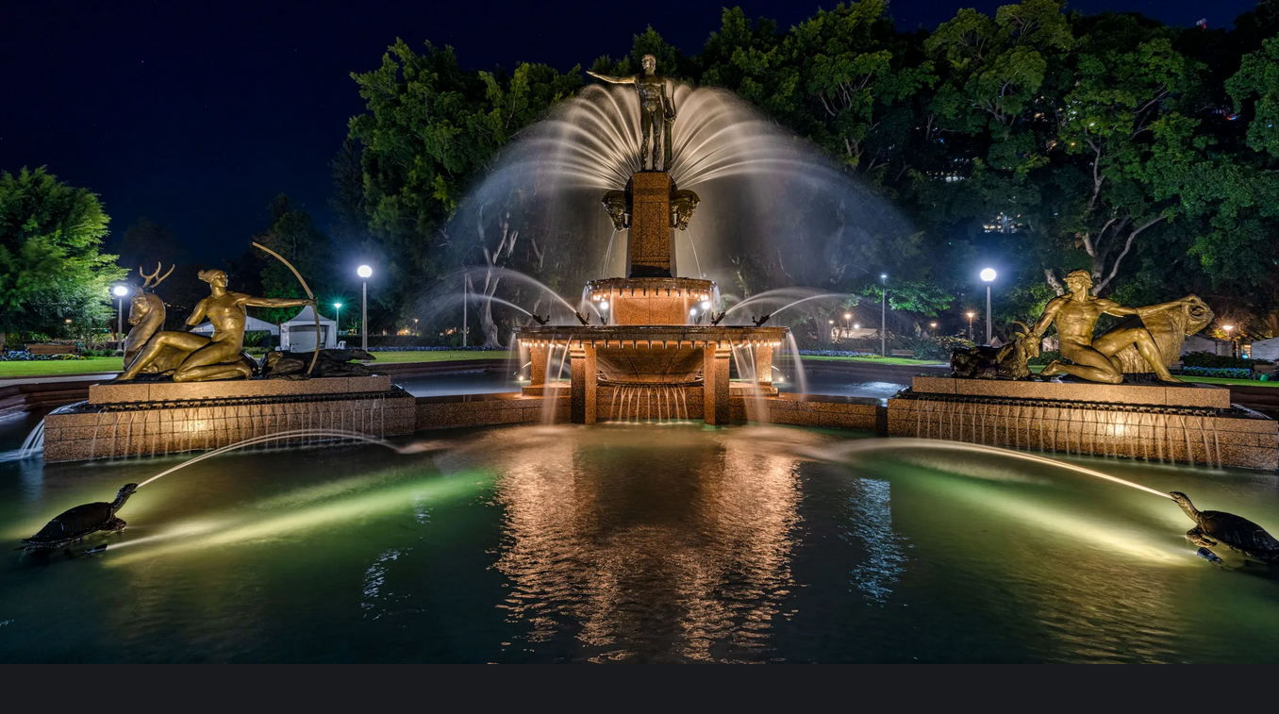

Slide 14
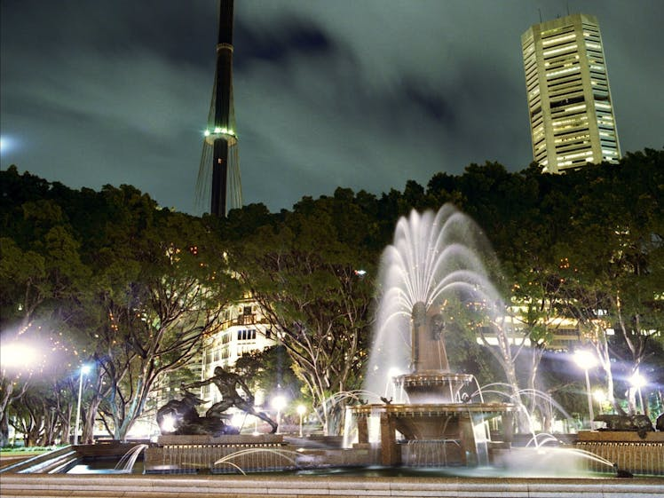

Slide 16


Slide 17
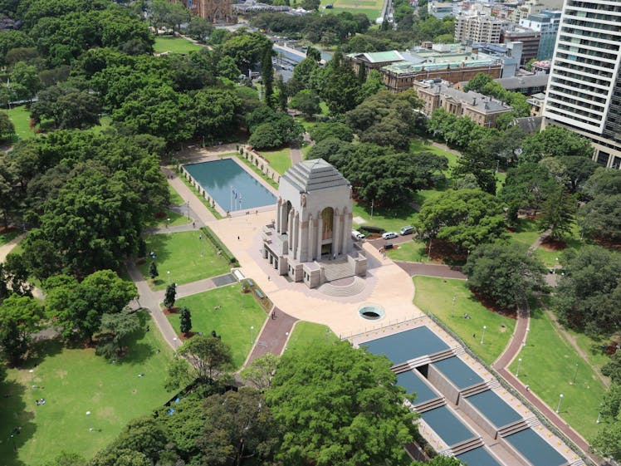

Slide 18
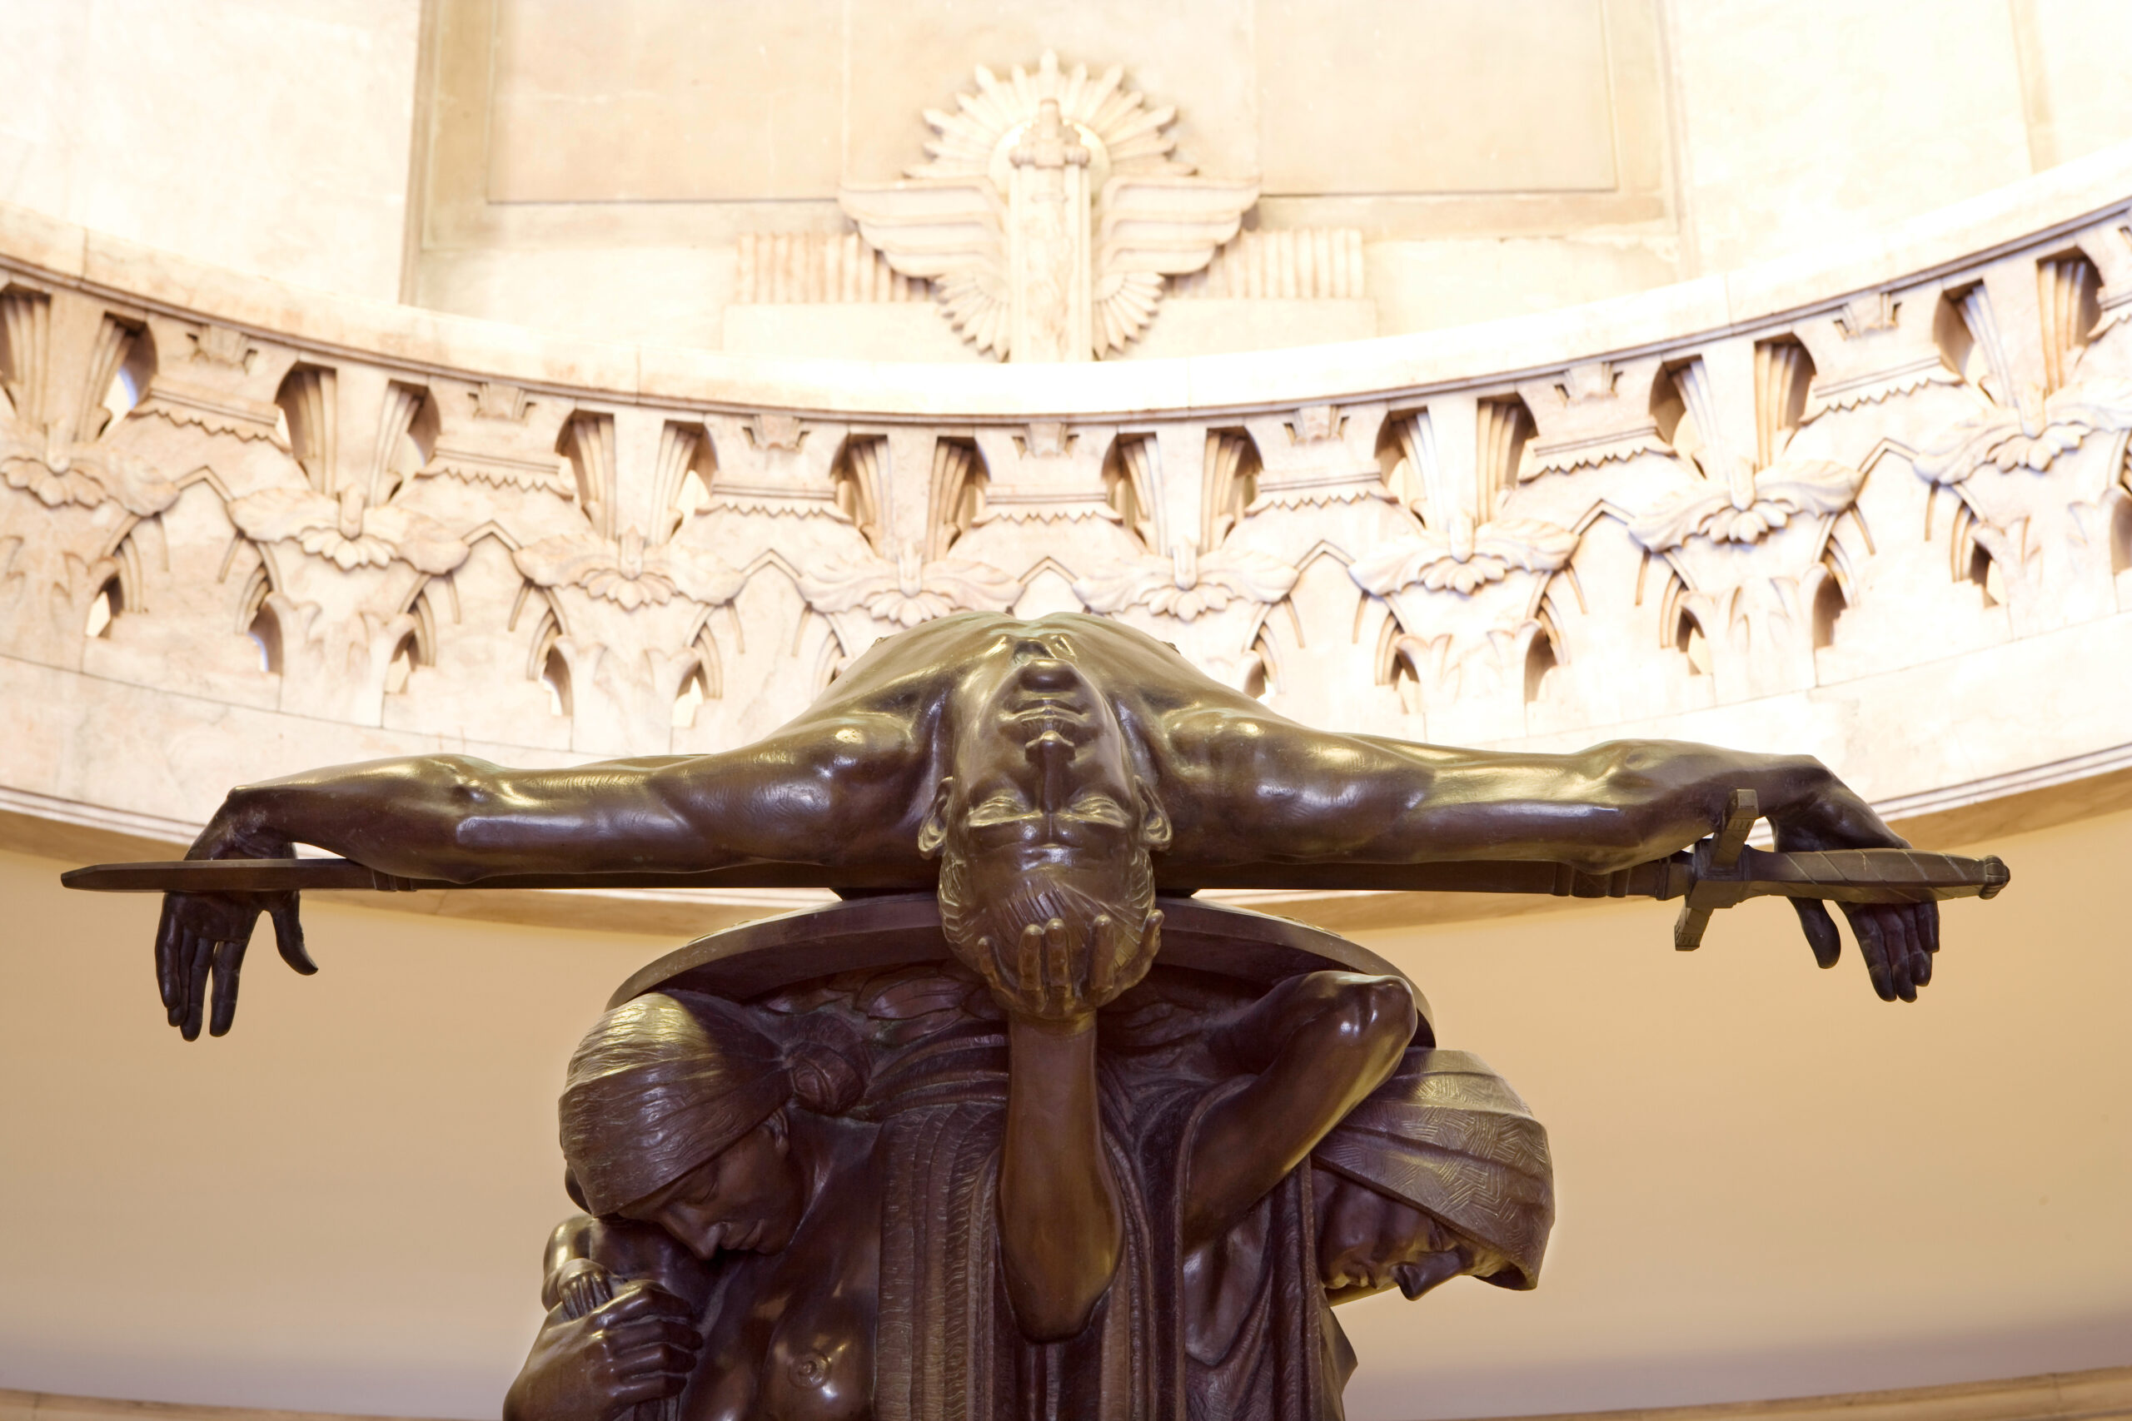

Slide 19
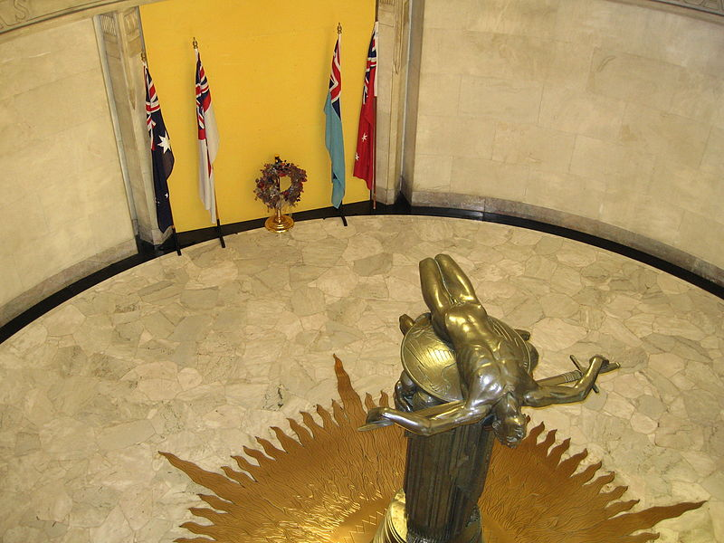

Slide 20
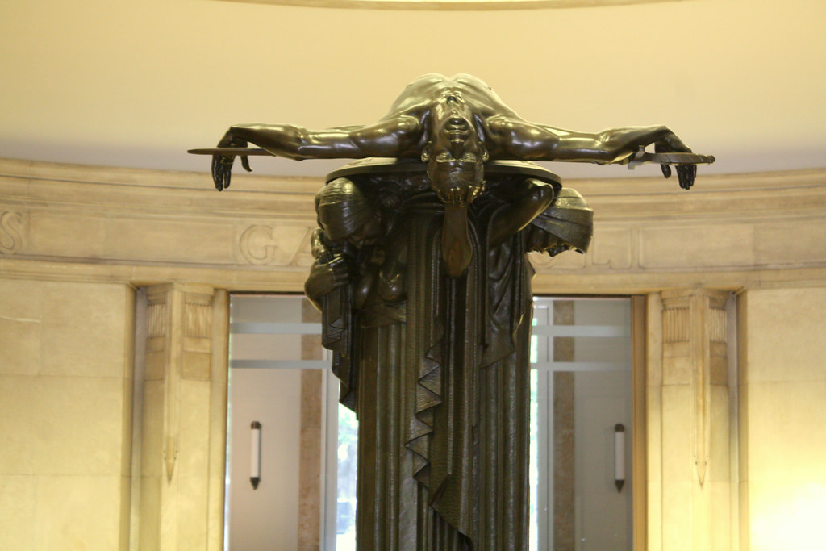

Slide 21
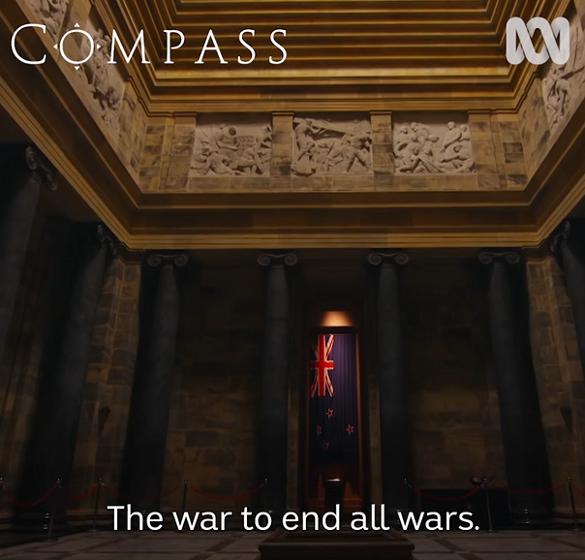
ABC Compass
25th April 2020
When war broke out, Australians called it the Great War (1914-1918). The war to end all wars.
5 years later there were 60,000 dead (Australians).
Around family dining room tables in every country town, in all our capital cities people struggled to answer the question, what was it all for? What stories ideas and images to make sense of it all?

Slide 22
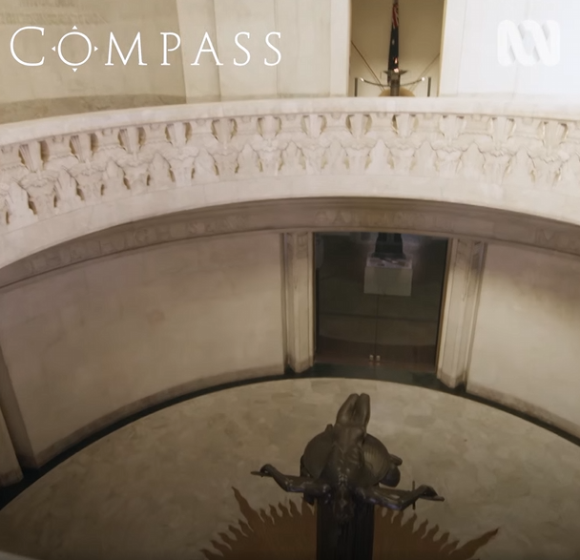
ABC Compass
25th April 2020
There is the statue of sacrifice. So powerful. According to the artist, this is a spartan (Greek) warrior) from a culture where the idea was come back with your shield and sword or come back on it. He is being upheld by his mother, his sister (and his wife). Held up by the women. It’s in a way their sacrifice.

Slide 23
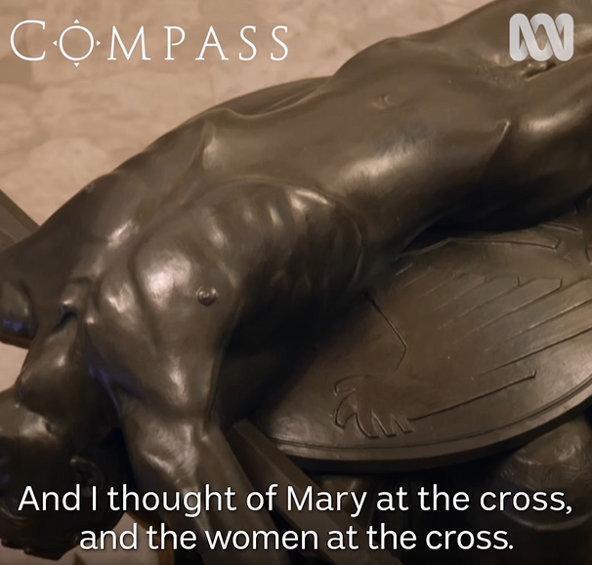
ABC Compass
25th April 2020
It’s a haunting sculpture for me, the limp body on a sword and shield… but the thing that really touches me is the profound sense of loss and sadness in the figures that uphold the shield and the sword. And I thought of Mary at the cross, and the women at the cross. But of course it is not a crucifixion scene (although it reminds him of it.)

Slide 24
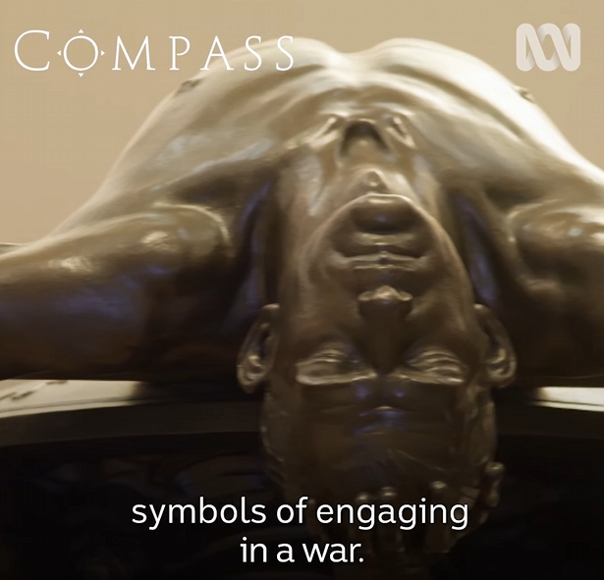
ABC Compass
25th April 2020
It’s a dead body that’s been brought back with the symbols of engaging in war. This war (WWI) was found with guns and grenades, with gas and there is no sign of that on his body. There are no marks, no wounds, it is a perfectly formed body, as if he has never been to war.
Well it is the idea of an unblemished sacrifice. And it is in a lot of cultures for a sacrifice to be effective. It needed to be perfect.

Slide 25
ABC Compass
25th April 2020
You offer your best, not your broken. And it’s frightening too because, the carnage of war in any time and place, has its victims.

Slide 26
Memorial of War
A perfect unblemished sacrifice.
A limp body stretched out like Christ on the Cross.
Evokes thoughts of Christ on the cross and the women.
An offering for the salvation of the nation.
Coming from a story in Greece, the nation represented in Daniel 8 as the Goat.
War is directly connected to sacrifice
War is directly connected to salvation through sending sons to die.
War is encapsulated in the pagan concept of sacrifice which is represented as the Daily in Daniel 8.

Slide 27
Memorial of War
Penal substitution influences human thought towards the need for war and sacrifice.
It is an expression of the enmity in the human heart against God.
War is paganism and offering the fruit of the body for the sin of the soul.
Therefore it makes sense that the SDA Church would change its position on war when it changed its view of the Daily in Daniel 8. There is a connection between these two points.
There are other factors involved but this is one of them.

