Slide 1
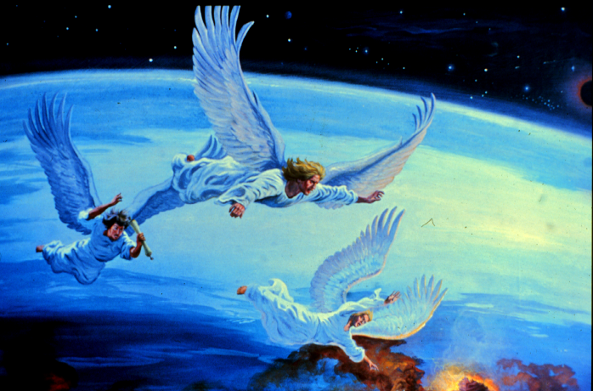
The Third Angel’s Message

Slide 2
The Third Angel’s Message
Then a third angel followed them, saying with a loud voice, "If anyone worships the beast and his image, and receives his mark on his forehead or on his hand, he himself shall also drink of the wine of the wrath of God, which is poured out full strength into the cup of His indignation. He shall be tormented with fire and brimstone in the presence of the holy angels and in the presence of the Lamb. And the smoke of their torment ascends forever and ever; and they have no rest day or night, who worship the beast and his image, and whoever receives the mark of his name." Revelation 14:9-11

Slide 3
The Third Angel’s Message
Worship the Beast or you will be executed
And he deceives those who dwell on the earth--by those signs which he was granted to do in the sight of the beast, telling those who dwell on the earth to make an image to the beast who was wounded by the sword and lived. He was granted power to give breath to the image of the beast, that the image of the beast should both speak and cause as many as would not worship the image of the beast to be killed. He causes all, both small and great, rich and poor, free and slave, to receive a mark on their right hand or on their foreheads, and that no one may buy or sell except one who has the mark or the name of the beast, or the number of his name. Revelation 13:14-17
Worship God or you will be executed?
Then a third angel followed them, saying with a loud voice, "If anyone worships the beast and his image, and receives his mark on his forehead or on his hand, he himself shall also drink of the wine of the wrath of God, which is poured out full strength into the cup of His indignation. He shall be tormented with fire and brimstone in the presence of the holy angels and in the presence of the Lamb. And the smoke of their torment ascends forever and ever; and they have no rest day or night, who worship the beast and his image, and whoever receives the mark of his name." Revelation 14:9-11

Slide 4
Where is Freedom?
And a slave does not abide in the house forever, but a son abides forever. Therefore if the Son makes you free, you shall be free [G1658] indeed. John 8:35-36
[G1658] Probably from the alternate of G2064; unrestrained (to go at pleasure), that is, (as a citizen) not a slave (whether freeborn or manumitted), or (generally) exempt (from obligation or liability): - free (man, woman), at liberty.
Are you completely unrestrained in your faith without fear? Or is there a fear if you don’t measure up to God’s standard, the He will burn you alive in hell until you are ashes?

Slide 5
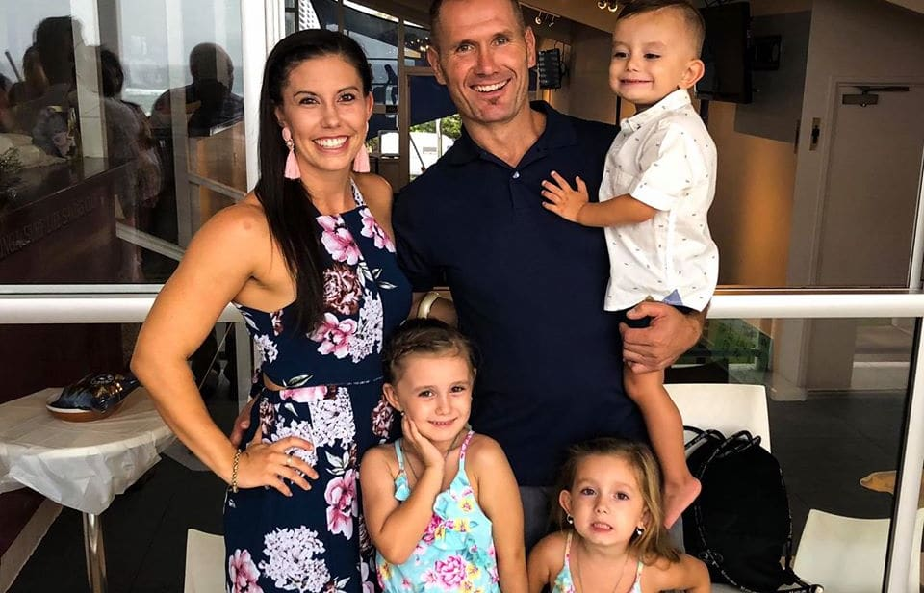
Hannah Clarke

Slide 6
Force Versus Freedom
The earth was dark through misapprehension of God. That the gloomy shadows might be lightened, that the world might be brought back to God, Satan’s deceptive power was to be broken. This could not be done by force. The exercise of force is contrary to the principles of God’s government; He desires only the service of love; and love cannot be commanded; it cannot be won by force or authority. Only by love is love awakened. To know God is to love Him; His character must be manifested in contrast to the character of Satan. This work only one Being in all the universe could do. Only He who knew the height and depth of the love of God could make it known. Upon the world’s dark night the Sun of Righteousness must rise, “with healing in His wings.” Malachi 4:2. { DA 22.1}
1John 4:18 There is no fear in love; but perfect love casts out fear, because fear involves punishment, and the one who fears is not perfected in love.

Slide 7
The Wrath of God.
"If anyone worships the beast and his image, and receives his mark on his forehead or on his hand, he himself shall also drink of the wine of the wrath of God, which is poured out full strength into the cup of His indignation. Rev 14:10
"Then My anger will be kindled against them in that day, and I will forsake them and hide My face from them, and they will be consumed, and many evils and troubles will come upon them; so that they will say in that day, 'Is it not because our God is not among us that these evils have come upon us?' "But I will surely hide My face in that day because of all the evil which they will do, for they will turn to other gods. Deuteronomy 31:17-18
Psalm 9:16 The LORD is known by the judgment He executes; The wicked is snared in the work of his own hands. Meditation. Selah
Gal 6:7 Do not be deceived, God is not mocked; for whatever a man sows, that he will also reap.

Slide 8
God’s Strange Act
For the LORD shall rise up as in mount Perazim, he shall be wroth as in the valley of Gibeon, that he may do his work, his strange [H2114] work; and bring to pass his act, his strange [H5237] act. Isaiah 28:21
H2114 A primitive root; to turn aside (especially for lodging); hence to be a foreigner, strange, profane; specifically (active participle) to commit adultery: - (come from) another (man, place), fanner, go away, (e-) strange (-r, thing, woman).
H5237 From H5235 (second form); strange, in a variety of degrees and applications (foreign, non-relative, adulterous, different, wonderful): - alien, foreigner, outlandish, strange (-r, woman).

Slide 9
God’s Vengeance
God keeps a reckoning with the nations. Not a sparrow falls to the ground without His notice. Those who work evil toward their fellow men, saying, How doth God know? will one day be called upon to meet long-deferred vengeance. In this age a more than common contempt is shown to God. Men have reached a point in insolence and disobedience which shows that their cup of iniquity is almost full. Many have well-nigh passed the boundary of mercy. Soon God will show that He is indeed the living God. He will say to the angels, “No longer combat Satan in his efforts to destroy. Let him work out his malignity upon the children of disobedience; for the cup of their iniquity is full. They have advanced from one degree of wickedness to another, adding daily to their lawlessness. I will no longer interfere to prevent the destroyer from doing his work.” { RH September 17, 1901, par. 8 }

Slide 10
God’s Judgments
I was shown that the judgments of God would not come directly out from the Lord upon them, but in this way: They place themselves beyond His protection. He warns, corrects, reproves, and points out the only path of safety; then if those who have been the objects of His special care will follow their own course independent of the Spirit of God, after repeated warnings, if they choose their own way, then He does not commission His angels to prevent Satan’s decided attacks upon them. 14MR 3.

Slide 11
What about the Flood?
Gen 6:7 So the LORD said, "I will destroy man whom I have created from the face of the earth, both man and beast, creeping thing and birds of the air, for I am sorry that I have made them."
God said that He would destroy man? The question is How did God do this?
Compare with
I would never again let [Niphal - passive] a flood cover the earth so now I swear that I will never again be angry and punish you. – Isa 54:9 NLT
Will you keep to the old way Which wicked men have trod, Who were cut down before their time, Whose foundations were swept away by a flood? They said to God, 'Depart from us! What can the Almighty do to them?' Job 22:15-17

Slide 12
Consider…
Suppose there were fifty righteous within the city; would You also destroy the place and not spare it for the fifty righteous that were in it? Far be it from You to do such a thing as this, to slay the righteous with the wicked, so that the righteous should be as the wicked; far be it from You! Shall not the Judge of all the earth do right?" Genesis 18:24-25
"What do you mean when you use this proverb concerning the land of Israel, saying: 'The fathers have eaten sour grapes, And the children's teeth are set on edge'? "As I live," says the Lord GOD, "you shall no longer use this proverb in Israel. "Behold, all souls are Mine; The soul of the father As well as the soul of the son is Mine; The soul who sins shall die. Ezekiel 18:2-4

Slide 13
Reaction to the Flood story.
Genesis says God was so angry with Himself for screwing up when He made mankind so flawed that He sent the flood to kill everyone: men, women, children, babies. What kind of tyrant punishes everyone just to get back at the few He is mad at? …
You know conservatives are always going on about how Americans are losing their values and their morality… Well maybe it’s because you worship a guy who drowns babies! And then God’s genius plan after He kills everyone is to repopulate the world with a new crop of the same [type of people] who [upset] Him the first time, with predictable results. He kills millions more. – Bill Mahr Trashes the Bible Noah Story.
Does God drown babies or unborn babies in the womb. In this case did the child pay for the sin of its parent(s)?

Slide 14
Reading Further
So God looked upon the earth, and indeed it was corrupt; for all flesh had corrupted their way on the earth. And God said to Noah, "The end of all flesh has come before Me, for the earth is filled with violence through them; and behold, I will destroy them with the earth. Genesis 6:12-13
And behold, I Myself am bringing floodwaters on the earth, to destroy from under heaven all flesh in which is the breath of life; everything that is on the earth shall die. Genesis 6:17

Slide 15
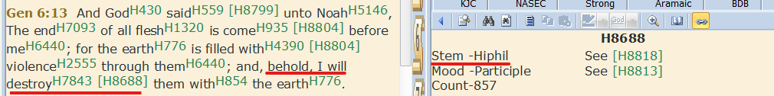
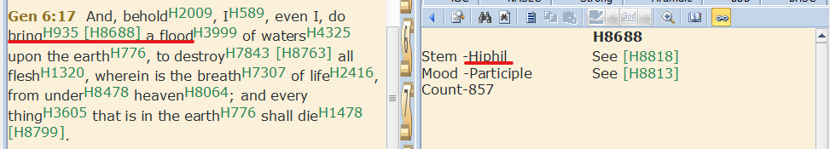
A Closer look

Slide 16
How does the Hiphil verb form work?
When it comes to God, the phrase “I will destroy” is used as a Hebrew idiom. There are two classes of idioms that can be used. 1. Causative. 2. Permissive. The writer’s (not the translator’s) use of the phrase is most often in the permissive form when it comes to quoting God— especially when the verb is negative, such as destruction and sickness. This permissive verb form in Hebrew is called Hiph`il, to which William Lowth explains:
“…the form called Hiphil in Hebrew often denotes only permission, and is rendered elsewhere to that sense by our translators.” (A Commentary Upon the Prophet Isaiah, p. 501) -
Kevin J. Mullins, Jesus Christ and Him Crucified p. 44.

Slide 17
Hiph’il can be read two ways
The causative nuance of the hiph‘il, and of its Aramaic and Akkadian counterparts the haph‘el / ’aph‘el and šuprus, respectively, includes not only actions in which the subject causes the object (another person or a thing) to do something, but a range of other ways in which the subject is responsible for the object’s action, such as allowing it, enabling it, tolerating it, or granting permission to do it.
"On the Tolerative/Permissive Hiphil,” in Le-Ma‘an Ziony: Studies in Honor of Ziony Zevit, ed. Frederick E. Greenspahn and Gary A. Rendsburg. Eugene, Oregon: Cascade Books, 2017. P. 397

Slide 18
How do we decide?
The only guide to distinguishing between them is context, but determining what the context requires—or at least what is consistent with the context—can be a very subjective task.
Ibid, Greenspahn and Rensburg p. 399.

Slide 19
What Guide Should we use to decide?
Jesus said to him, "Have I been with you so long, and yet you have not known Me, Philip? He who has seen Me has seen the Father; so how can you say, 'Show us the Father'? John 14:9
Christ exalted the character of God, attributing to him the praise, and giving to him the credit, of the whole purpose of his own mission on earth,—to set men right through the revelation of God. In Christ was arrayed before men the paternal grace and the matchless perfections of the Father. In his prayer just before his crucifixion, he declared, “I have manifested thy name.” “I have glorified thee on the earth; I have finished the work which thou gavest me to do.” When the object of his mission was attained,—the revelation of God to the world,—the Son of God announced that his work was accomplished, and that the character of the Father was made manifest to men. {ST January 20, 1890, par. 9}
Christ never killed anyone. {Christ Triumphant 248.4}

Slide 20
How should we Read the Old Testament?
2 Cor 3:14 But their minds were blinded. For until this day the same veil remains unlifted in the reading of the Old Testament, because the veil is taken away in Christ.
Brethren, I write no new commandment to you, but an old commandment which you have had from the beginning. The old commandment is the word which you heard from the beginning. Again, a new commandment I write to you, which thing is true in Him and in you, because the darkness is passing away, and the true light is already shining. 1 John 2:7-8
The life of Christ on earth is our yard stick for reading the actions of God in the Old Testament. God only acts in the Old Testament as Christ revealed during His time on earth.

Slide 21
Apparent Contradiction Resolved
Gen 6:7 I will begin the process to destroy man
= What He will do
Gen 6:13 and 17 & Isa 54:9 I will permit a flood to destroy them
= How He would do this. He would let what they sowed to destroy them.
Gal 6:7 Be not deceived; God is not mocked: for whatsoever a man soweth, that shall he also reap.

Slide 22
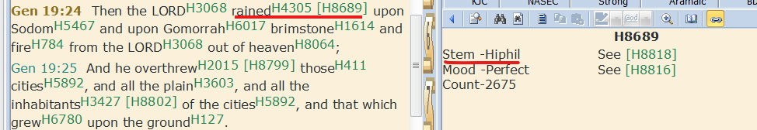
Sodom and Gomorrah
Did the Lord sent fire directly or did he permit fire to fall on these cities?

Slide 23
Consider Further…
And when His disciples James and John saw this, they said, "Lord, do You want us to command fire to come down from heaven and consume them, just as Elijah did?" But He turned and rebuked them, and said, "You do not know what manner of spirit you are of. For the Son of Man did not come to destroy men's lives but to save them." And they went to another village. Luke 9:54-56
Like the Saviour’s disciples, John the Baptist did not understand the nature of Christ’s kingdom. He expected Jesus to take the throne of David; and as time passed, and the Saviour made no claim to kingly authority, John became perplexed and troubled. He had declared to the people that in order for the way to be prepared before the Lord, the prophecy of Isaiah must be fulfilled; the mountains and hills must be brought low, the crooked made straight, and the rough places plain. He had looked for the high places of human pride and power to be cast down. He had pointed to the Messiah as the One whose fan was in His hand, and who would thoroughly purge His floor, who would gather the wheat into His garner, and burn up the chaff with unquenchable fire. Like the prophet Elijah, in whose spirit and power he had come to Israel, he looked for the Lord to reveal Himself as a God that answereth by fire. { DA 215.2}

Slide 24
John the Baptist discovers the truth…
The disciples bore the message, and it was enough. John recalled the prophecy concerning the Messiah, “The Lord hath anointed Me to preach good tidings unto the meek; He hath sent Me to bind up the brokenhearted, to proclaim liberty to the captives, and the opening of the prison to them that are bound; to proclaim the acceptable year of the Lord.” Isaiah 61:1, 2. The works of Christ not only declared Him to be the Messiah, but showed in what manner His kingdom was to be established. To John was opened the same truth that had come to Elijah in the desert, when “a great and strong wind rent the mountains, and brake in pieces the rocks before the Lord; but the Lord was not in the wind: and after the wind an earthquake; but the Lord was not in the earthquake: and after the earthquake a fire; but the Lord was not in the fire:” and after the fire, God spoke to the prophet by “a still small voice.” 1 Kings 19:11, 12. So Jesus was to do His work, not with the clash of arms and the overturning of thrones and kingdoms, but through speaking to the hearts of men by a life of mercy and self-sacrifice. { DA 217.2}

Slide 25
Force is the last resort of every false Religion
Trial and persecution will come to all who, in obedience to the Word of God, refuse to worship this false sabbath. Force is the last resort of every false religion. At first it tries attraction, as the king of Babylon tried the power of music and outward show. If these attractions, invented by men inspired by Satan, failed to make men worship the image, the hungry flames of the furnace were ready to consume them. So it will be now. The Papacy has exercised her power to compel men to obey her, and she will continue to do so. We need the same spirit that was manifested by God’s servants in the conflict with paganism. Giving an account of the treatment of the Christians by the emperor of Rome, Tertullian says, “We are thrown to the wild beasts to make us recant; we are burned in the flames; we are condemned to prisons and to mines; we are banished to islands,—such as Patmos,—and all have failed.” So it was in the case of the three Hebrew worthies; their eye was single to the glory of God; their souls were steadfast; the power of the truth held them firmly to their allegiance to God. It is in the power of God alone that we shall be enabled to be loyal to him. { ST May 6, 1897, par. 16 }

Slide 26
No Fear in Love…
1 John 4:18 There is no fear in love; but perfect love casts out fear, because fear involves torment. [Penal infliction or punishment] But he who fears has not been made perfect in love.
Where ever there is the threat of penal infliction or punishment there is fear and where there is fear there is no true love.
Force the Last Resort of EVERY FALSE Religion.
Do we worship a God who uses threats of death for not complying?

Slide 27
The Third Angel’s Message
Worship the Beast or you will be executed
And he deceives those who dwell on the earth--by those signs which he was granted to do in the sight of the beast, telling those who dwell on the earth to make an image to the beast who was wounded by the sword and lived. He was granted power to give breath to the image of the beast, that the image of the beast should both speak and cause as many as would not worship the image of the beast to be killed. He causes all, both small and great, rich and poor, free and slave, to receive a mark on their right hand or on their foreheads, and that no one may buy or sell except one who has the mark or the name of the beast, or the number of his name. Revelation 13:14-17
Worship God or you will be executed?
Then a third angel followed them, saying with a loud voice, "If anyone worships the beast and his image, and receives his mark on his forehead or on his hand, he himself shall also drink of the wine of the wrath of God, which is poured out full strength into the cup of His indignation. He shall be tormented with fire and brimstone in the presence of the holy angels and in the presence of the Lamb. And the smoke of their torment ascends forever and ever; and they have no rest day or night, who worship the beast and his image, and whoever receives the mark of his name." Revelation 14:9-11

Slide 28
What is the Seal of God?
ev 14:1 Then I looked, and behold, a Lamb standing on Mount Zion, and with Him one hundred and forty-four thousand, having His Father's name [G3686] written on their foreheads.
G3686 From a presumed derivative of the base of G1097 (compare G3685); a “name” (literally or figuratively), (authority, character): - called, (+ sur-) name (-d).
2 Cor 3:18 But we all, with unveiled face, beholding as in a mirror the glory of the Lord, are being transformed into the same image from glory to glory, just as by the Spirit of the Lord.
What God are we beholding? A God who looks like Jesus or a destroying God who wipes out the majority of the human race?
What are we being transformed into?
Are we being sealed into the true character of God?

Slide 29
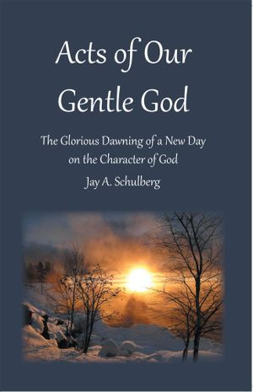



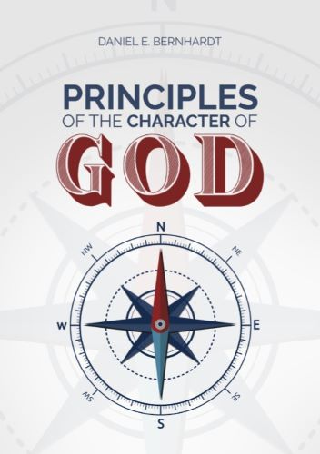
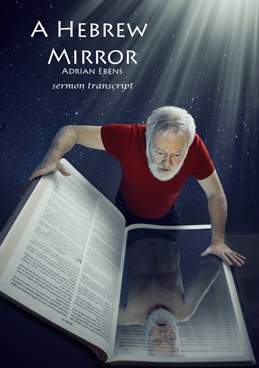
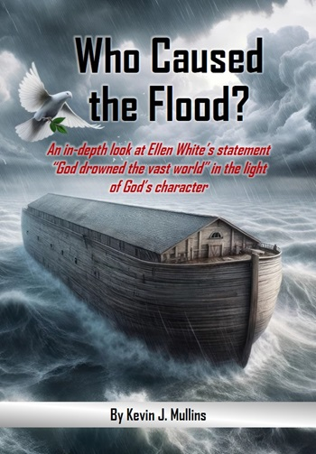
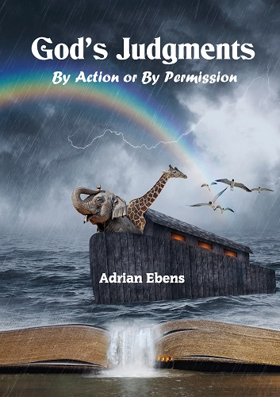
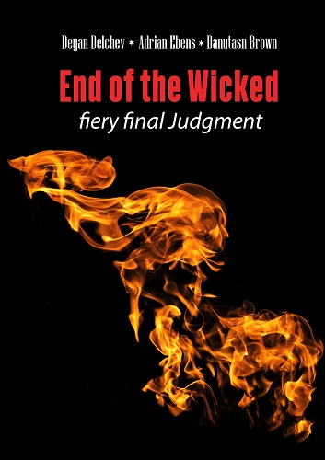
Download from Maranathamedia.com

